Slide 1
CLIMATE CHANGE IS DUE TO OCEAN VARIATIONS – NOT CO₂
July 2014
William M. Gray
Department of Atmospheric Science

Slide 2
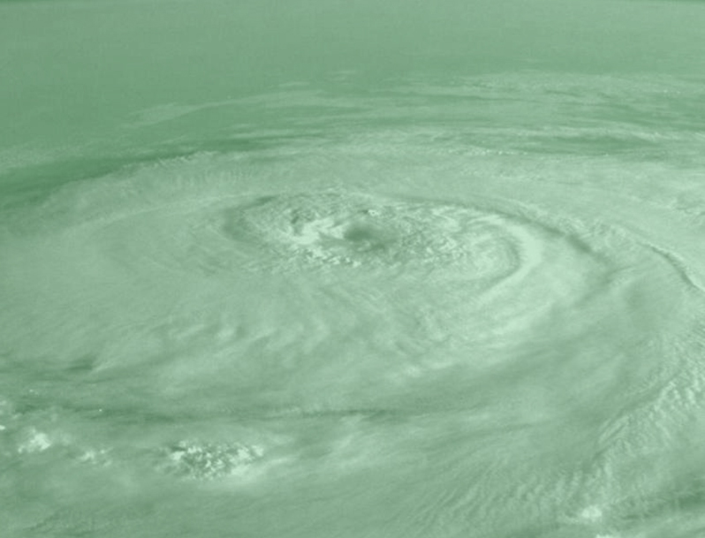
There is no scientific justification for the CO₂ global warming hypothesis.

Slide 3
FAMOUS NATIONAL ACADEMY OF SCIENCE STUDY (1979) (The Charney Report)
Doubling CO₂ will lead to global ∆T of 1.5-4.5°C (~3°C)
Due to positive water-vapor feedback ∆T ∆ moisture reduced global OLR (IR)
- grossly unrealistic
∆CO₂
RH const.
1°C 2°C = 3°C WARMING

Slide 4
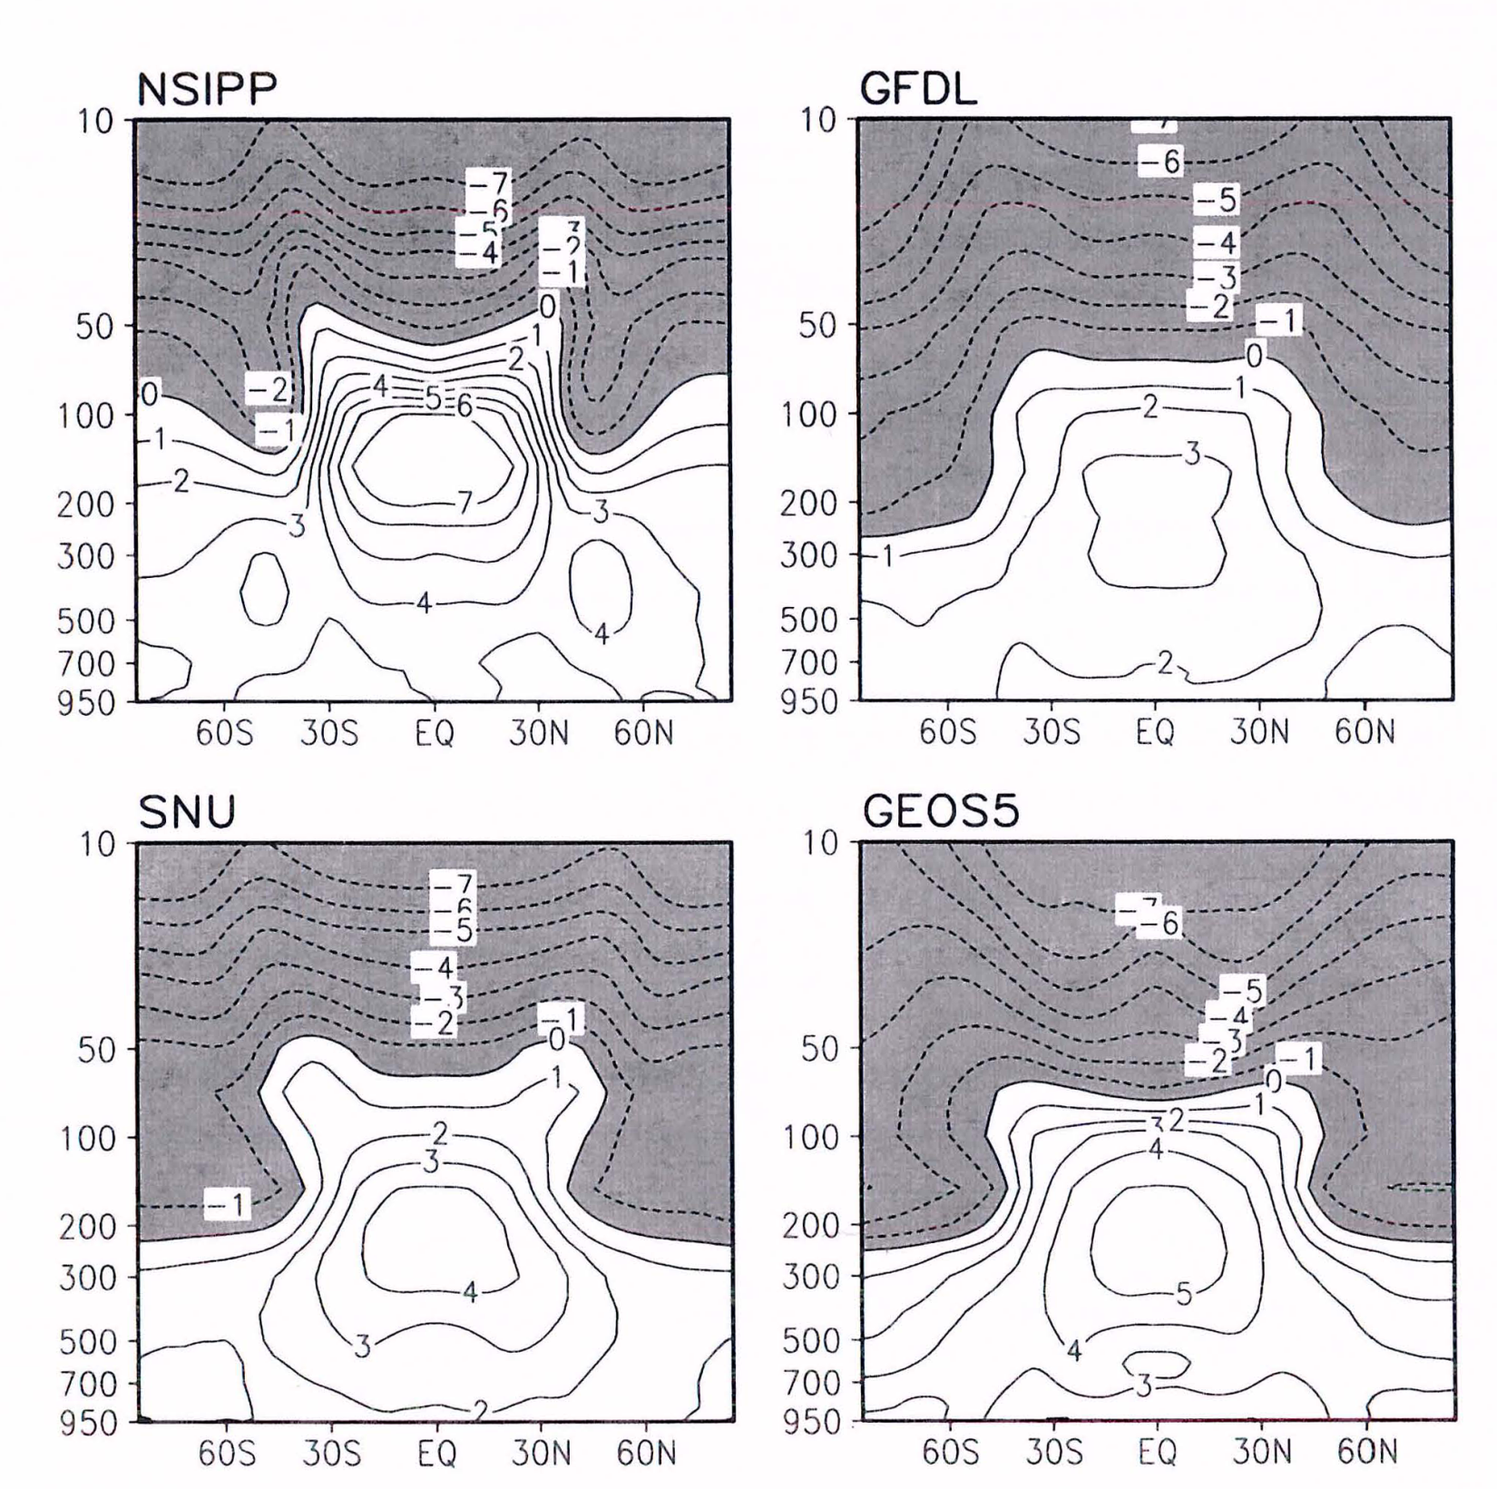

Slide 5
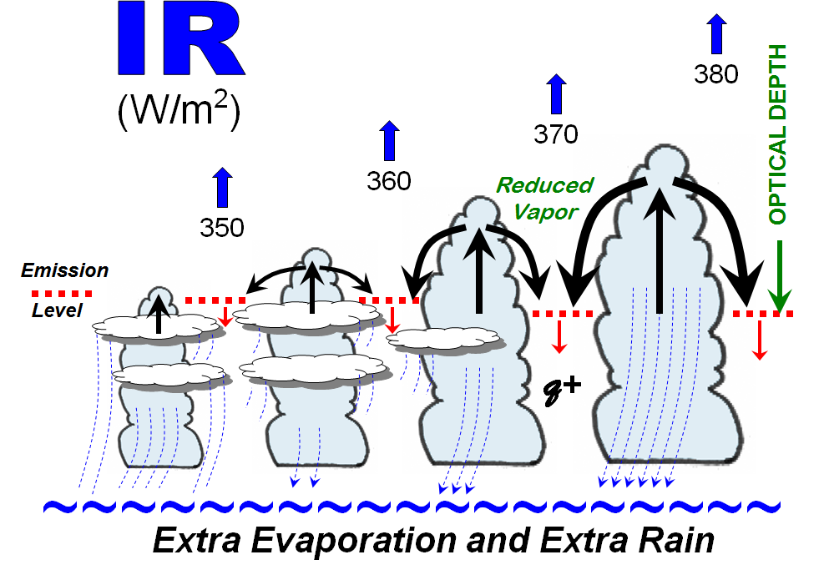
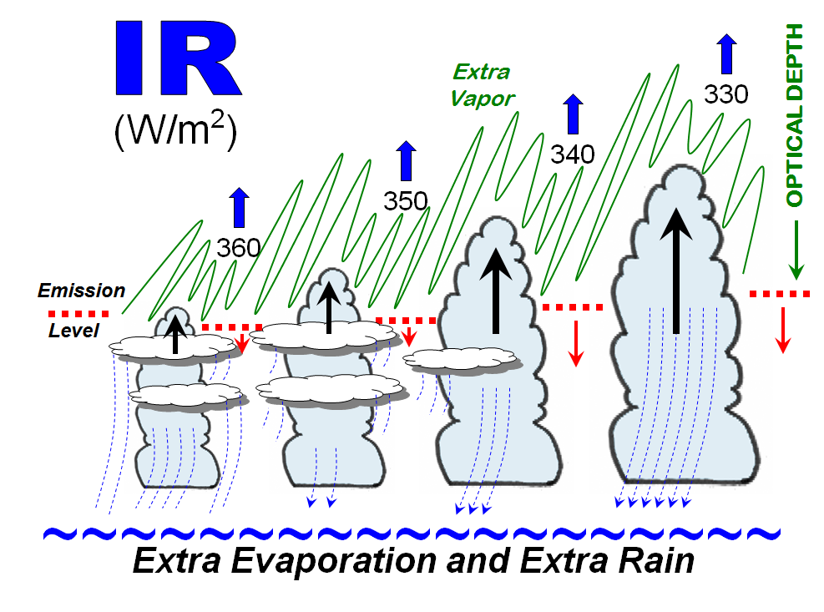
IR
ENHANCED
REALITY
0
AS PRECIPITATION AND DEEP CONVECTION INCREASE
0
GCMs
SUPPRESSED
IR

Slide 6
Cb
125
150
175
200
225
250
275
300
More IR
14 -
12 -
11 -
10 -
10 0.5 q_{s}
UPPER TROPOSPHERE
ALTITUDE (km)
PRESSURE (mb)
10 2 q_{s}
1/4
1/16
10 5 q_{s}
8 q_{s}
10 km
30 x 8
10x5
50
10x2
20
10x.5
5
Net 240 Condensation
Rain 165
75 vapor subsidence
RH = 75/240 = 31%
Rain Eff. = 165/240 = 69%

Slide 7
HOW UPPER TROPOSPHERIC SUBSIDENCE CONTROLS UPPER MOISTURE CONTROLS THE EMISSION LEVEL AND IR FLUX TO SPACE
LESS
MORE
IR
Moist
IR
191 Wm⁻²
Wm⁻²
WET
Dry
198 Wm⁻²
191
198
DRY
water- vapor
0.2 g/cm²
24
WARM
water- vapor
0.2 g/cm²
ht
COLD
T = 241ºK
ht
T = 243ºK
241º
243º
COLD
WARM
Lapse-Rate
Temp.

Slide 8
IR = 2
GCM grid ω
MOIST
– ω
RH = High
0
Vertical Motion (ω)
GRID SPACE
DRYER
IR = 4
ω_{d}
– ω
– ω_{u}
Sub-grid up & down motion concentration
RH = 60%
RH = 100%

Slide 9
HANSEN – early model
Changes for a doubling of CO₂
+ 50%
+ 6%
Pressure (hPa)
Pressure (hPa)
Δq
ΔRH
Change in specific humidity (%)
Change in relative humidity (%)
WAY TOO MUCH VAPOR

Slide 10
2 X CO₂ Restriction
Equilibrium Response
342 Solar
3.7
342 IR + Albedo
Top of Atmos.
3.7 IR
Double CO₂
= 3.7
Sfc.
3.7
3.7
IR 0.7
Sen. Heat 0.5
Evap. 2.5
ΔT = 0.2-0.3°C
3% ↑

Slide 11
DOUBLING CO₂ SURFACE VALUES
GCMs
3ºC
2ºC
1ºC
Direct CO₂ Warming
∆ Vapor and Cloud Feedback Warming
Net Global Warming
Projected Reality
0.5ºC
0.3ºC
Direct CO₂ Warming w/Rainfall
-0.2ºC
Net Global Warming
∆ Vapor and Cloud Negative Feedback

Slide 12
MAIN DRIVER OF
RECENT CENTURIES
OF CLIMATE CHANGE
DEEP OCEAN CIRCULATION CHANGES FROM SALINITY VARIATIONS

Slide 13
S. Pole
N. Pole
Ocean Mean +3ºC
CURRENT Poles and Ocean Cold
mixing
mixing
S. Pole
N. Pole
Ocean Mean +17ºC
CRETACEOUS PERIOD Poles and Ocean Warm
mixing
mixing

Slide 14
THC (or AMO)
STRONG
THC (or AMO)
WEAK

Slide 15
H
H
3
1
2
X
X
SAS
SAS
Courtesy of John Marshall (MIT)

Slide 16
THC
SAS
SAS

Slide 17
Solar +25
~~~~~~~~~~
MEAN
MOC
10
-25
15
Mixed Layer Thermocline
MOC = -25
Steady State
∆E = 0
SP
NP
Solar +25
~~~~~~~~~~
THC STRONG
15
-35
20
Mixed Layer
COOLING + More Rain more upwelling
MOC = -35
∆E = - 10
SP
NP
Solar +25
~~~~~~~~~~
THC WEAK
5
- 15
10
Mixed Layer
WARMING - Less Rain less upwelling
MOC = -15
∆E = + 10
SP
NP

Slide 18
MOC or THC
Strong
MORE UPWELLING COOLING
GLOBAL
COOLING
More Rain
MOC or THC
Weak
LESS UPWELLING COOLING
GLOBAL
WARMING
Less Rain

Slide 19
extrapolated

Slide 20
Multi-Century
THC+
Multi-Decadal + Multi-Century
THC+
THC+
TEMP
?
TEMP
Multi-century + decadal
THC-
mean
THC-
THC
0
neg.
?
Multi-Century
1880
1910
1940
1975
1998
2030

Slide 21
Globe Cooler
Globe Warmer
19TH Century
20TH Century

Slide 22
21st NOAA Climate Workshop, Huntsville, AL (1996)
FORECAST OF GLOBAL CIRCULATION CHARACTERISTICS IN THE NEXT 25-30 YEARS
William M. Gray
(written in 1996)
We expect that these changing Ocean (or MOC) patterns will lead to a small global surface temperature cooling. The mean global surface temperature change in the next 20-30 years will be more driven by nature than by anthropogenic influences and be one of weak cooling, not warming.

Slide 23
CONCLUSION
The Ocean, not CO₂ increase is the primary driver for climate change.
CO₂ increases are beneficial.
Climate research must become free of political domination.

Slide 24
Wm. M. Gray climate change papers for Heartland Conferences:
ICCC3 – 2009 (NY)
ICCC4 – 2010 (NY)
ICCC7 – 2012 (Chicago)
ICCC9- 2014 (Las Vegas)
http://tropical.atmos.colostate.edu/

