Slide 1
IPCC: Still “Gangster Science”
Willie Soon¹ Independent Scientist July 7-9, 2014
9th International Climate Conference
Panel 7: Solar Science and Climate
Las Vegas
¹All Views Expressed Are Strictly My Own and Should Be Yours Too

Slide 3
Two problems: (1) No expertise in solar physics (2) Misleading/Confused discussion on radiative forcing (3) Hide key physics: Absolute TSI calibration problem (4) Cherry picking: PMOD against ACRIM+RMIB TSI (5) Selective and outdated knowledge/citations (6) Dangerous ignorance: TSI reconstruction problems and assumptions in Wang et al. (2005) and Steinhilber et al. (2009, 2012) should be pointed out
(7) On artificial 11-yr solar cycles and flawed Sun-like stars studies: Danger of Schmidt et al. (2011) (8) Refusal to cite Fontenla et al. (2011)-the best paper on physical modeling of Sun’s irradiance on all wavelengths
(9) Real story on Bill Livingston and Matt Penn’s solar magnetic field measurements at NSO (10) Zero expertise in the study of solar-type stars: Astronomers wanted
Cosmic rays and cloud story: for other to open the discussion

Slide 4
(3) Hide key physics: Absolute TSI calibration problem
p. 8-32: “However, the few tenths of a percent bias in the absolute TSI value has a minimal consequences for climate simulations …”
Untrue, allowing the freedom of setting any TSI value hides the fundamental problem in getting the correct mean climatology of the Earth.

Slide 5
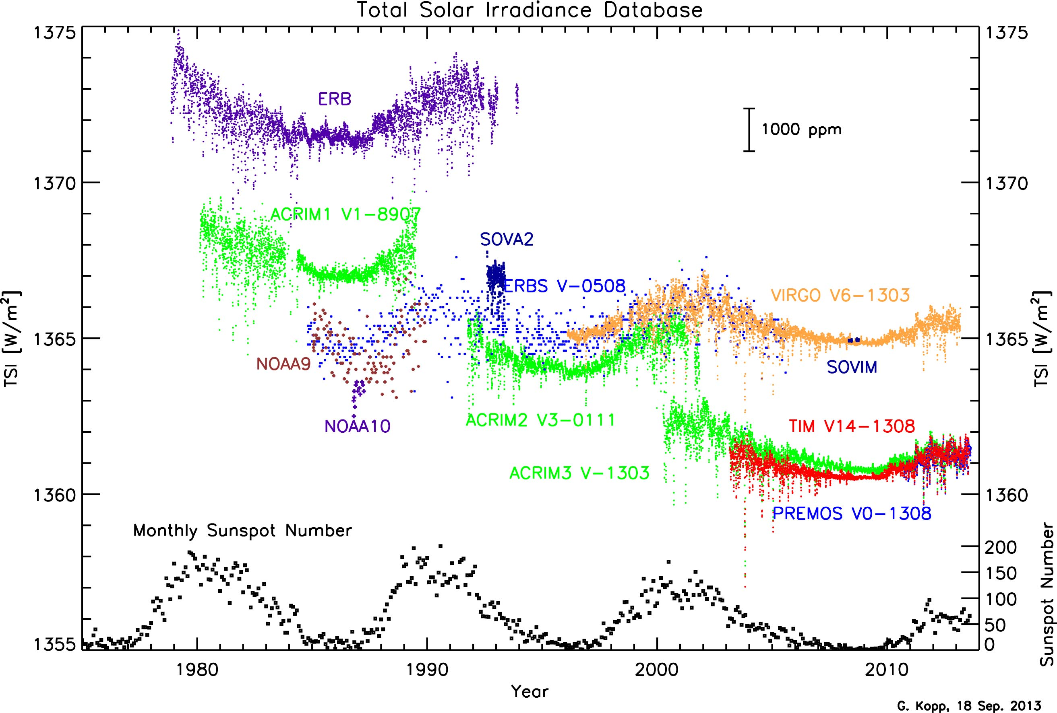
Twelve instruments with 12 TSI values: How do you correctly normalized them all?
http://spot.colorado.edu/~koppg/TSI/
Notes:
5

Slide 6
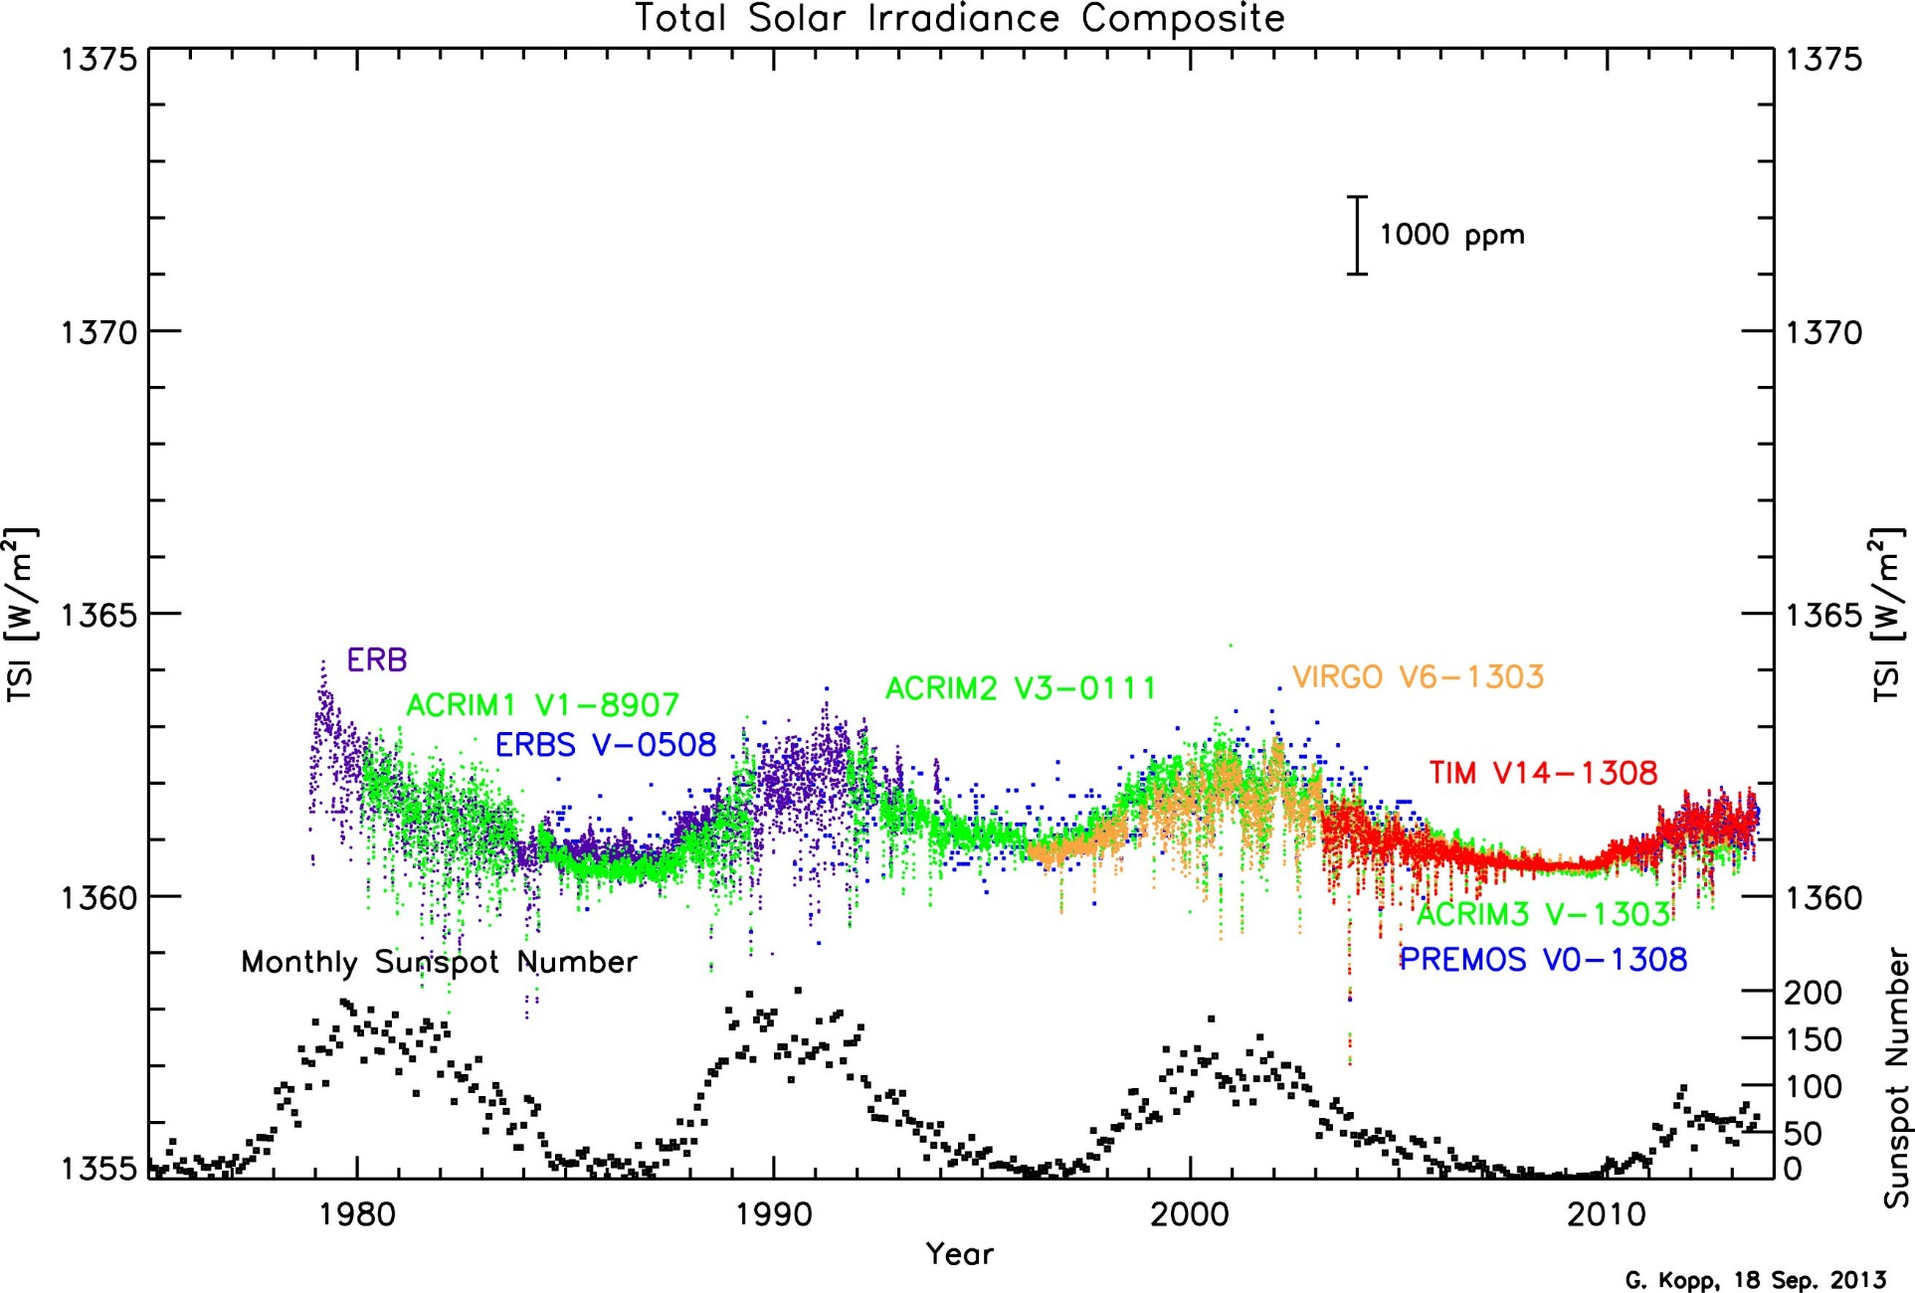
One out of many possible way to make a composite TSI
http://spot.colorado.edu/~koppg/TSI/

Slide 7
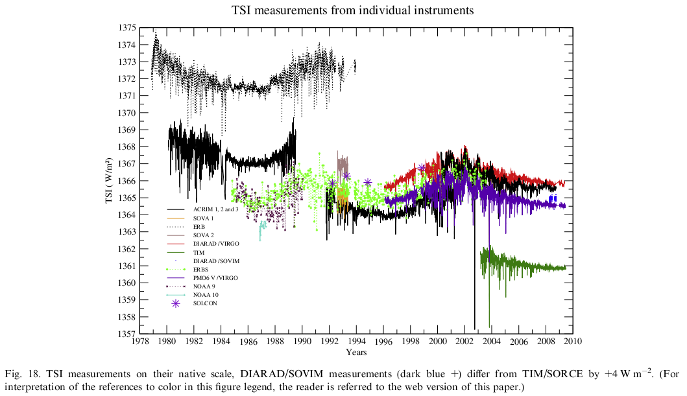
Fourteen instruments with 14 TSI values: A compilation by RMIB scientists
Mekaoui et al. (2010) Advances in Space Research, vol. 45, 1393-1406
Notes:
7

Slide 8
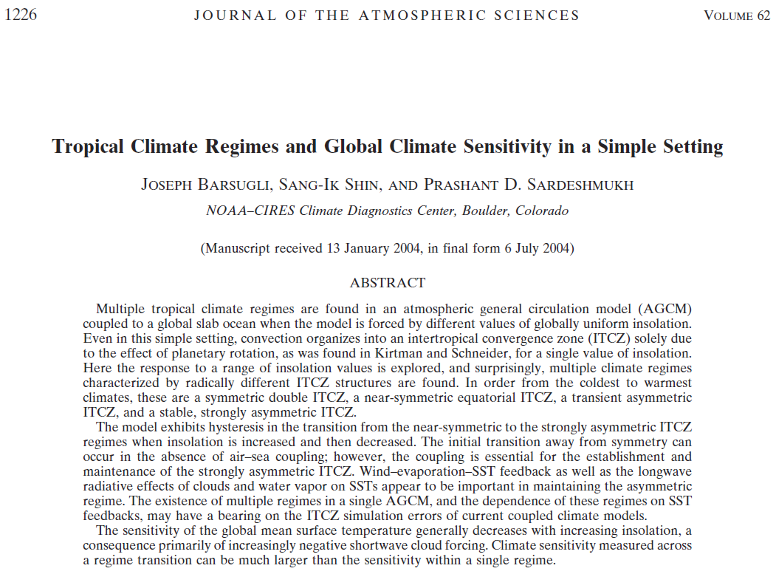
Stuffs on climate models you don’t often hear (or often hidden)?

Slide 9
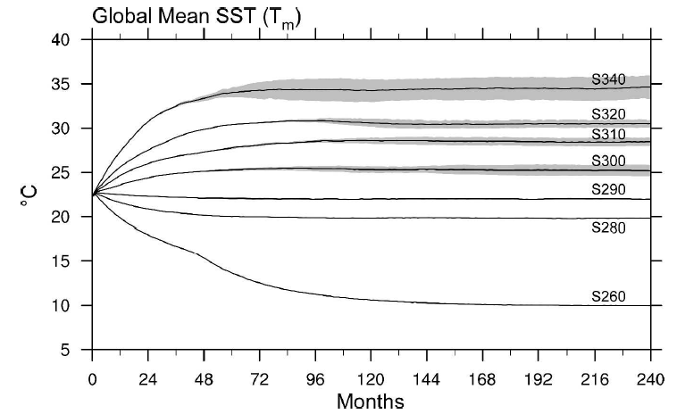
Look if you put in 340 W/m² (or 1360/4 W/m²): You get an overheated ocean temperature of 35°C or about 38°C in global surface temperature (including the land)

Slide 10
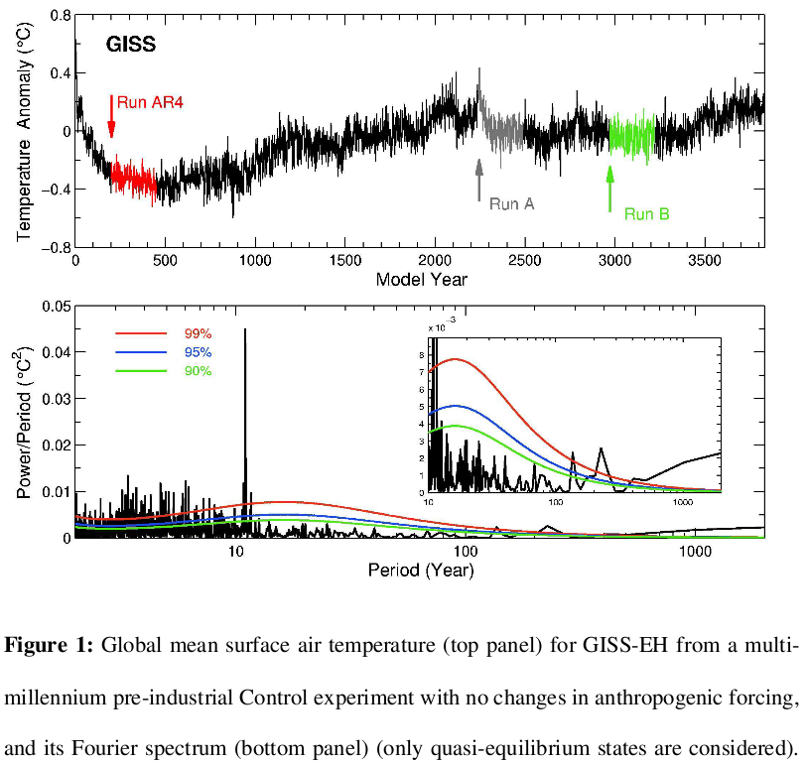
Where is the quasi-equilibrium state of the Earth’s ocean-land-atmosphere system?
4000 years run without any climate forcing imposed
Artificial 11-year cycle imposed by the modelers
Liang et al. (2013) Journal of the Atmospheric Sciences, vol. 70, 1291-1296

Slide 12
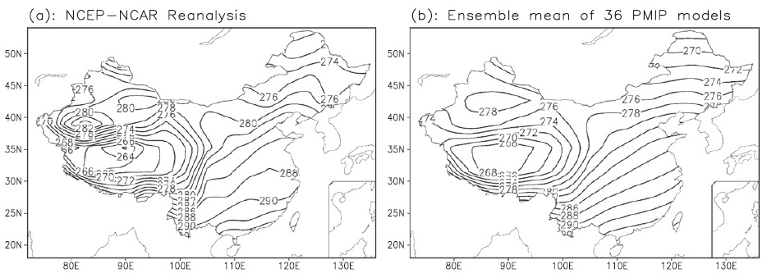
How well can the 36 climate models in Paleoclimate Modeling Intercomparison Project (PMIP) simulate mid-Holocene Climate Optimum temperatures in China?
Jiang et al. (2012) Journal of Climate, vol. 25, 4135-4153

Slide 13
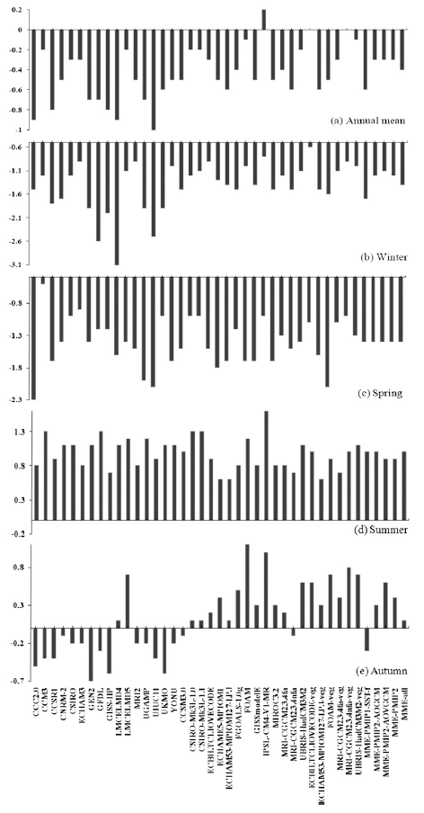
How well can the 36 climate models in Paleoclimate Modeling Intercomparison Project (PMIP) simulate mid-Holocene Climate Optimum temperatures in China?
35 out of 36 and 36 out of 36 PMIP models simulated cooler annual-mean and winter
temperatures, respectively, during Mid-Holocene (6000 years ago) than present
Jiang et al. (2012) Journal of Climate, vol. 25, 4135-4153

Slide 14
Jiang et al. (2012) Journal of Climate, vol. 25, 4135-4153

Slide 15
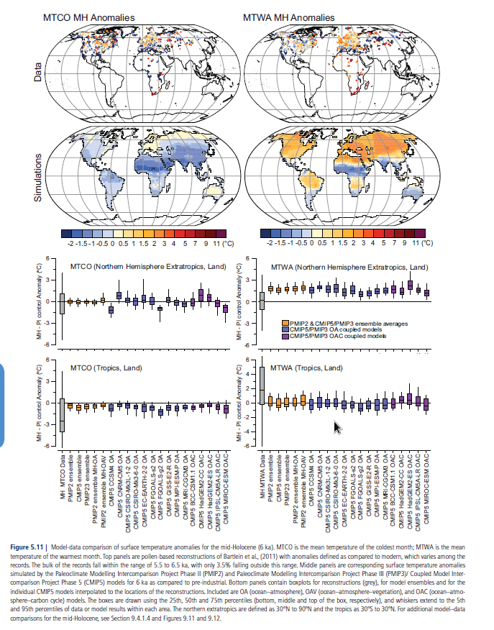
Here is what AR5 paleoclimate chapter shown for mid-Holocene: With no data in China
Bogus comparison for tropics: With almost no data, at least not much in Bartelin et al. (2011)

Slide 16
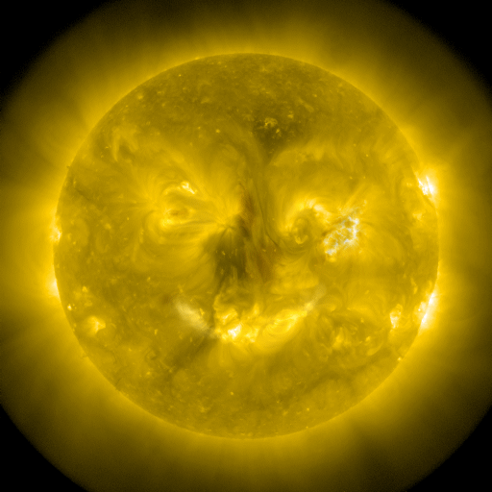
The day IPCC issued its SPM (without the full report): September 27, 2013

Slide 17
(10) Zero expertise in the study of solar-type stars: Astronomers wanted
p. 8-34: “Concerning the uncertainty range, in AR4 the upper limit corresponded to the reconstruction of Lean (2000), based on the reduced brightness of non-cycling Sun-like stars assumed typical of a Maunder minimum state. The use of such stellar analogs was based on the work of Baliunas an Jastrow (1990), but more recent surveys have not reproduced their results and suggest that the selection of the original set was flawed (Hall and Lockwood, 2004; Wright, 2004); the lower limit from 1750 to present is due to the increase in the amplitude of the 11-year cycle only.”

Slide 18
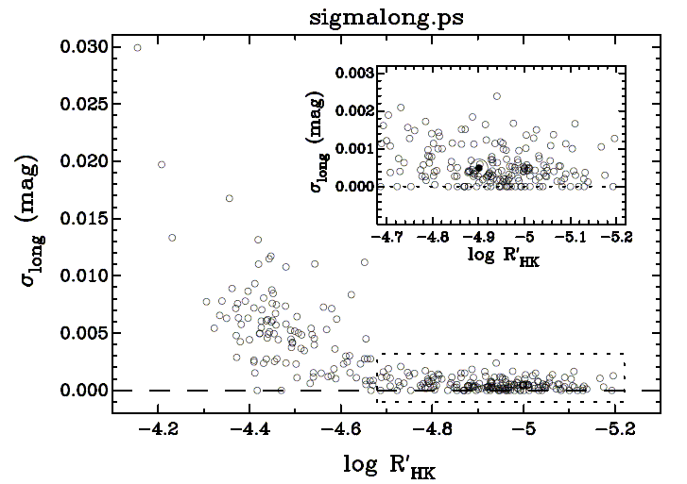
Constraints on amplitude of variability: Results from 300 Sun-like stars (Greg Henry, Tennesse State University, December 3, 2007)
Note: 0.001 mag = 0.1% σ_{long} is in r.m.s units; peak-to-trough amplitude is 3 times larger for a cyclic signal
our Sun
1%
Stronger activity

Slide 19
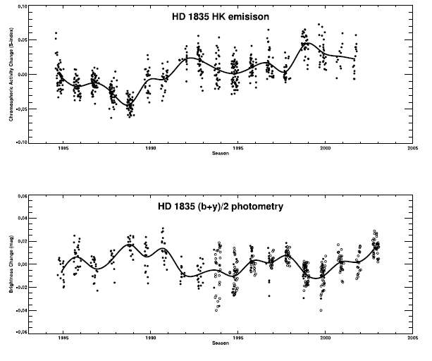
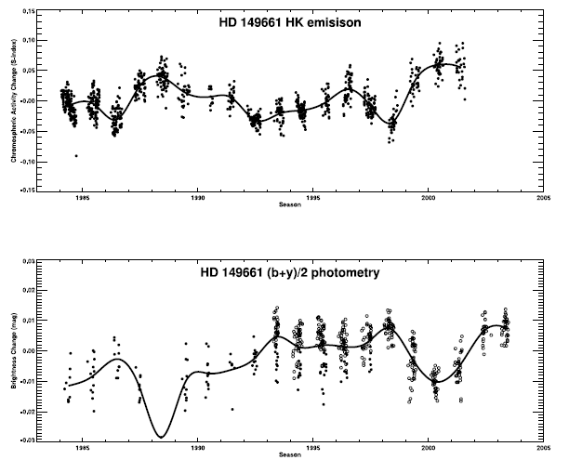
Active sun-like stars when the Sun is younger: Dark magnetic spot-dominated Irradiance modulation
4%
4%
Lockwood et al. (2007)

Slide 20
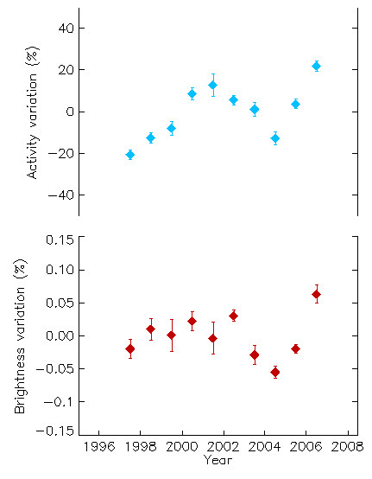
Confirmation of the current solar magnetic-brightness relation: 18 Sco
0.15%
Hall et al. (2007); Jeff Hall and Greg Henry July 22, 2008 – private communication

Slide 21
From one yellow star to 42,832 Suns? (out of 156,097 stars studied by NASA’s Kepler mission)

Slide 22
NASA’s Kepler Mission

Slide 23
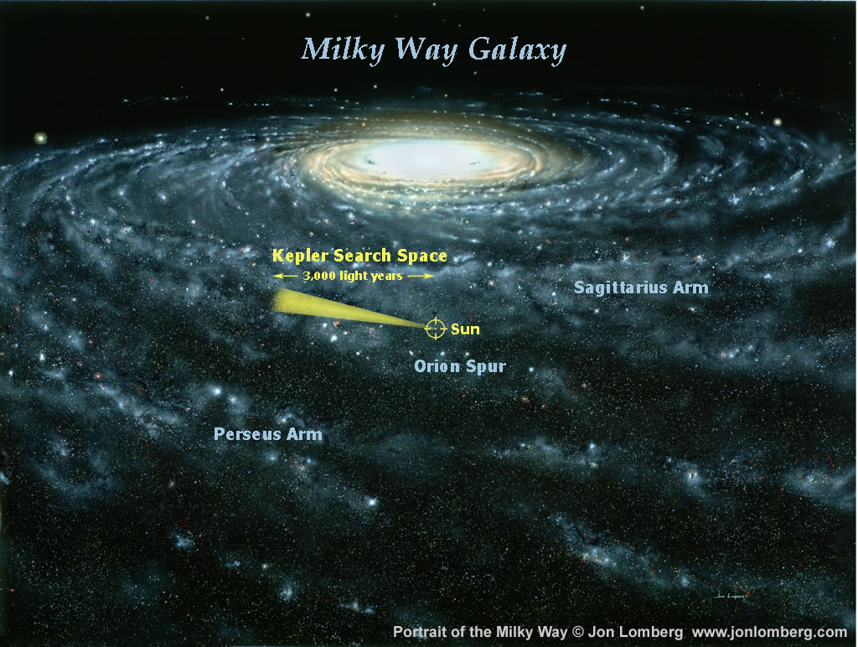
SEARCHING THE EXTENDED SOLAR NEIGHBORHOOD
The stars sampled are similar to the immediate solar neighborhood. The stars actually come from all over the Galaxy near our radius, since they wander after being born. Young stellar clusters and their ionized nebular regions highlight the arms of the Galaxy.
Gibor Basri (2008)

Slide 28
The Common Sun: Our Star
Sun
Solar-type stars (Kepler)
Basri et al (2013) The Astrophysical Journal, vol. 769: 37

Slide 29
(10) Zero expertise in the study of solar-type stars: Astronomers wanted
“We have found active fractions employing several methodologies that are between 20% and 33% … They imply that the Sun has a “normal” level of magnetic activity compared to the Kepler sample. We find no empirical evidence in the Kepler data for an excess of young active solar-type stars near us, nor is the Sun unusually photometrically quiet compared to its neighbors. That is perhaps not surprising, given similar results for Ca II (T. Henry et al. 1996). … There have been previous suggestions that the Sun might be photometrically quieter than the bulk of similar stars … although they were tentative.”

Slide 30
Two problems: (1) No expertise in solar physics (2) Misleading/Confused discussion on radiative forcing (3) Hide key physics: Absolute TSI calibration problem (4) Cherry picking: PMOD against ACRIM+RMIB TSI (5) Selective and outdated knowledge/citations (6) Dangerous ignorance: TSI reconstruction problems and assumptions in Wang et al. (2005) and Steinhilber et al. (2009, 2012) should be pointed out
(7) On artificial 11-yr solar cycles and flawed Sun-like stars studies: Danger of Schmidt et al. (2011) (8) Refusal to cite Fontenla et al. (2011)-the best paper on physical modeling of Sun’s irradiance on all wavelengths
(9) Real story on Bill Livingston and Matt Penn’s solar magnetic field measurements at NSO (10) Zero expertise in the study of solar-type stars: Astronomers wanted
Cosmic rays and cloud story: for other to open the discussion

Slide 31
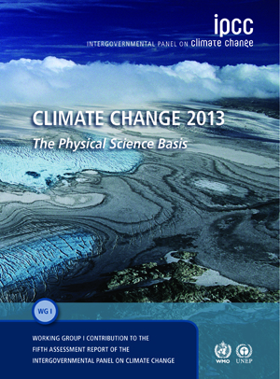
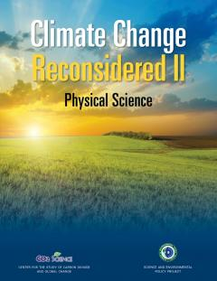
Green Team
Red Team

Slide 33
Conclusion: The gangster science as practiced by the United Nations IPCC AR5 WG I report will not prevail (because even the almighty and super powerful IPCC does not get to vote on reality)

Slide 34
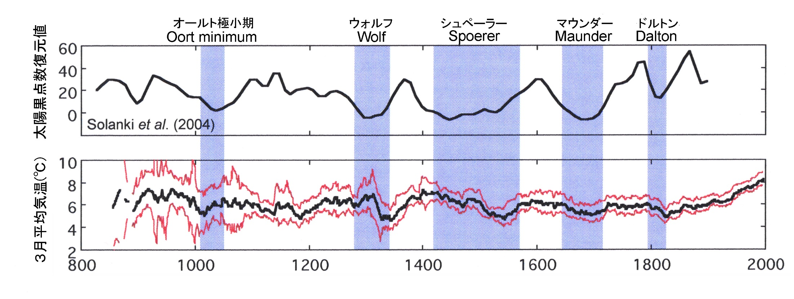
No Evidence for Sun-Climate Links?
UHI detected at Kyoto
Aono (2014) Report (and private communication June 30, 2014) + Aono and Kazui (2008) IJOC, vol. 28, 905-914

