Slide 1
SLR: IPCC-AR5 vs NIPCC
No evidence for acceleration
S. Fred Singer, SEPP
ICCC-9. Las Vegas, NV
July 9, 2014
<singer@SEPP.org>

Slide 2

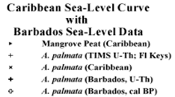
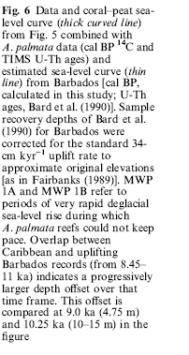

Slide 3
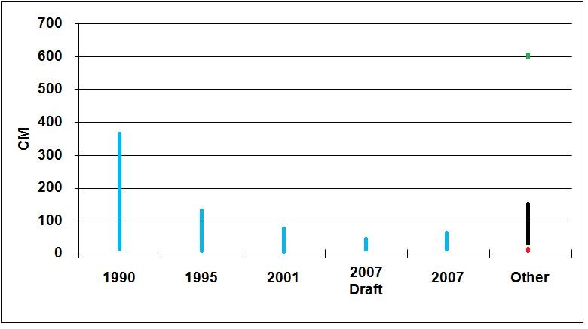


Sea Level Rise to 2100
H
R
S
 | IPCC 1990 | IPCC 1995 | IPCC 2001 | 2007 Draft | IPCC 2007 | Hansen (H) | Rahmst. (R) | Singer (S)
Max | 367 | 124 | 77 | 43 | 59 | 600 | 140 | 20
Min | 10 | 3 | 11 | 14 | 18 | 600 | 50 | 18
Notes:
Fig. 17: Estimates of sea level rise from IPCC reports of 1990, 1995, 2001, and 2007. Note the strong reduction in expected maximum rise, presumably based on better data. Also shown are the expected SL rise values of Rahmstorf, Hansen, and Singer. The ongoing rate of rise in recent centuries has been 18 cm per century.

Slide 5
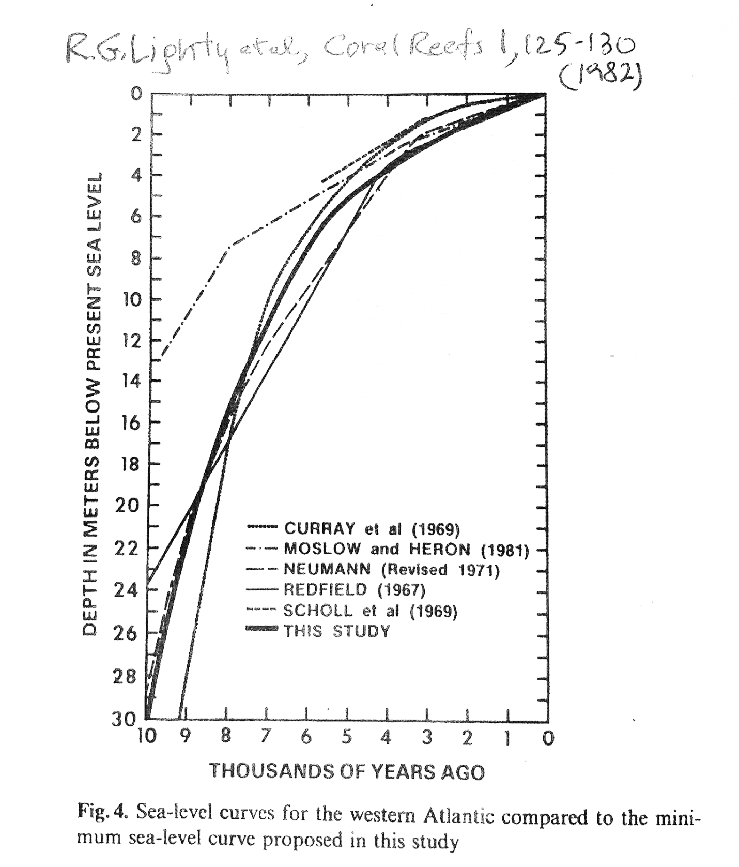
Notes:
Fig 16: Source; Toscano & Macintyre 2003

Slide 6
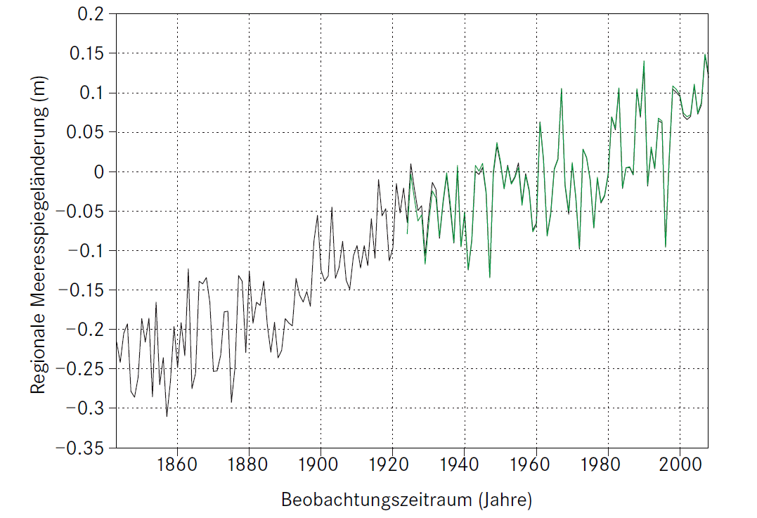
Notes:
http://www.spektrum.de/sixcms/media.php/976/reklim.PDF

Slide 7
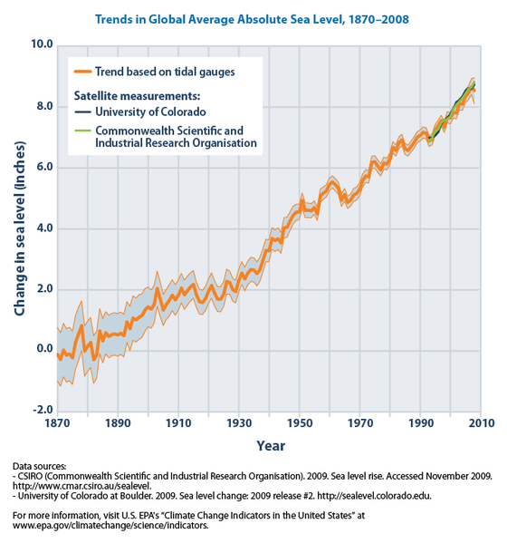
Notes:
google

