Slide 1
The Neglected Sun: How the IPCC managed to forget natural variability in their climate models
Dr Sebastian Lüning

Slide 2
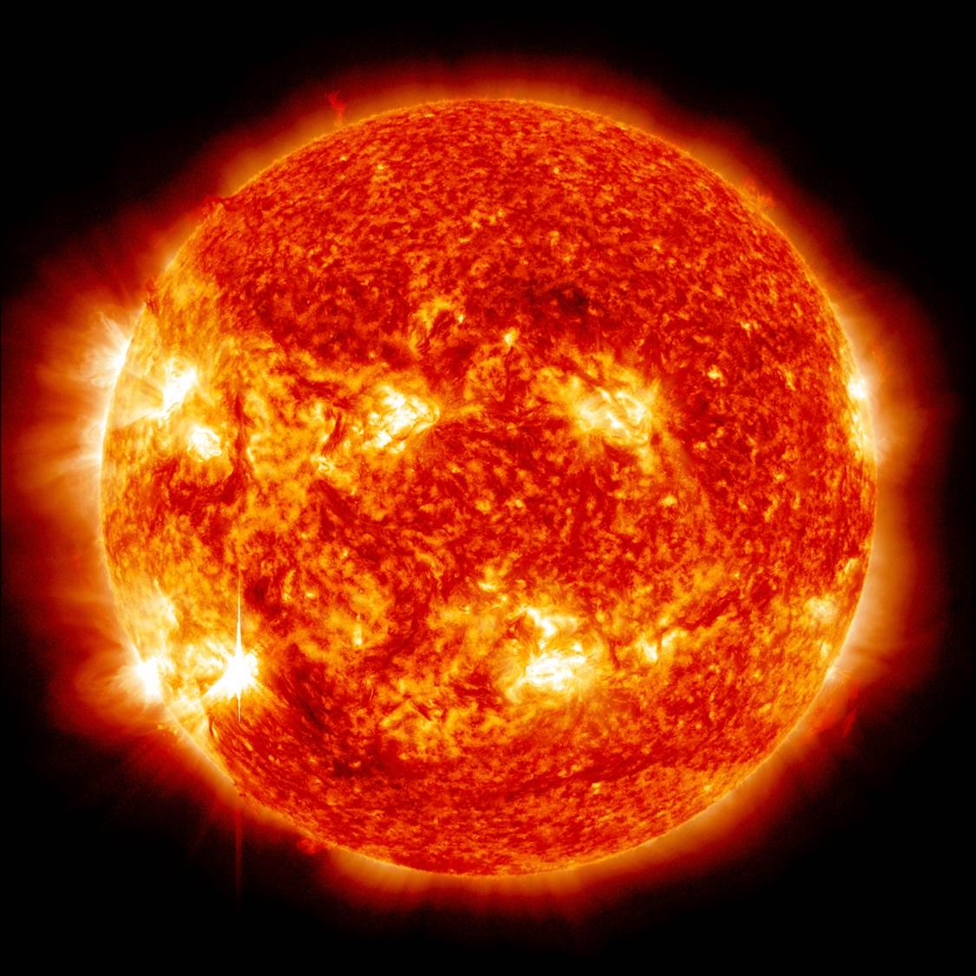
Our Sun
99.98 percent of the total energy contribution to the Earth’s climate originates from the sun
It appears plausible that small changes in solar output may have major climatic consequences on Earth

Slide 3
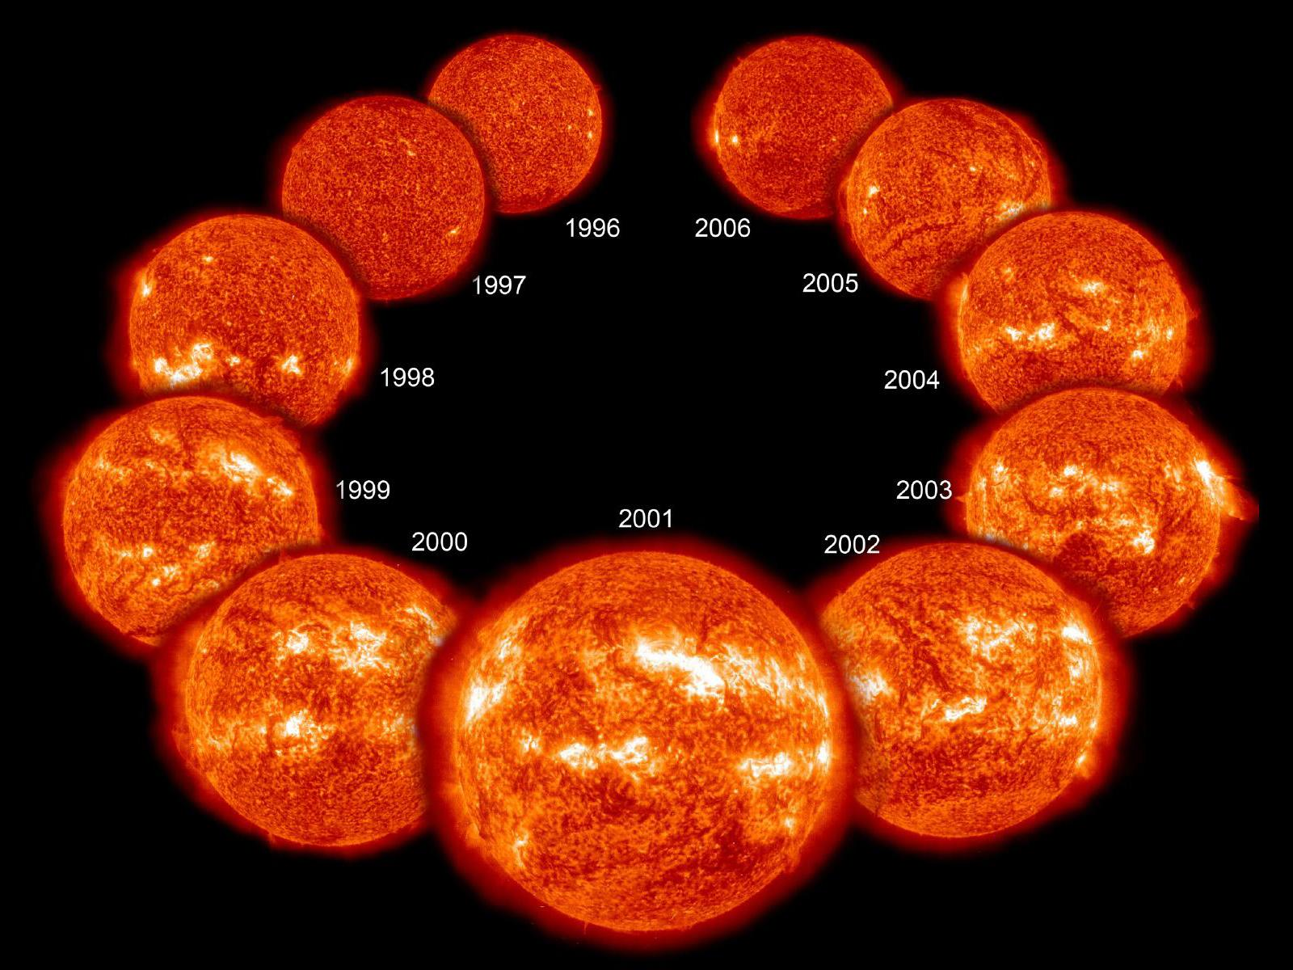
The 11 Year Solar Cycle: The Shortest of all Cycles

Slide 4
Reconstruction of Solar Activity of the Past
Steinhilber et al. 2012
Solar activity reconstructed via cosmic rays as recorded by 10Be in ice core records from Greenland and Antarctica and global 14C tree ring records

Slide 5
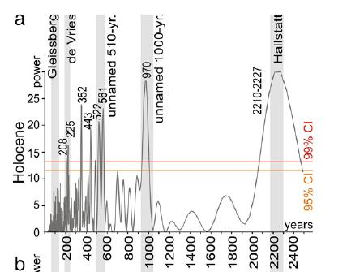
Frequency Analysis of Holocene Solar Activity Data
Data: Solanki et al. 2004
Analysis from Kern et al. 2012

Slide 6
Overview of Solar Cycle Types
Suess/de Vries
Schwabe
Gleissberg
Hale
Eddy
Hallstatt
11
22
87
210
1.000
2.300
Years
Cycle Duration

Slide 7
Hallstatt (2300 years) and Eddy (1000 years) Cycles
“Our wavelet analysis identifies fundamental solar modes at 2300-yr (Hallstattzeit), 1000-yr (Eddy), and 500-yr (unnamed) periodicities”

Slide 8
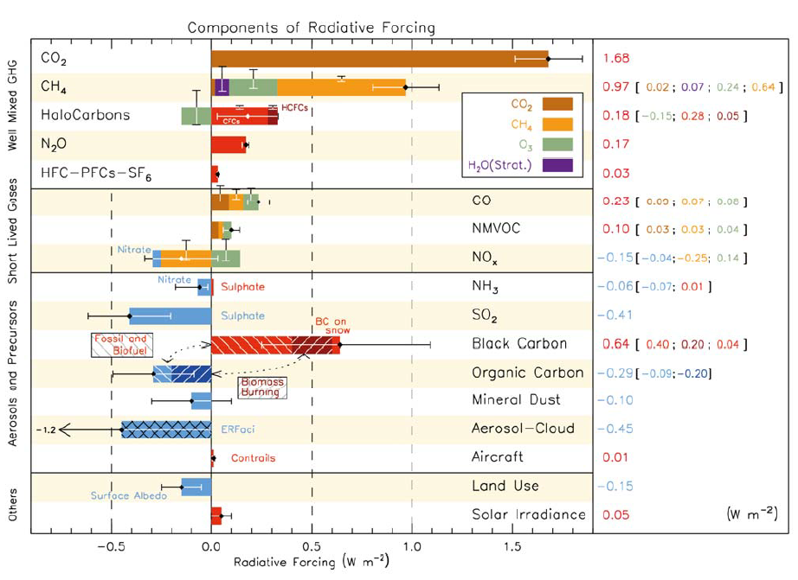
Claim in IPCC 2013 (AR5): Hardly any climate effect of the sun
Radiative forcing according to IPCC AR4:
CO₂: 1.66 W/m²
Sun: 0,12 W/m²
Sun has hardly any climatic significance in the IPCC models

Slide 9
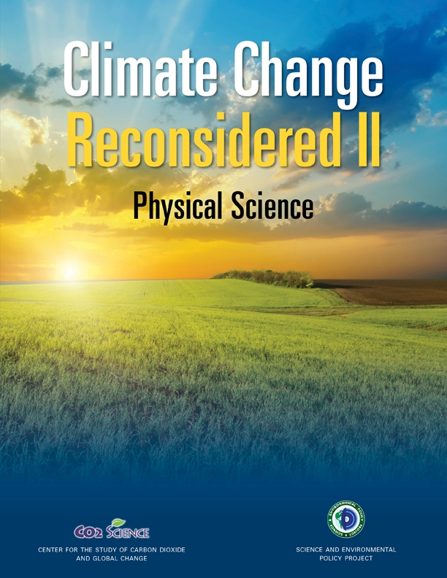
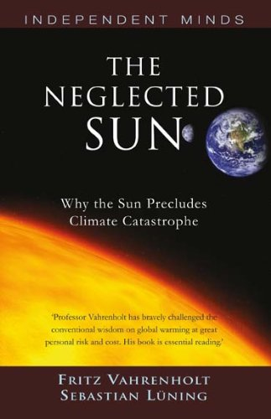
BUT: Geological and historical data show significant influence of climate by solar activity. How to solve the enigma?

Slide 10
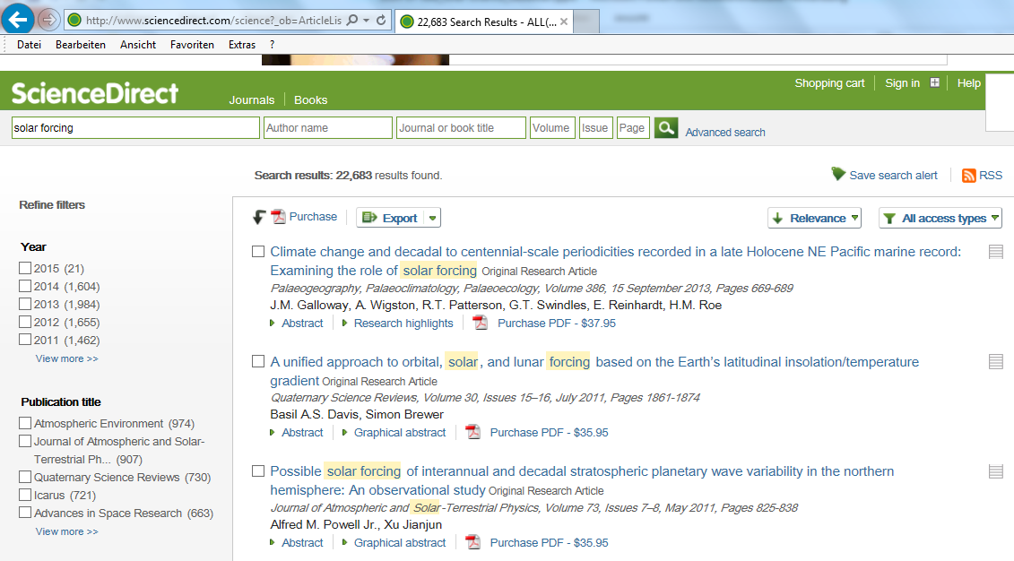
ScienceDirect: 22,683 hits when searching for „solar forcing“
Papers are usually reported on only in skeptics blogs, not by mainstream media
Blogs

Slide 11
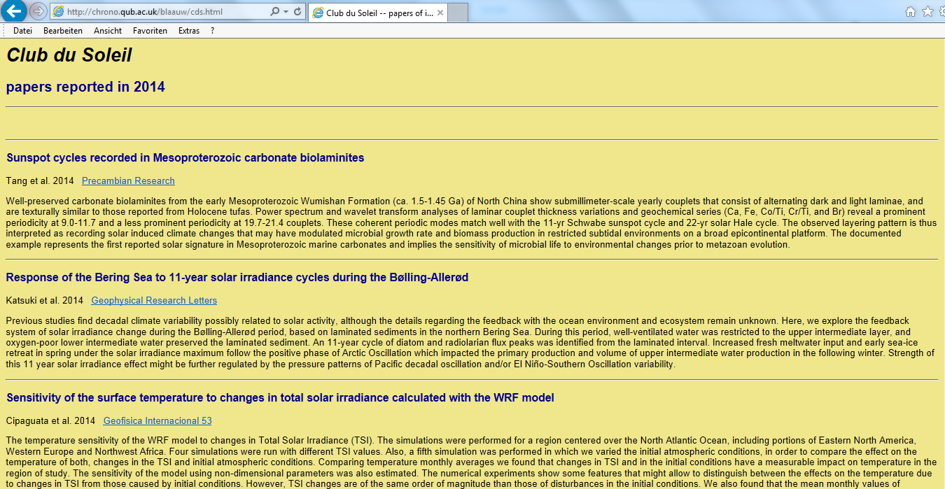
Club du Soleil by Maarten Blaauw (Queen's Univ. Belfast): Overview of new papers on solar-climate interaction

Slide 12
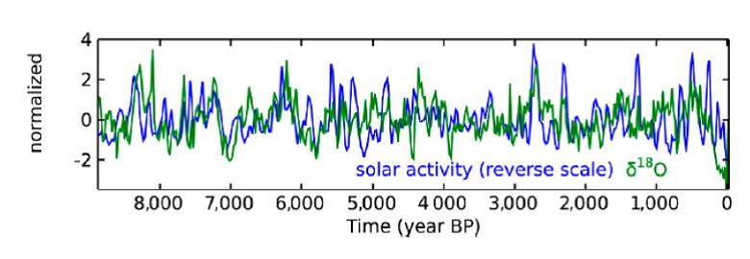
“Surprising“ Findings in Steinhilber et al. 2012:
Steinhilber et al. 2012
Comparison of solar activity (blue curve) and Asian climate records (green curve, delta ¹⁸O of stalagmites in Chinese cave) reveals generally good fit

Slide 13
Junginger et al. 2014
From abstract:
Rapidly decreasing water levels of up to 90 m over less than a hundred years are best explained by changes in solar irradiation either reducing the East African–Indian atmospheric pressure gradient and preventing the CAB from reaching the study area, or reducing the overall humidity in the atmosphere, or a combination of both these effects. […] the water-level record from the Suguta Valley demonstrates the importance of both orbitally-controlled insolation variations and short-term changes in solar irradiation as factors affecting the significant water level variations in East African rift lakes.

Slide 14
Moffa-Sánchez et al. 2014

Slide 15
Ogurtsov & Oinonen 2014

Slide 16
How much has the planet warmed up in the last 150 years?
http://zpolitics.com/global-warming-slumber-party/

Slide 17
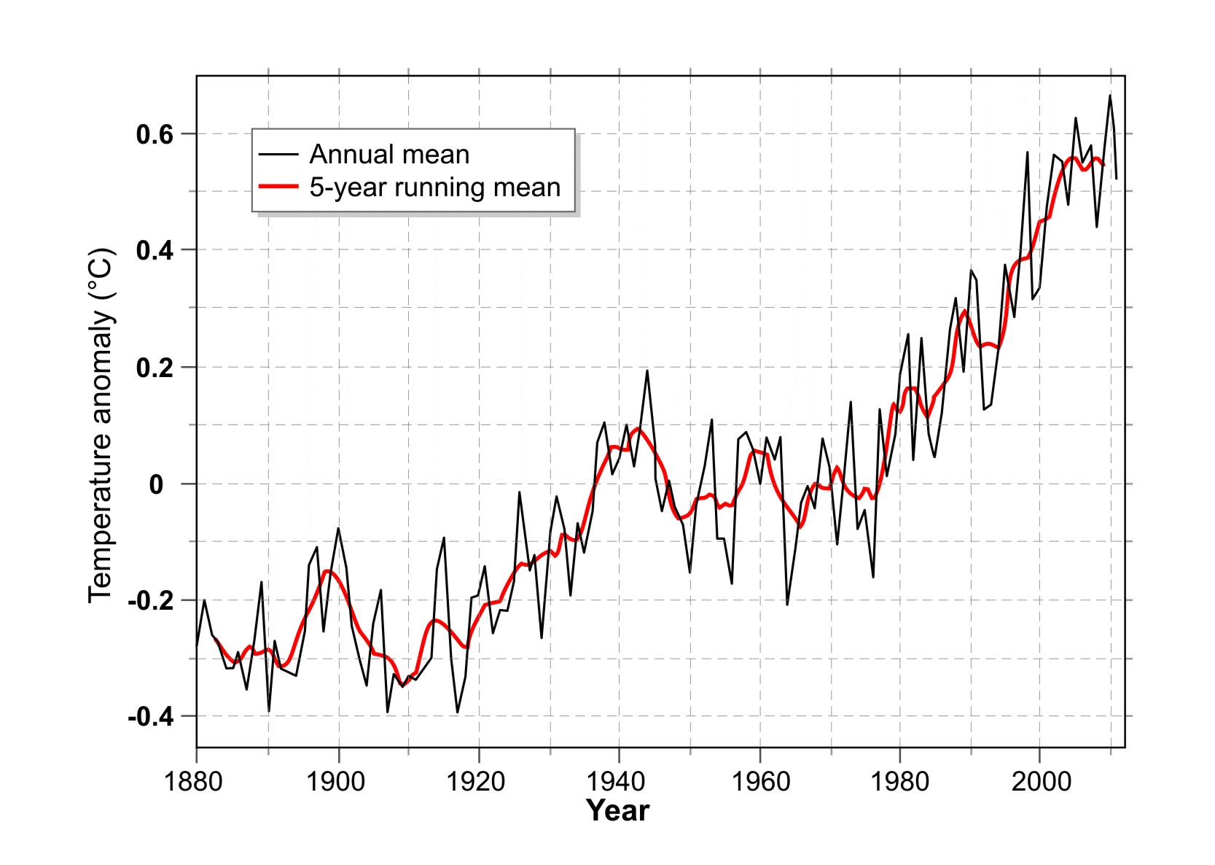
Global Warming of the 20th Century: 0.8°C

Slide 18
What was the reason for this warming?

Slide 19
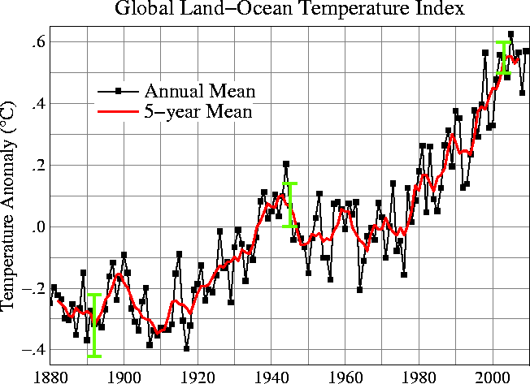
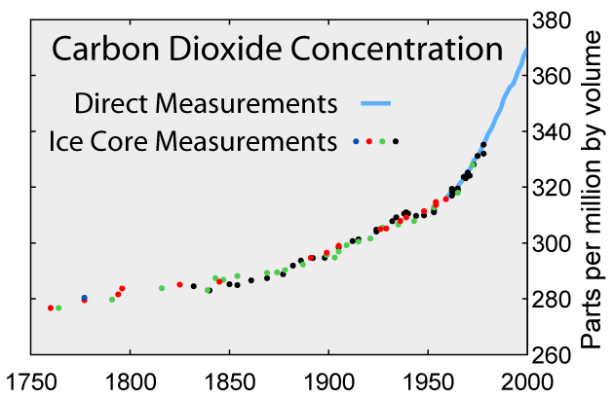
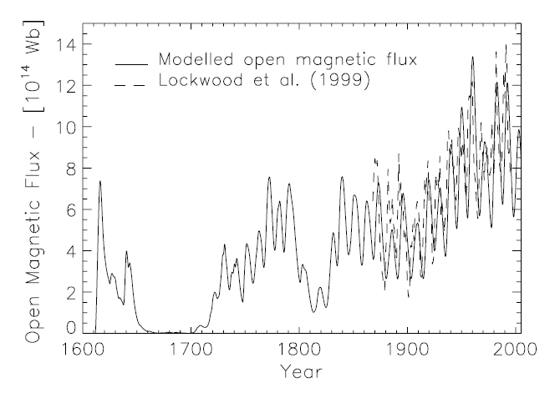
Increase of Temperature, CO₂ and Solar Activity
Temperature
Besides temperature and CO₂ also solar activity has increased over the past 150 years.
The solar magnetic field has more than doubled.
CO₂
Sun

Slide 20
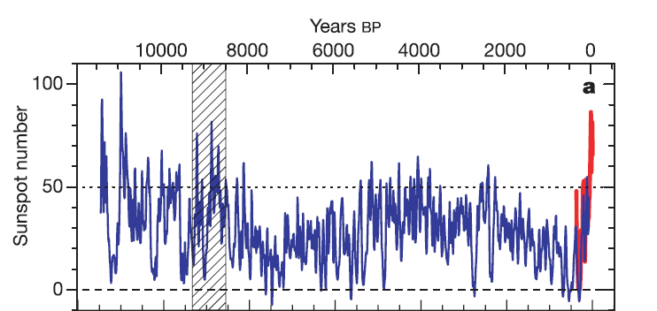
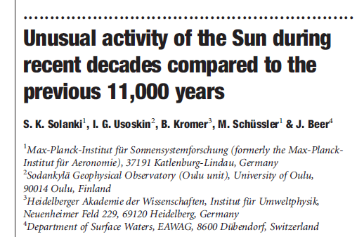
Solar activity of the past decades was one of the highest over the past 10.000 years
Solanki et al. 2004 (nature):
17
17

Slide 21
Has the planet been heating up to unprecedented levels?
http://www.buzzle.com/articles/whats-the-difference-between-climate-change-and-global-warming.html

Slide 22
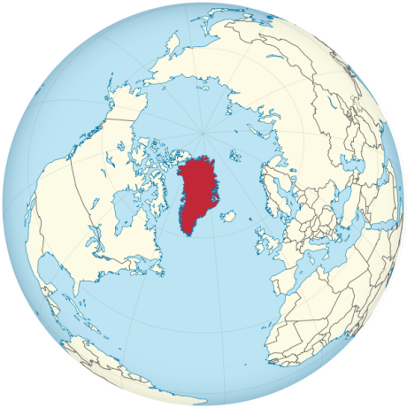
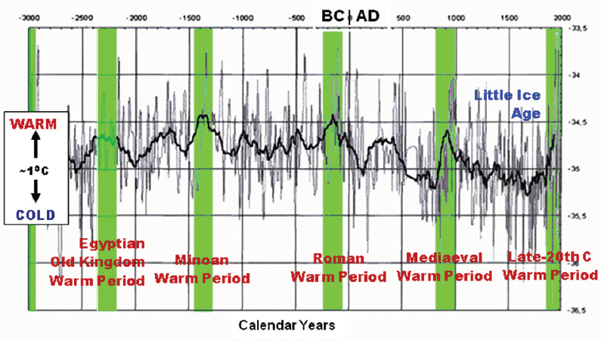
Greenland Temperature reconstruction for the past 5,000 years based on deuterium in ice cores
Carter 2008

Slide 23
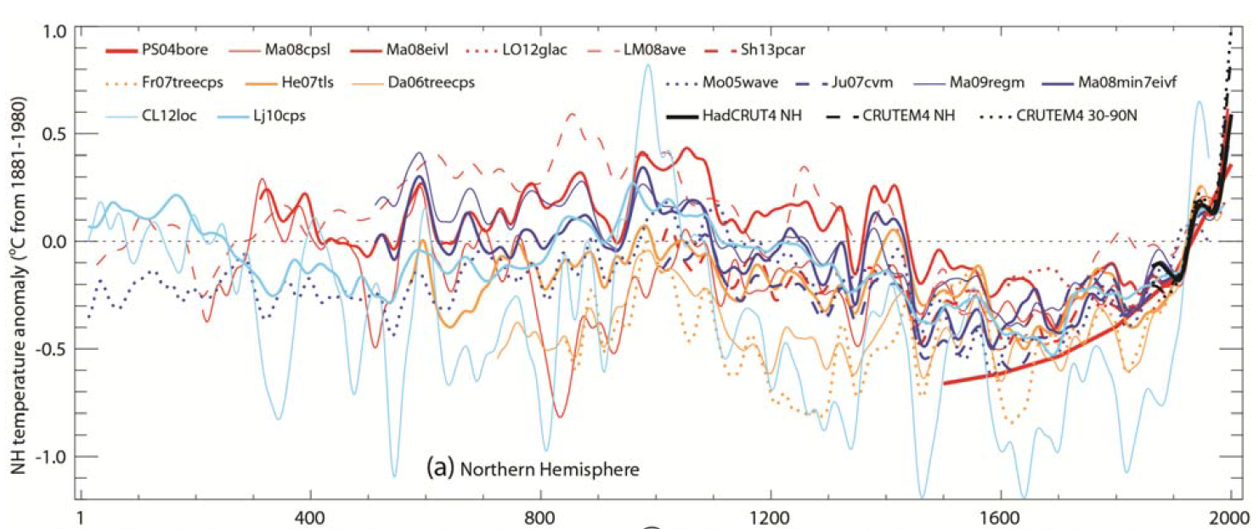
Rennaissance of the Medieval Warm Period
2013 (IPCC AR5, Fig. 5.7):
Cold Phase of the Migration Period
Medieval Warm Period
Little Ice Age
Modern Warm Period
Years A.D.

Slide 24
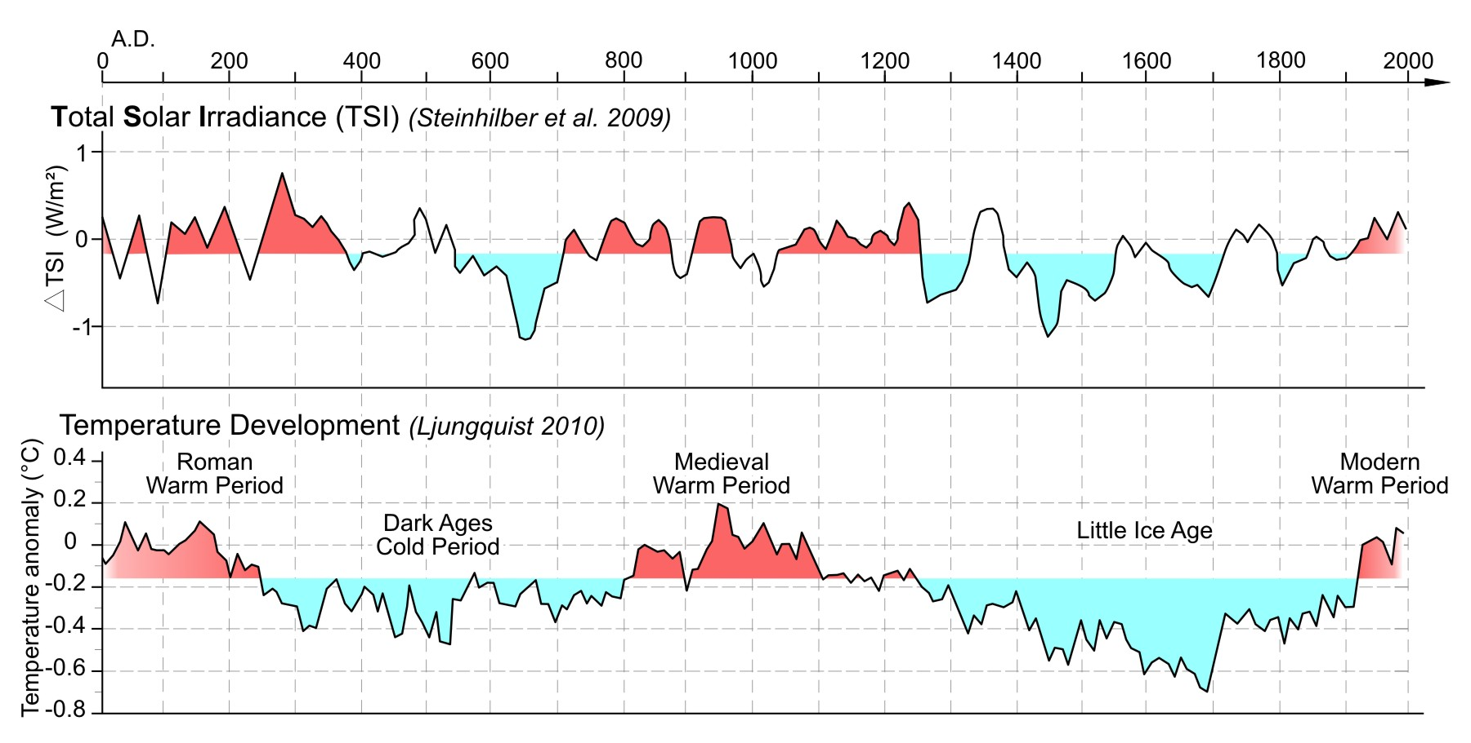
History Match: Sun without climate effect?

Slide 25
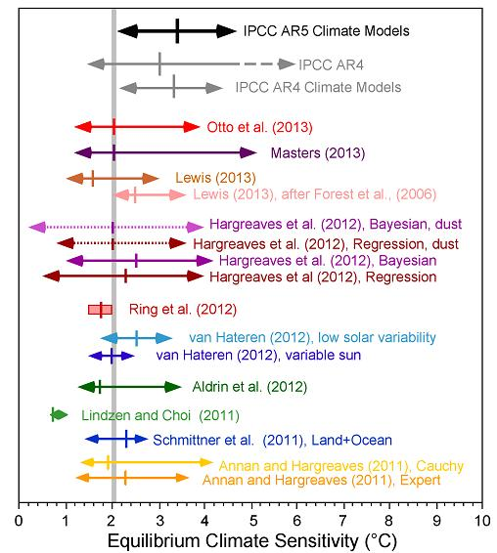
A large number of studies yield a CO₂ climate sensitivity that is significantly reduced compared to the IPCC value
Otto et al. 2013:
“The most likely value of equilibrium climate sensitivity based on the energy budget of the most recent decade is 2.0°C, with a 5–95% confidence interval of 1.2–3.9°C, compared with the 1970–2009 estimate of 1.9 °C”
http://www.cato.org/blog/current-wisdom-even-more-low-climate-sensitivity-estimates

Slide 26
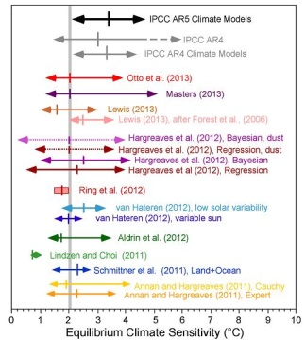
Proposed CO₂ Climate Sensitivities
3°C
2°C
Recent Studies
1.5°C

Slide 27
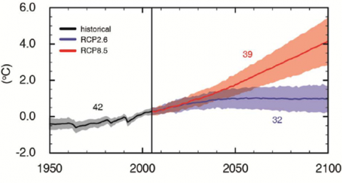
How much will the planet warm up until 2100?
IPCC AR5, 2013:
High CO2 emission scenario
Low CO2 emission scenario

Slide 28
George E.P. Box
British Statistician 1919-2013
http://meetville.com/quotes/tag/science/page110

Slide 29
Thank You

