Slide 1
ICCC-9, Las Vegas, July 7-9, 2014
No Alarming Sea Level Rise Nature itself vs IPCC – Observations vs Models
Nils-Axel Mörner
Paleogeophysics & Geodynamics, Stockholm, Sweden
morner@pog.nu
President INQUA Com. on Sea Level Changes and Coastal Evolution (1999-2003) Leader of the Maldives Sea Level Project (2000-2009+) Co-ordinator INTAS project on Geomagnetism and Climate (1997-2003)

Slide 2
Om May 6, 2014
The White House Climate Report was released
stating:
Sea Level will rise
20 cm to 2.0 m
(8 inches to 6.6 feet)
by year 2100
Nonsense, my Friends
quod erat demonstrandum

Slide 3
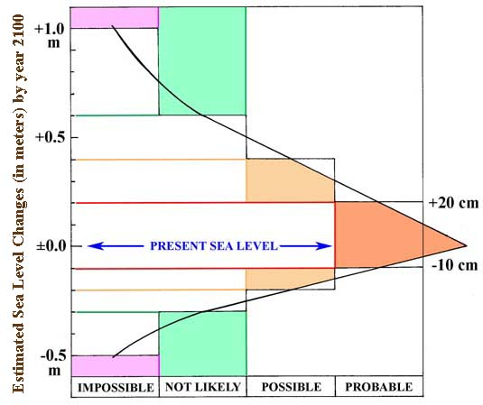

Slide 4
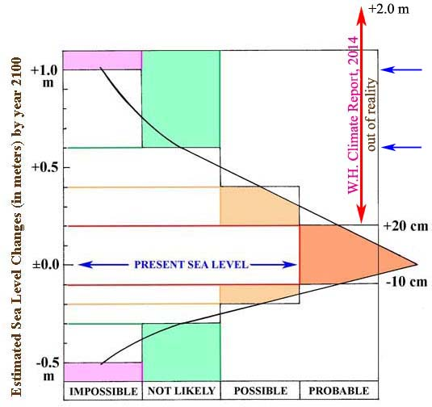
Sea Level by year 2100
ULTIMATE LIMIT
LIKELY LIMIT

Slide 5
3 main variables
will affect & control
Future Sea Level
Changes in the ocean water volume (glacial eustasy)
Ultimate frame: 10 mm/year ≈ maximum postglacial rates
Thermal expansion (steric eustasy)
Ultimate frame: <5 mm/year ≈ short-term heating
At shore: always zero (±0.0 mm/yr) – no water to expand
Redistribution of water masses over the globe
important but regional to local
and compensated on a global scale

Slide 6
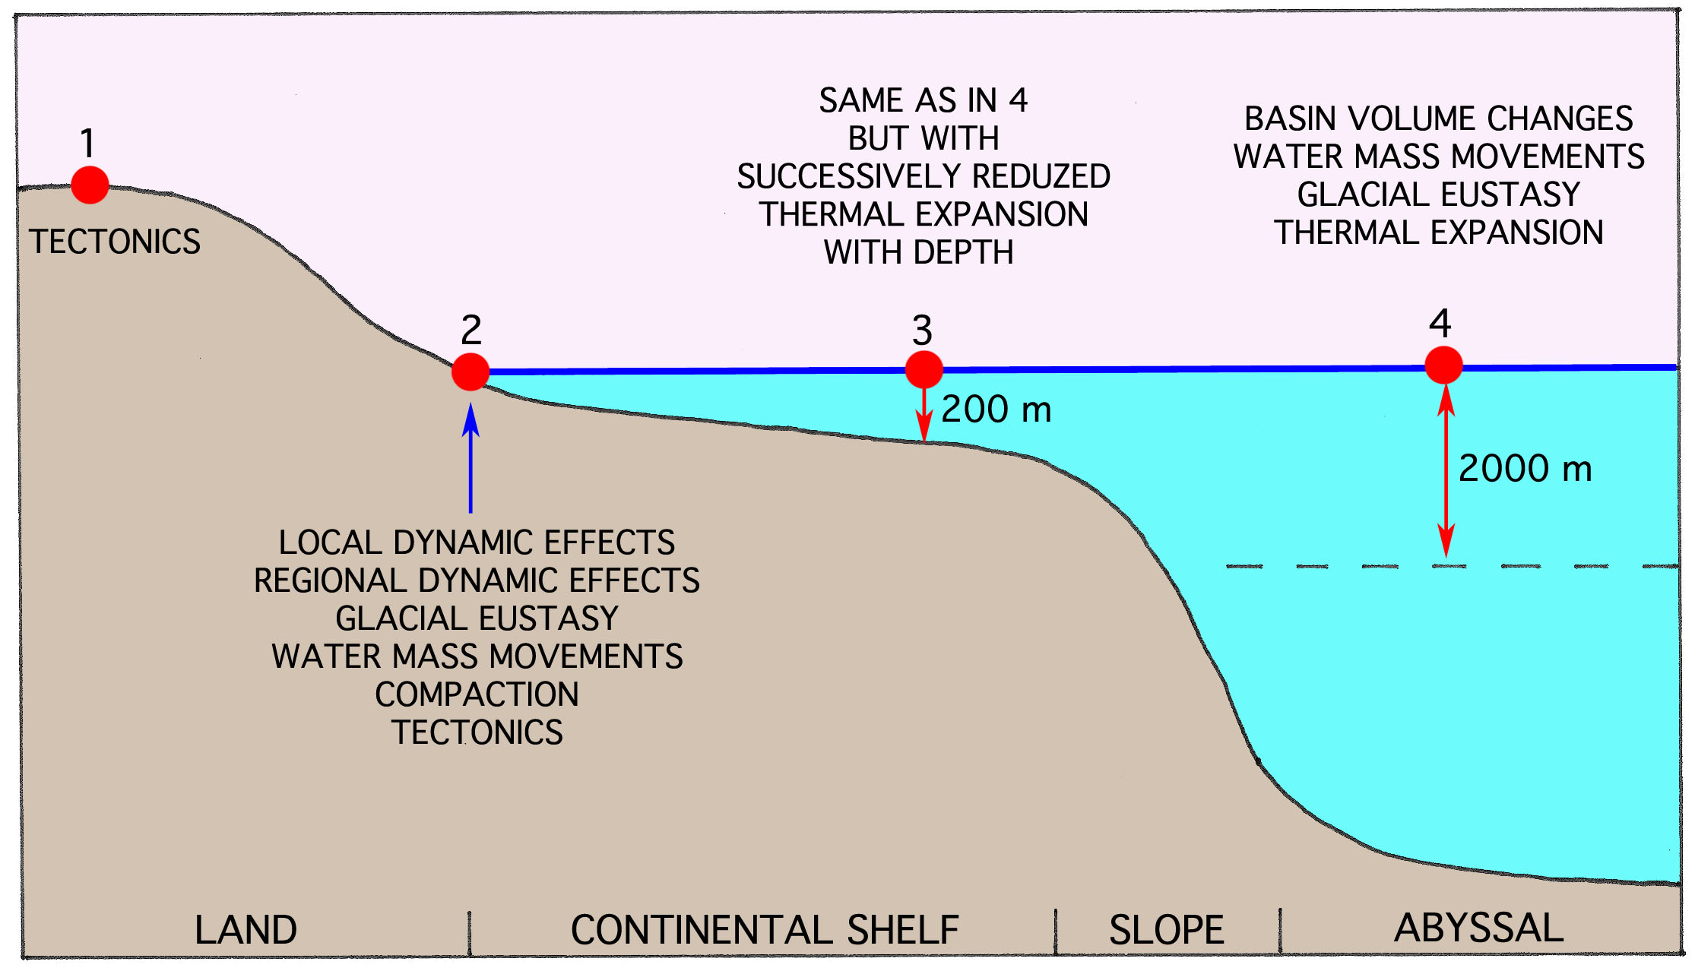
The sea level variables affects the ocean level
differentially from shore to open oceans

Slide 7
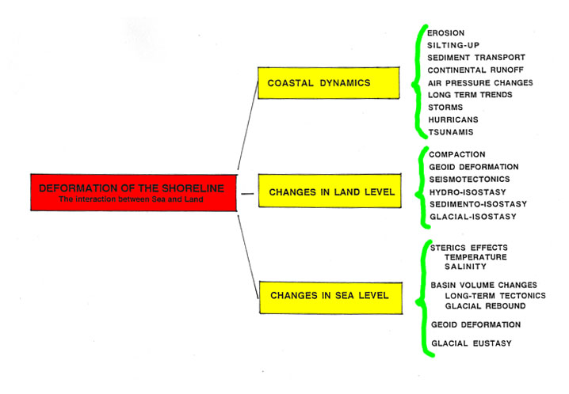
OBSERVATIONAL FACTS at point 2
Numerous interacting factors control the stability of the shoreline

Slide 8
If you don’t know what you are talking about
you should be silent
Ludwig Wittgenstein,
Tractatus Logico-Philosophicus
1933 (1961)
but unfortunately they* go on cackling
*the IPCC and their boy scouts
(including the White House Climate Report)

Slide 9
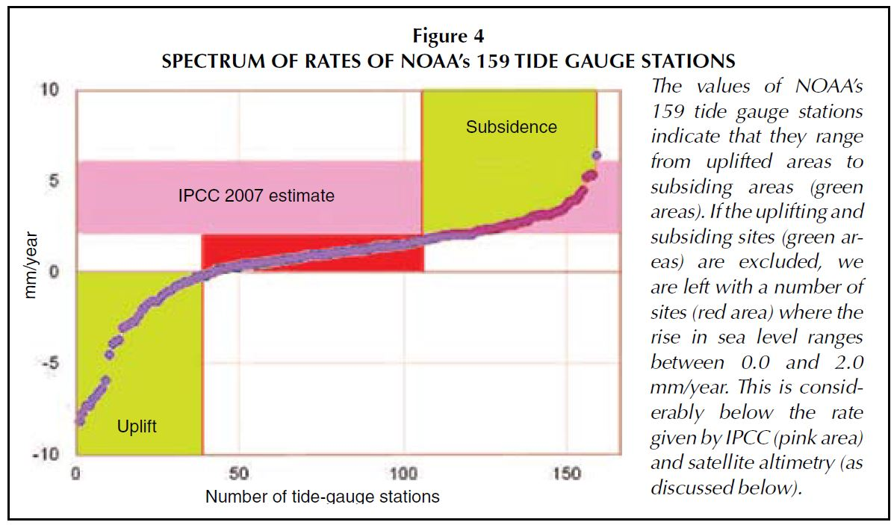
from: Mörner, 2010

Slide 10
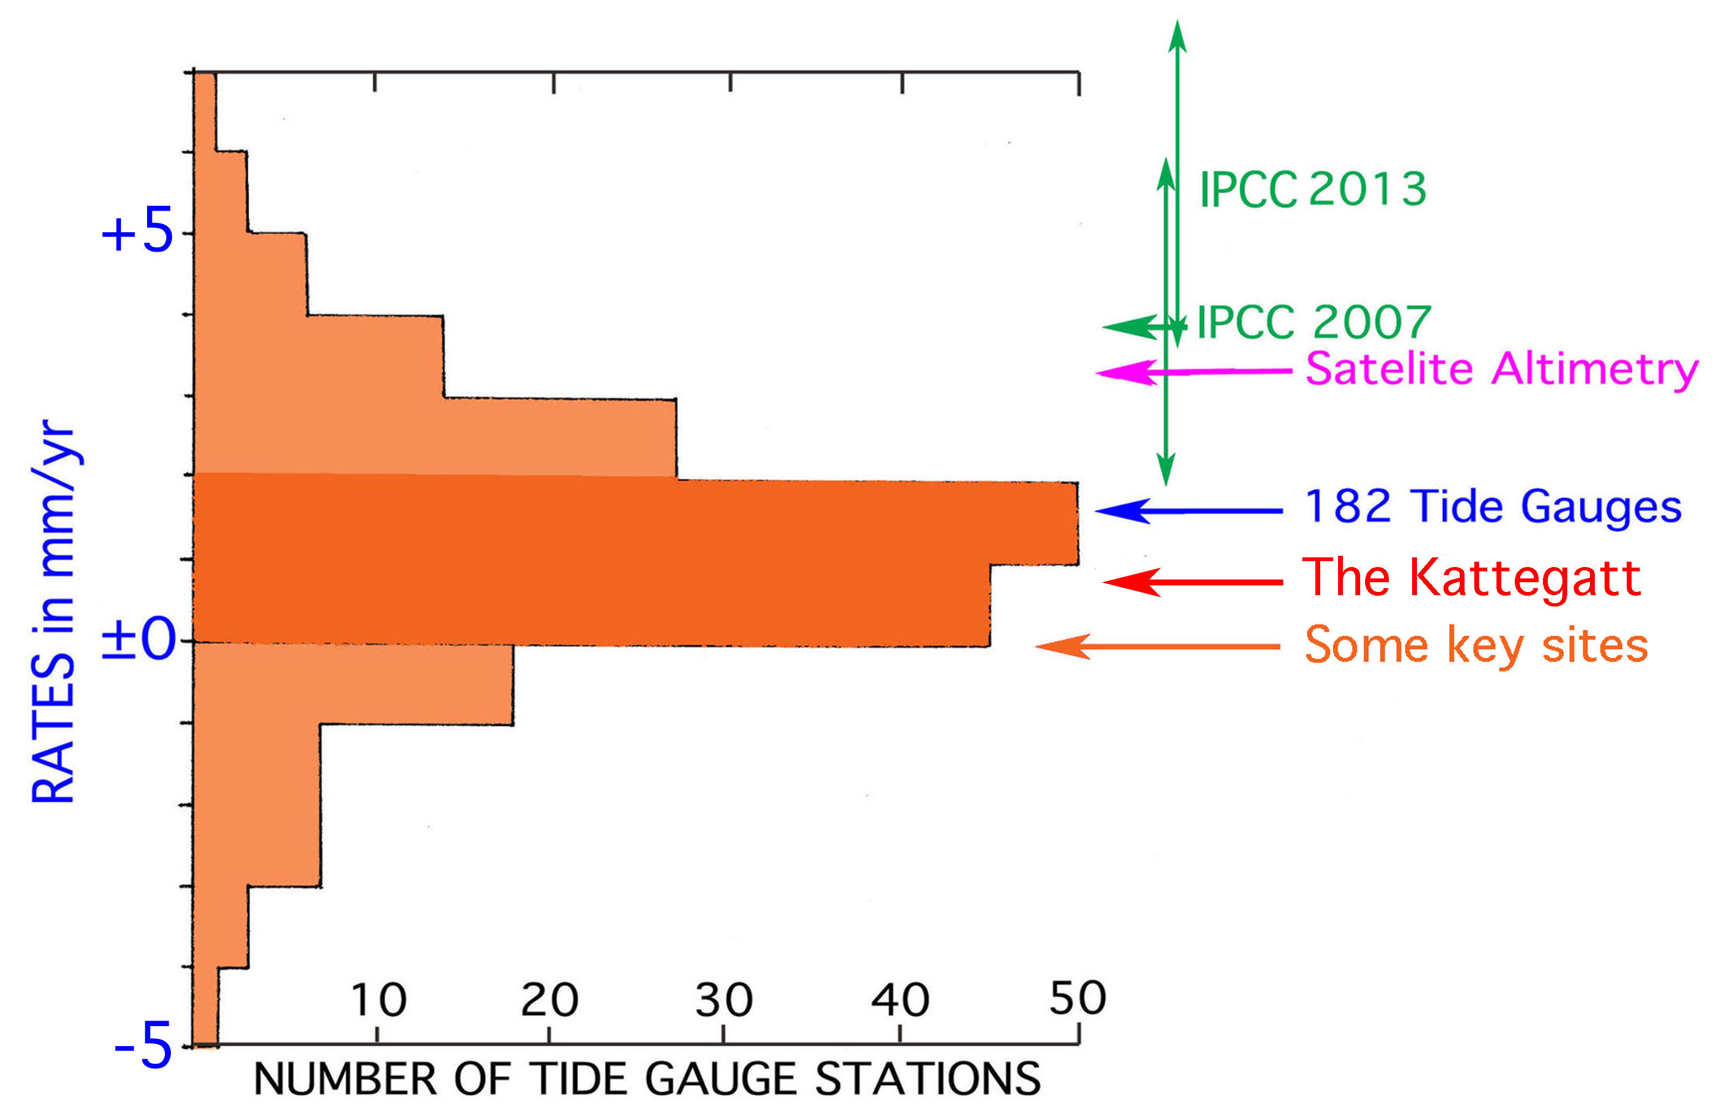

Slide 11
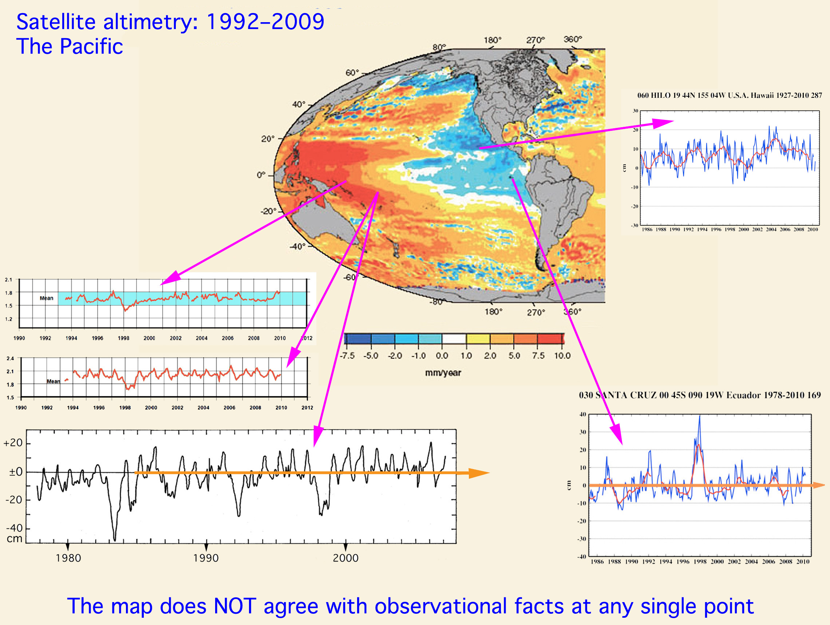

Slide 12
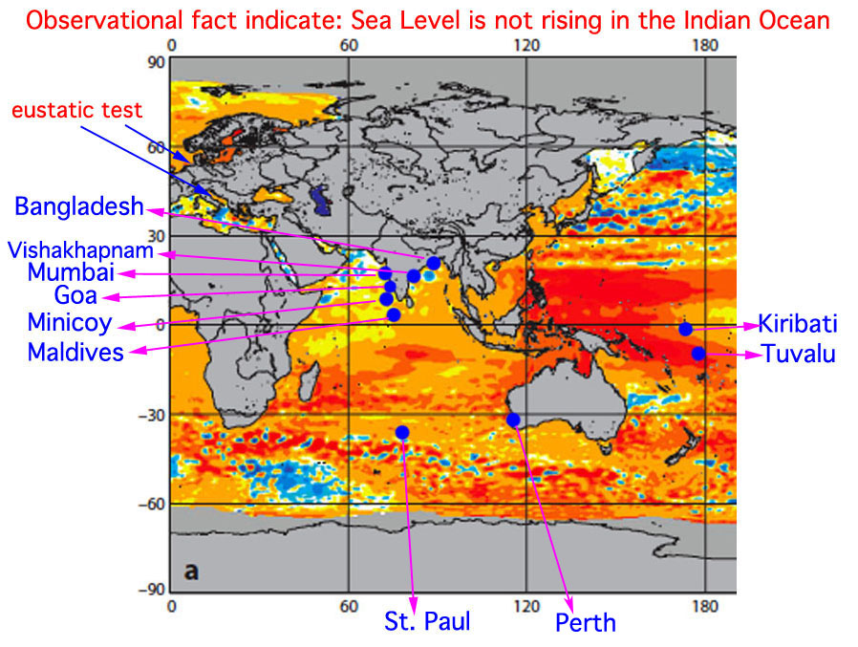

Slide 13
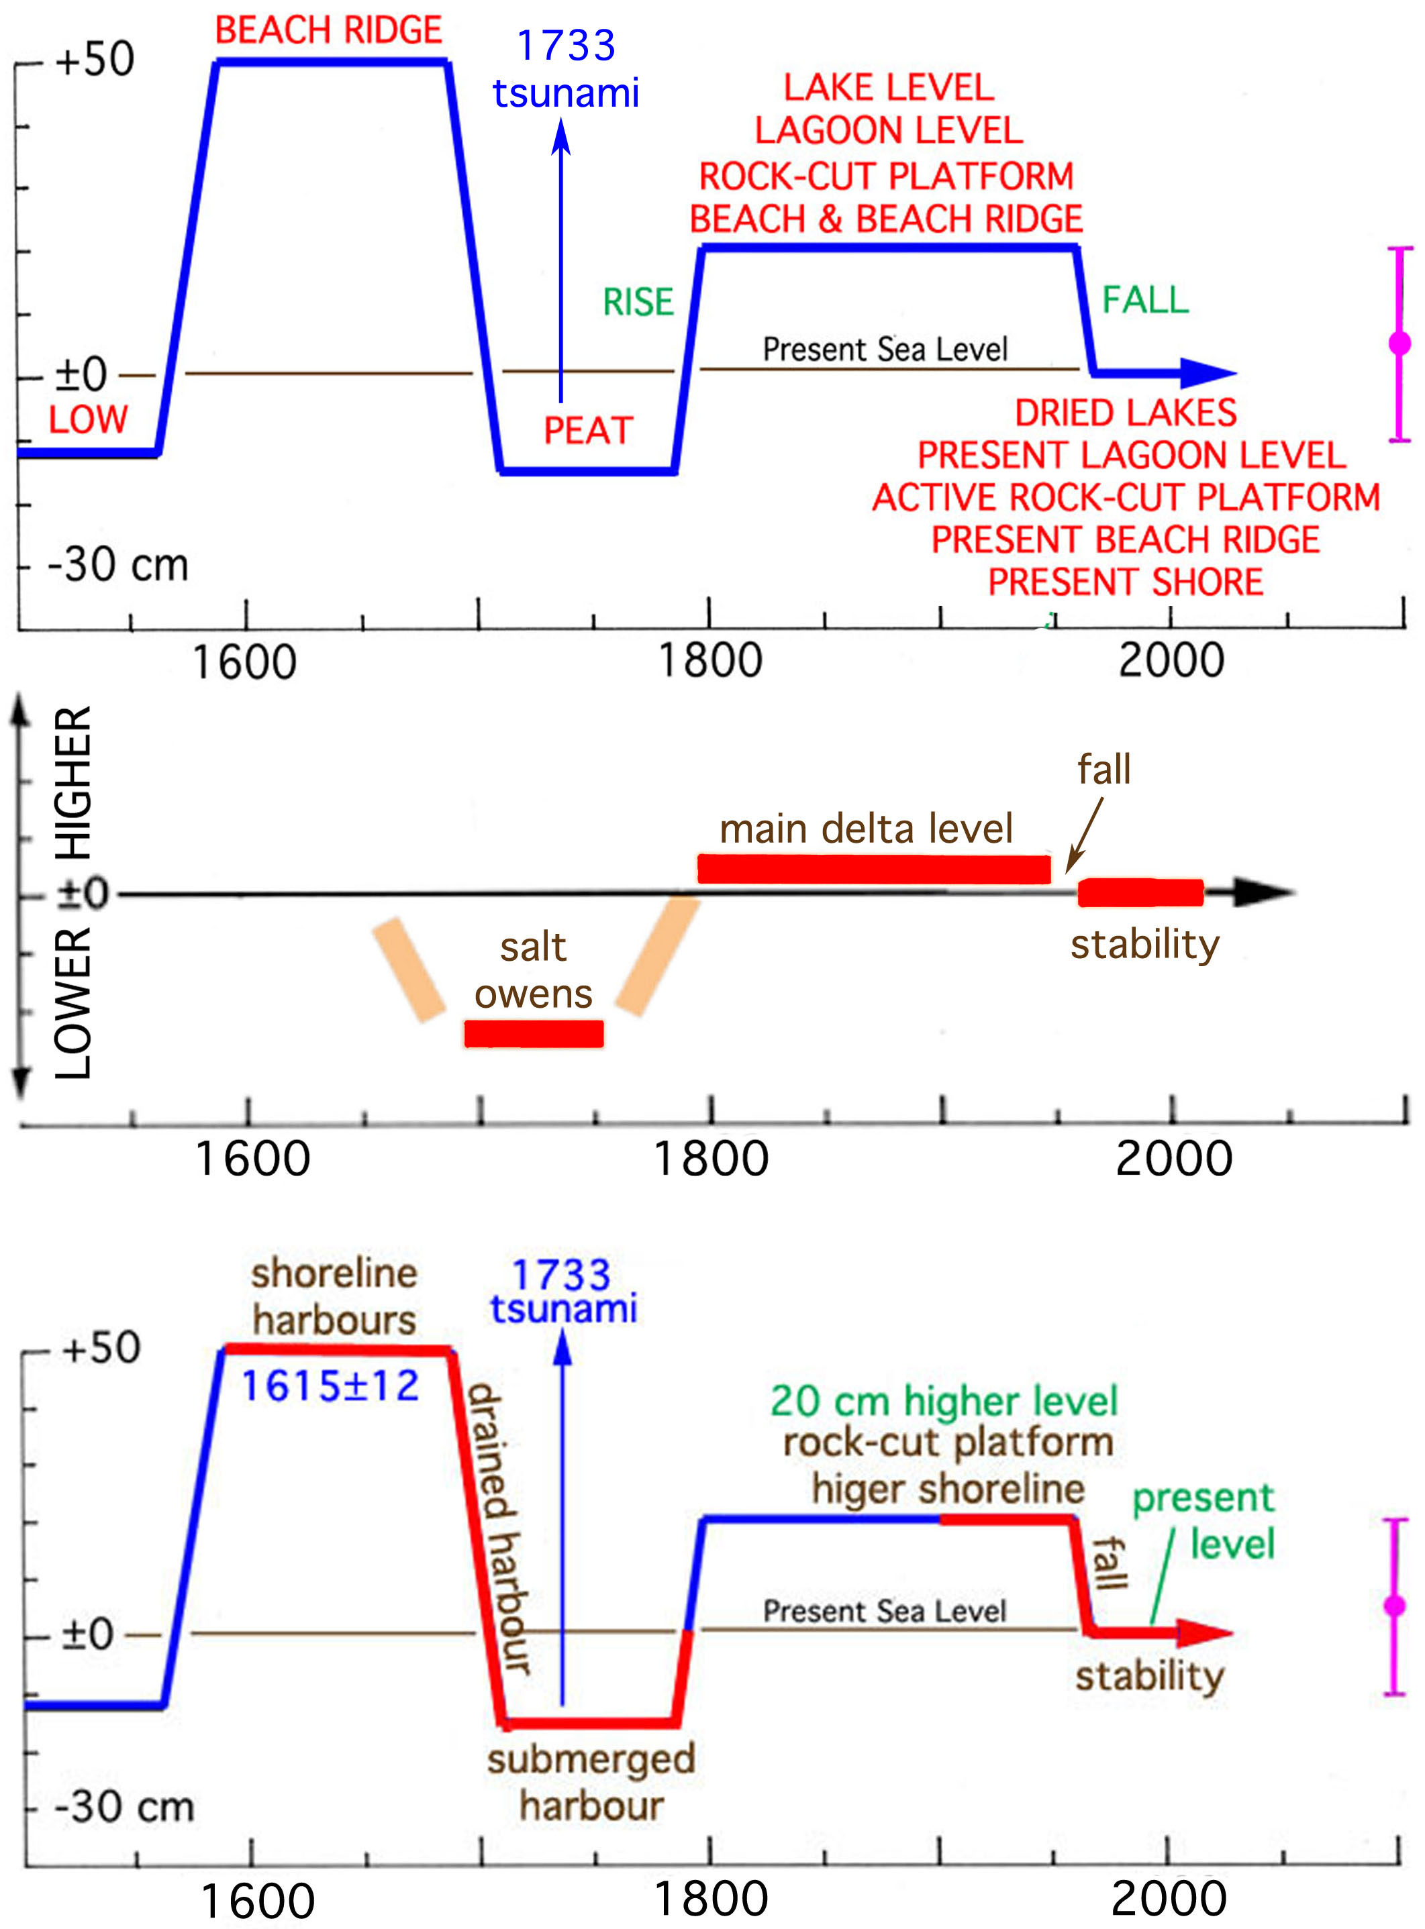
Indian Ocean
Maldives sea level stable in 40 years
Bangladesh
sea level stable fin 50 years
Goa, India
sea level stable in 50 years

Slide 14
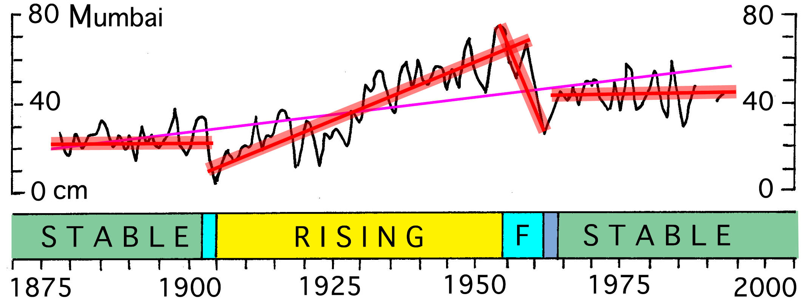
Indian Ocean
Maldives sea level stable in 40 years
Bangladesh
sea level stable fin 50 years
Goa, India
sea level stable in 50 years

Slide 15
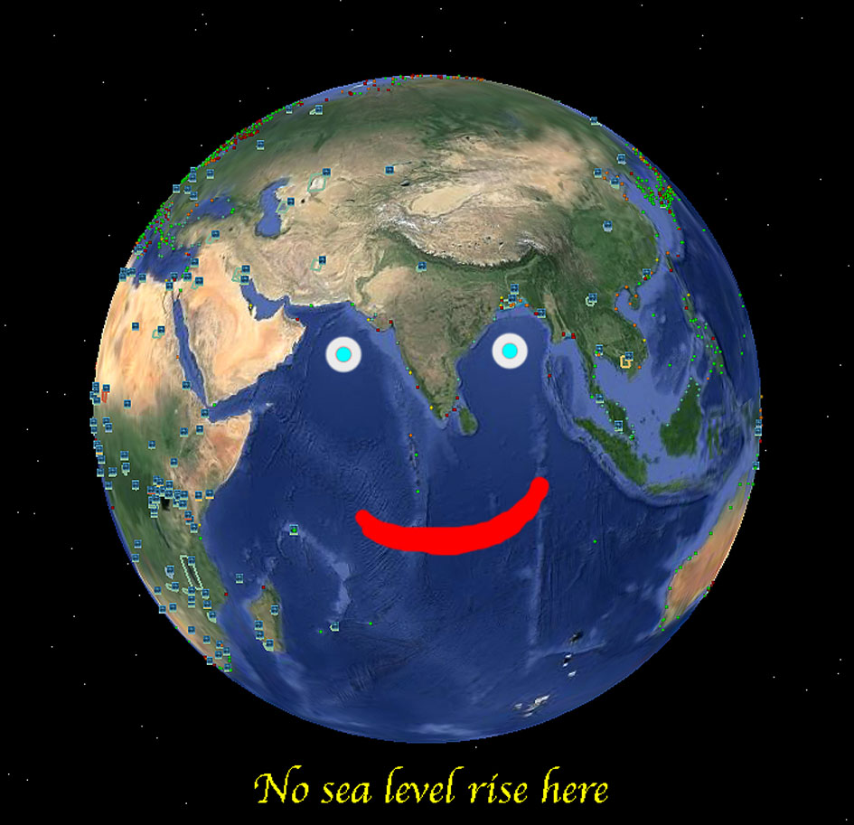

Slide 16
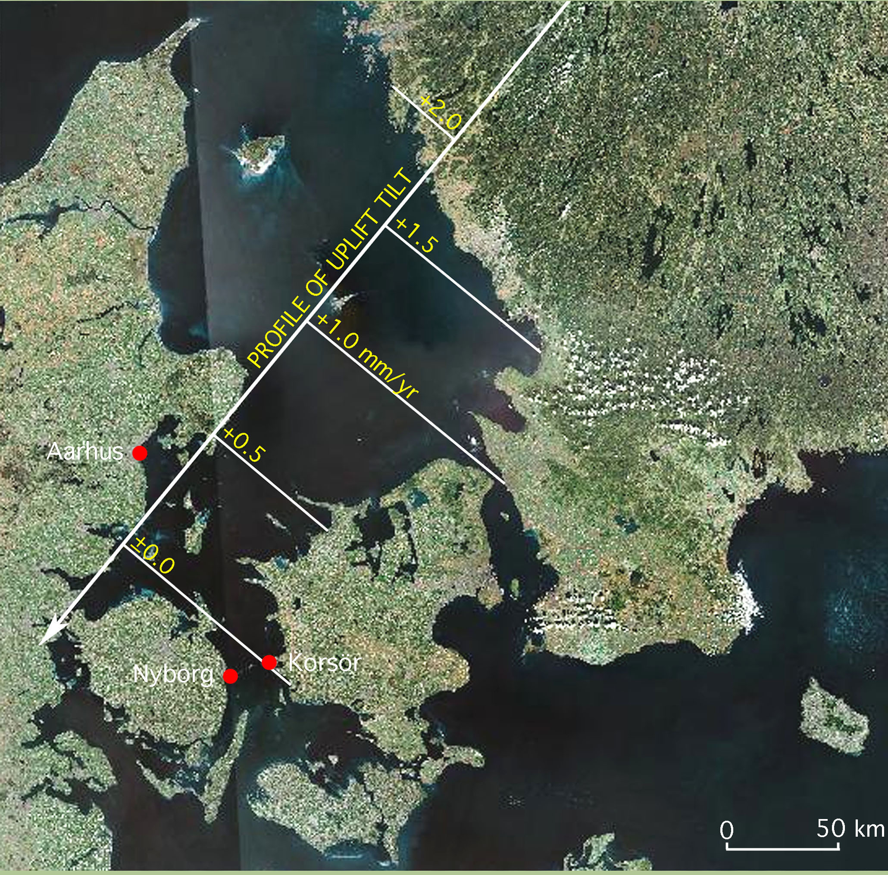
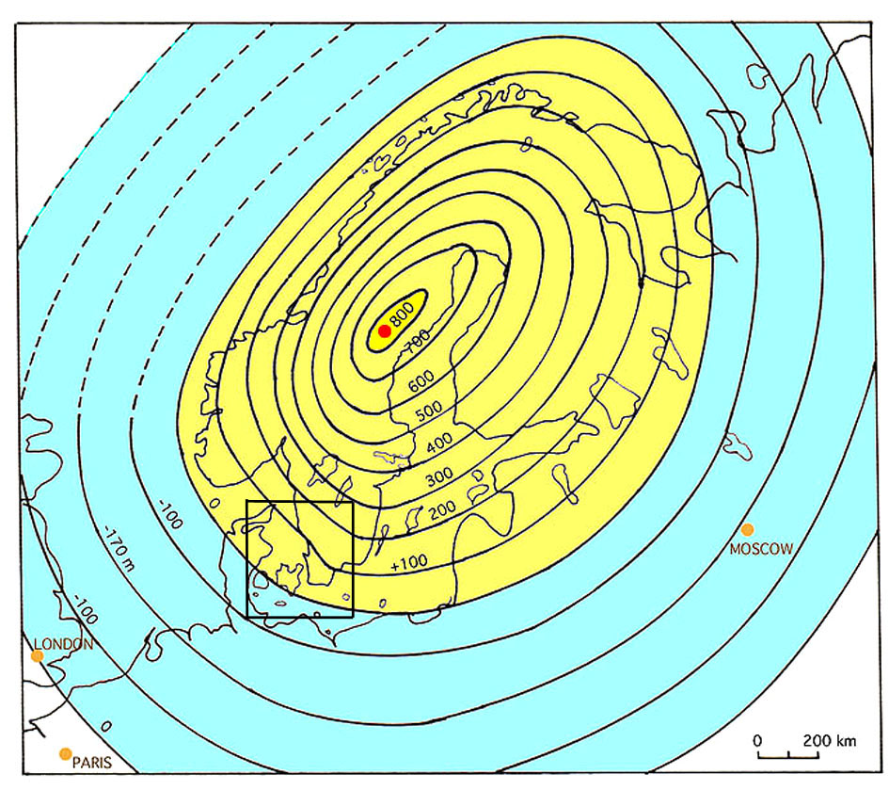
The Kattegatt
at the margin of uplift
Profile of tilting
with present day
uplift in mm/yr
In the marginal zone
there are 3 tide gauges
(red dots)
where
regional eustasy
can be defined
at
0.8-0.9 mm/yr

Slide 17
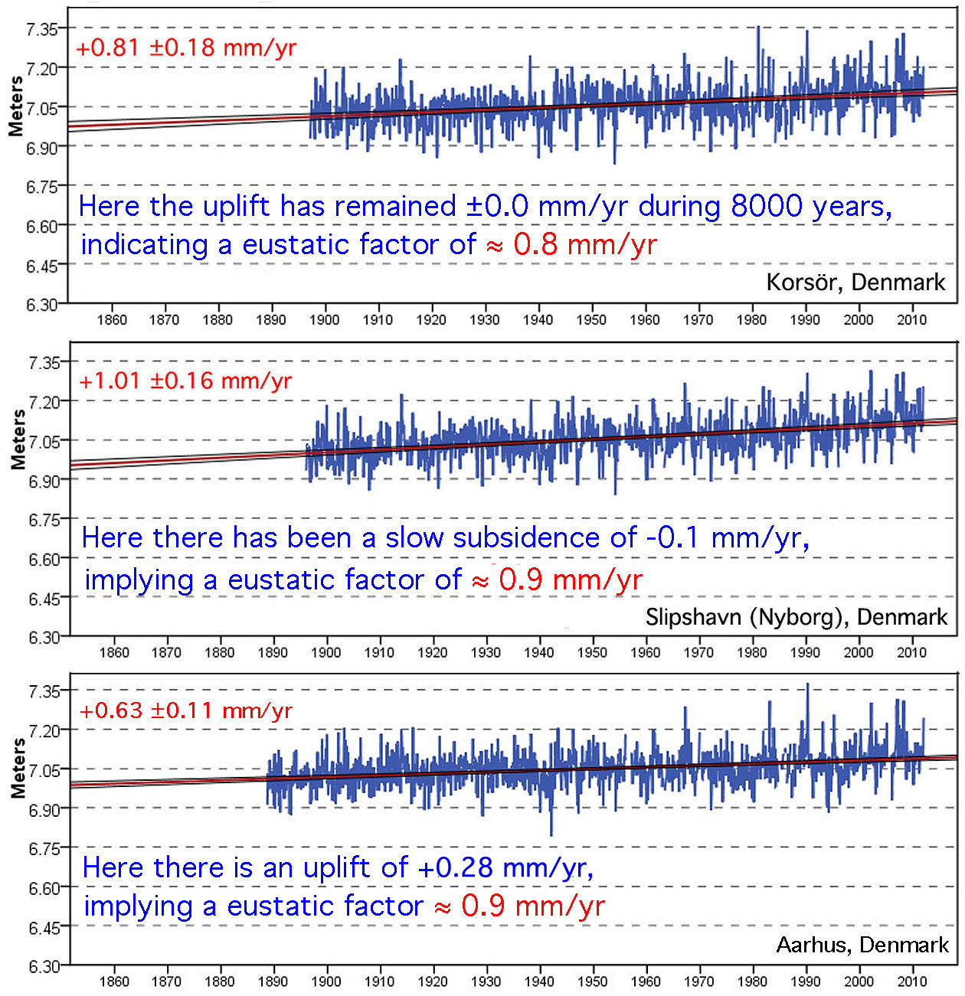

Slide 18
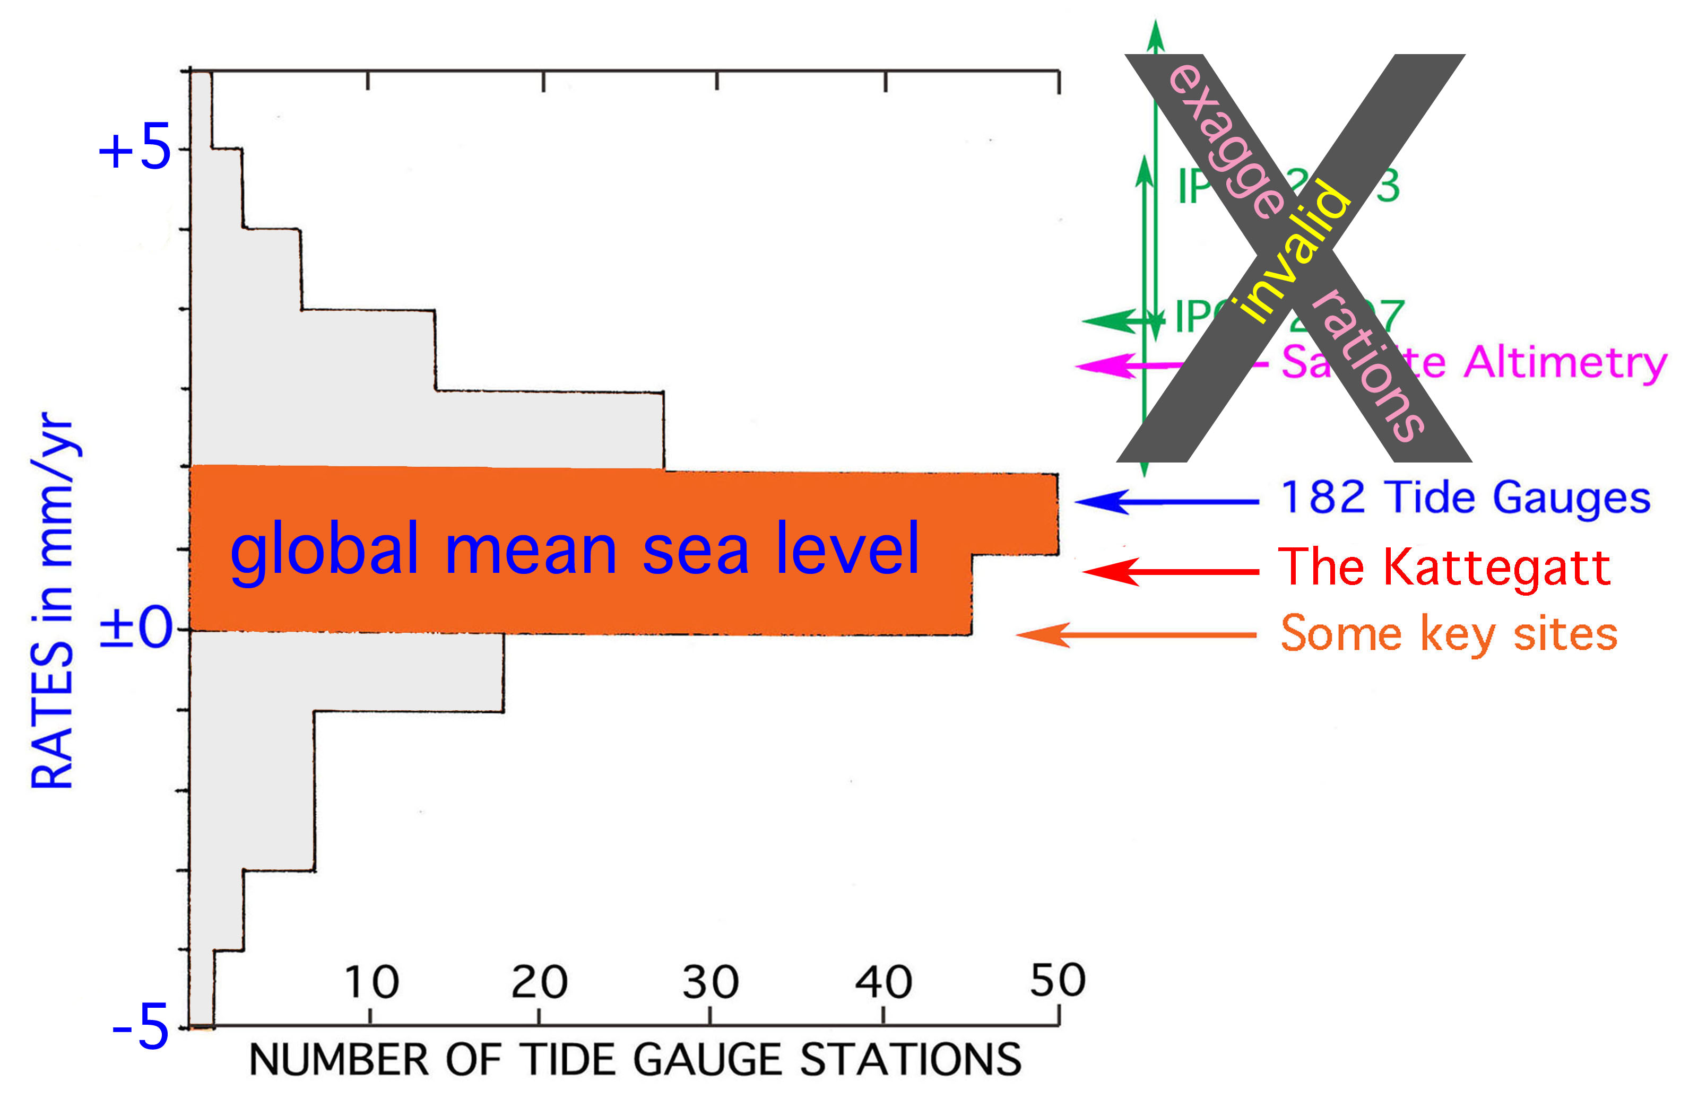
Global mean sea level – today ±100 years
is to be found within this range of rates
1 – the IPCC statements being biased due to preconceived ideas
2 – the satellite altimetry being biased due to subjective “corrections”

Slide 19
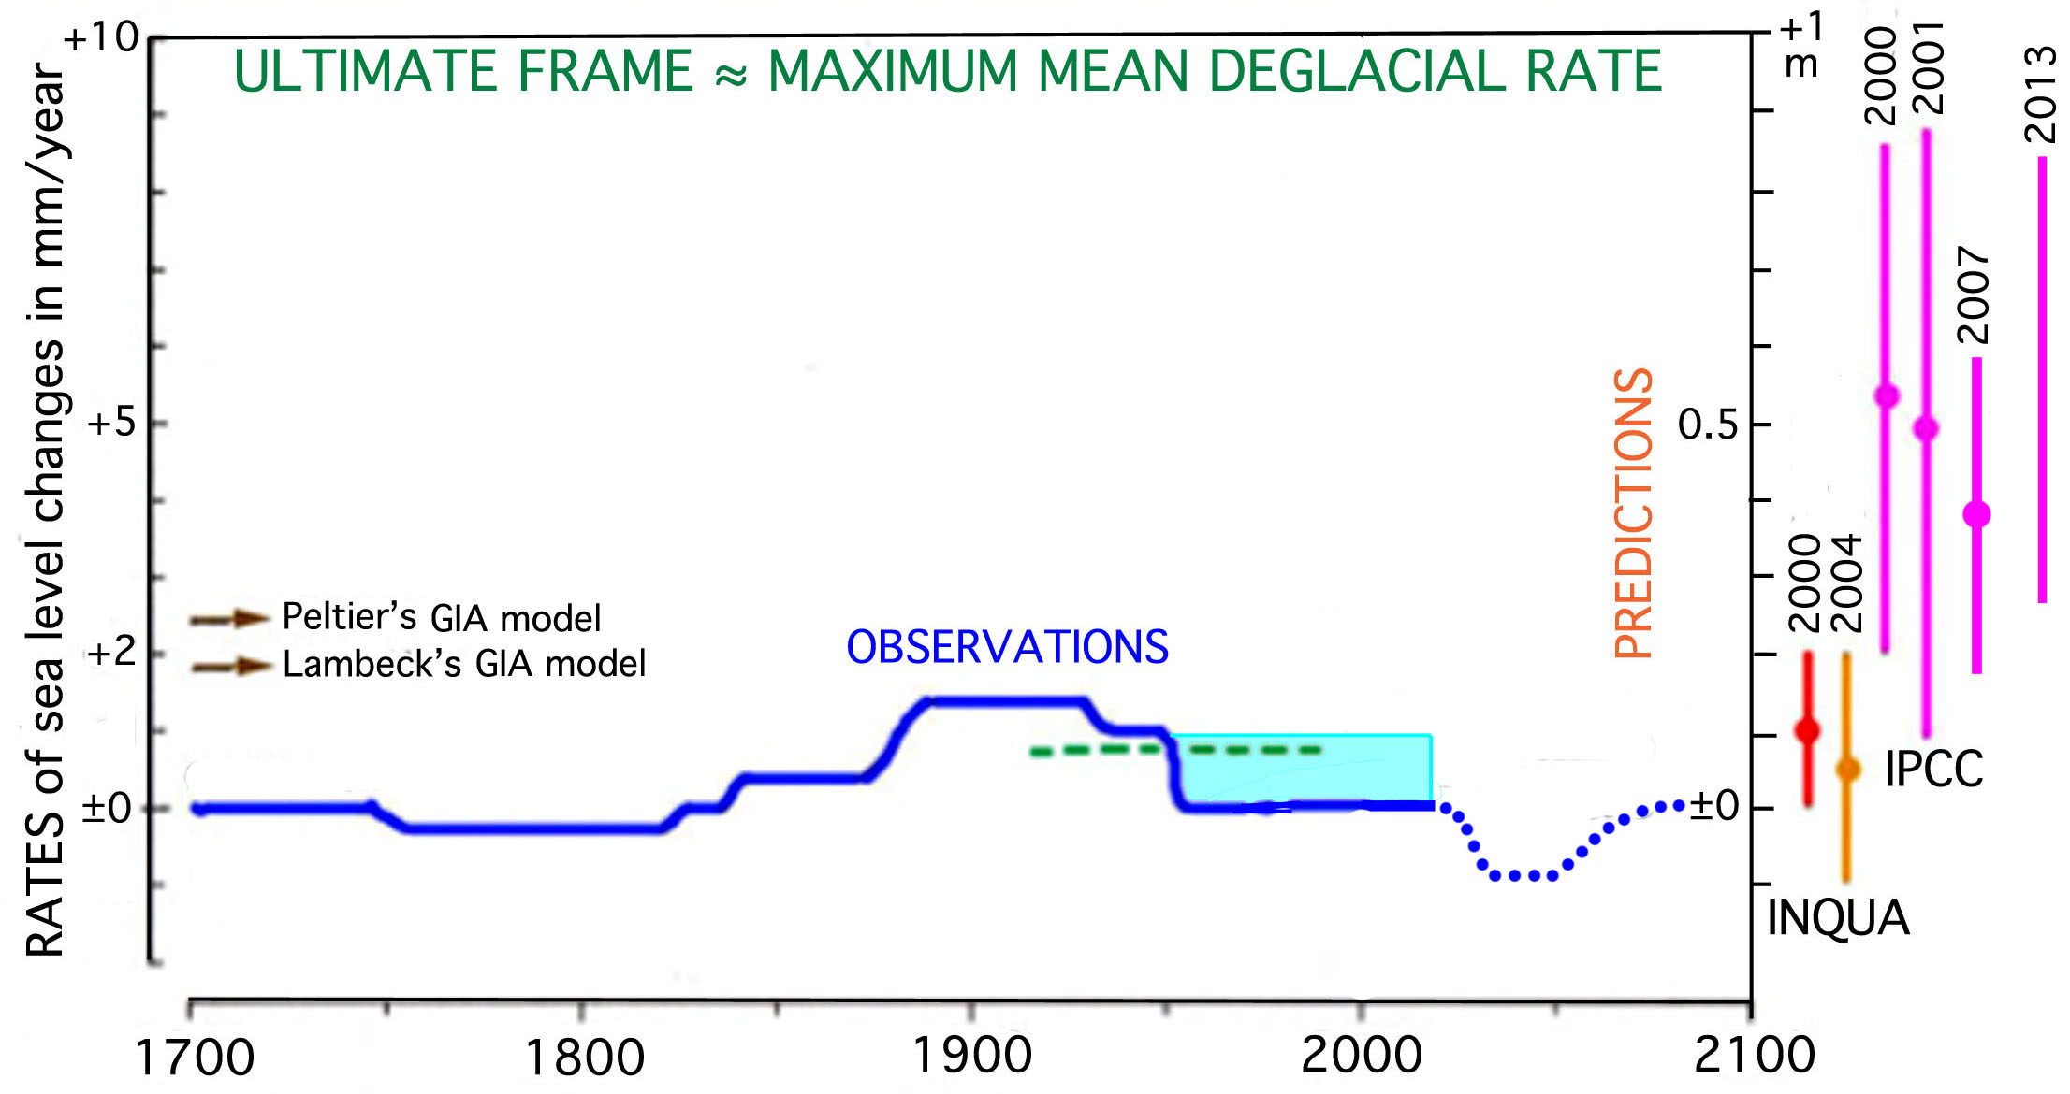
Combined observational data (in mm/år) for the last 300 years:
variations – up and down– but no trend at all.
For year 2100, INQUA and Mörner give values fitting well with observations,
whilst IPCC gives values far above observational data.

Slide 21
Sea Level year
2100
estimated to be
only
+5 ±15 cm

Slide 22
A few selected background references (to the author’s papers)
1973 – Eustatic changes during the last 300 years. Palaeogeogr. Palaeoclim, Palaeoecol, 13, 1-14.
1976 – Eustasy and geoid changes. Journal of Geology, 84, 123-151.
1986 – The concept of eustasy. A redefinition. Journal of Coastal Research, Sp.Is 1. 49-51.
1995 – Earth rotation, ocean circulation and paleoclimate. GeoJournal, 37, 419-430.
2004 – Estimating future sea level changes. Global Planetary Change, 40, 49-54.
2007 – The Greatest Lie Ever Told. P&G-print, Stockholm, 20 pp (2nd ed, 2009, 3rd ed. 2010).
2007 – Sea level changes and tsunamis, environmental stress and migration over the seas.
Internationales Asienforum, 38, 353-374.
2010 – Some problems in the reconstruction of mean sea level and its changes with time. Quaternary
International, 221, 3-8.
2010 – Sea level changes in Bangladesh. New observational facts. Energy & Environment, 21. 234-249.
2011 – There is no alarming sea level rise. 21st Century Science & Technology, winter 2010/11, 12-22.
2011 – Setting the frames of expected future sea level changes. In: Evidenced-based Climate Science,
D.J. Easterbrook, ed., Chapter 6, 197-209, Elsevier 2011.
2011 – The Maldives as a measure of sea level and sea level ethics. In: Evidence-based Climate Science,
D.J. Easterbrook, ed., Chapter 7, 185-196, Elsevier 2011.
2013 – Sea level changes: past records and future expectations. Energy & Environment, 24, 508-536.
2014 – Deriving the eustatic sea level component in the Kattegatt sea. Global Perspective on
Geography, 2, 16-21.

Slide 24
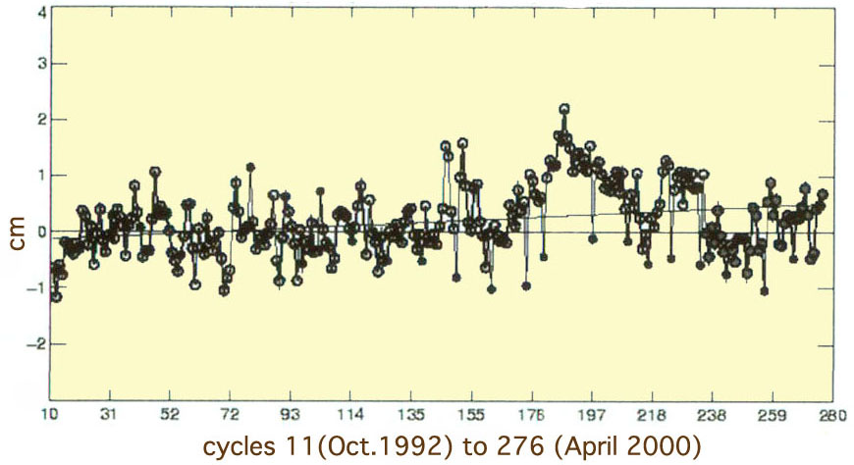
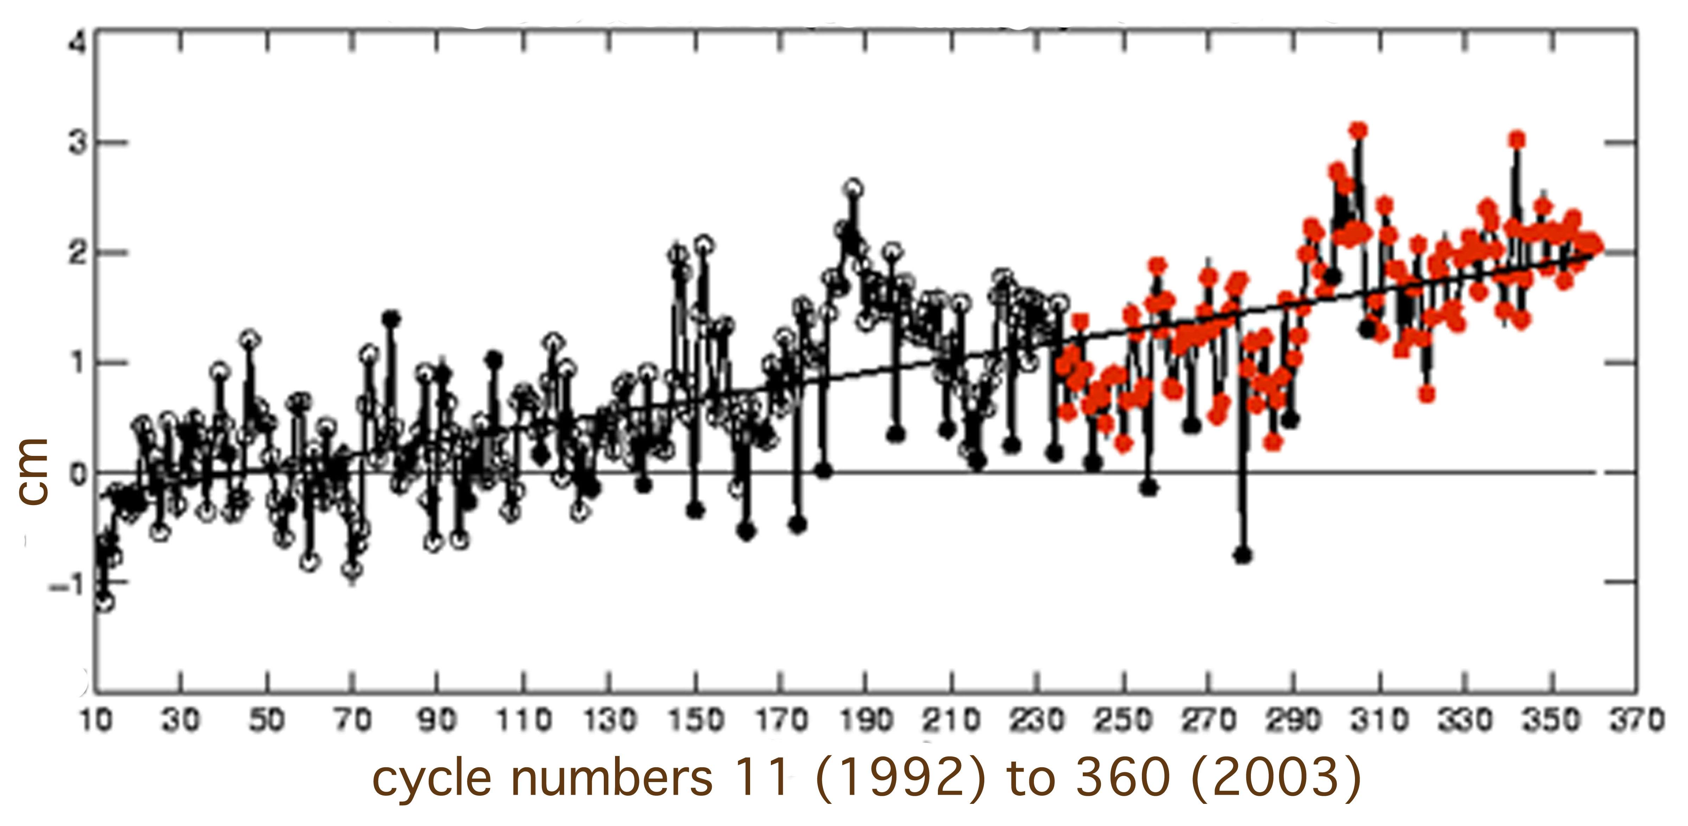
Satellite Altimetry
First record (Menard , 2000): no rise
Mörner (2004): no rise + ENSO event
Aviso (2003): all tilted by 2.3 mm/yr
(the subjective “correction” fiddling begins)
The tilt is NOT measured
(today 3.2 mm/yr)

Slide 25
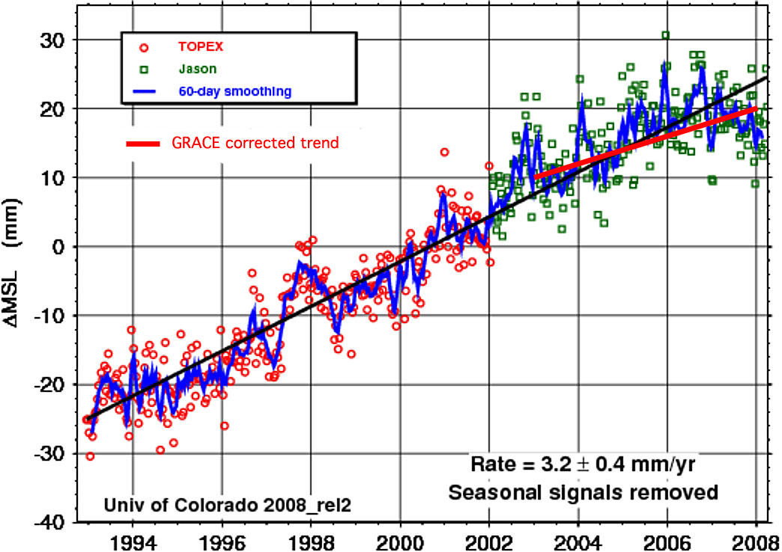
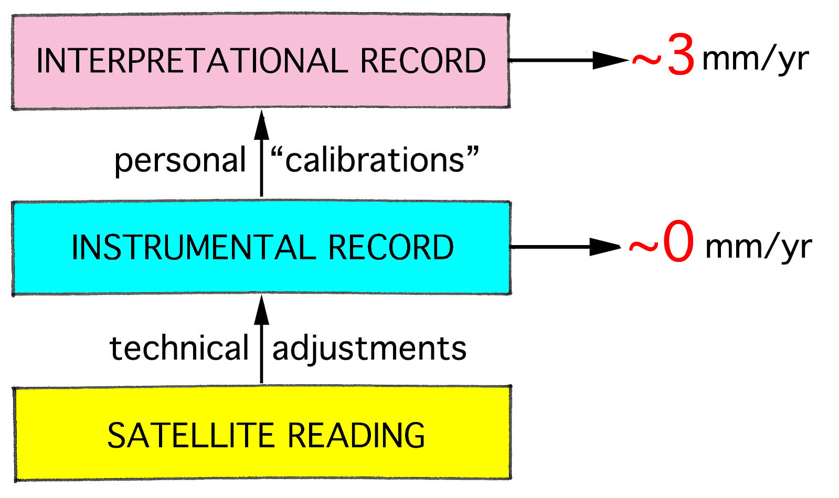
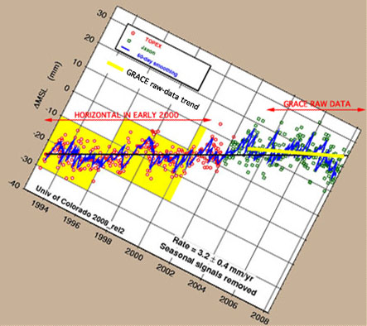
Satellite Altimetry

Slide 26
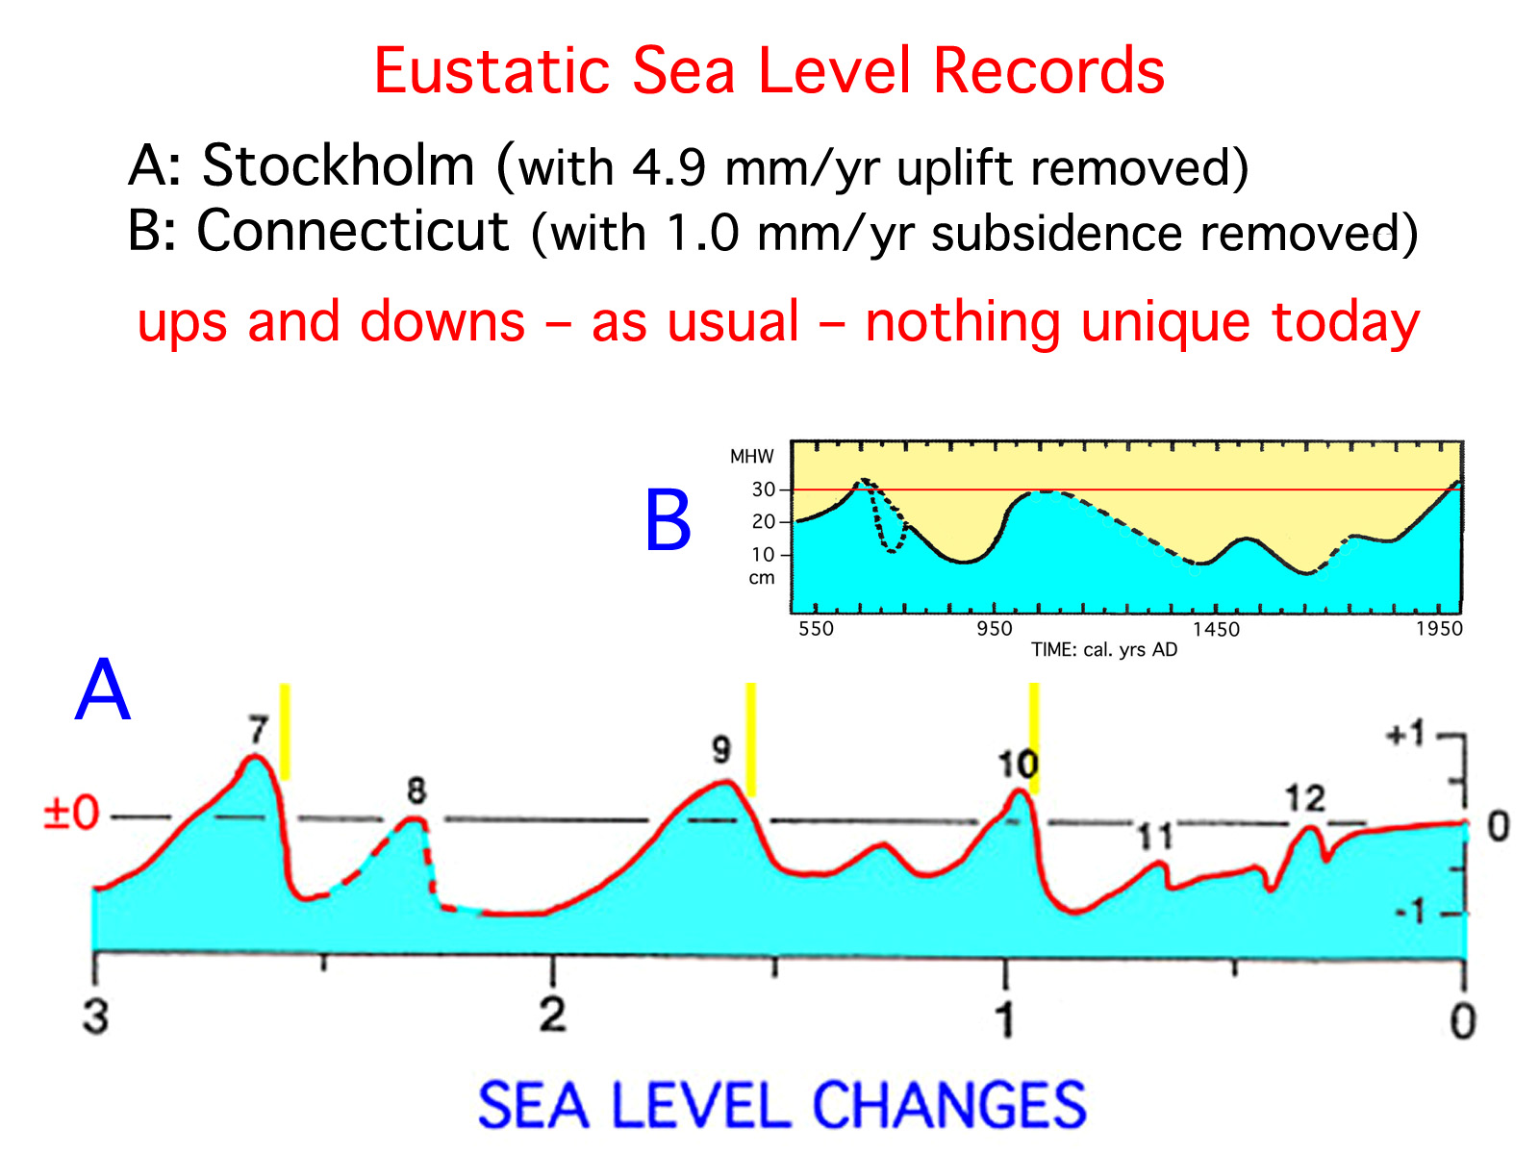

Slide 27
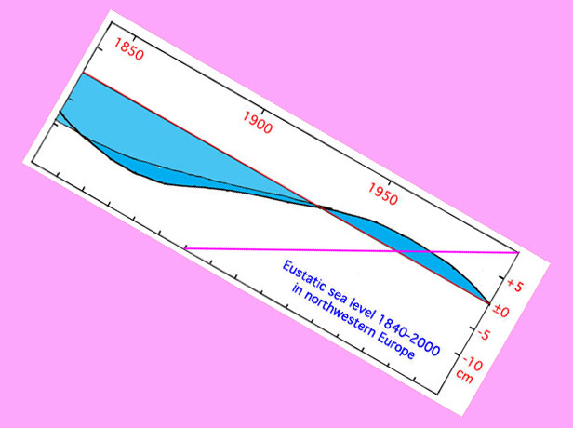
If the rate of sea level rise of ~3 mm/yr from satellite altimetry would be correct
Amsterdam and Cuxhaven would be uplifted at impossible rates

Slide 28
Poseidon: Well, little Earthling, you know who I am: the God of the Seas and also the earth-shaker. I am the King of the Oceans. I know how they work. I know how they change. I make the rules myself. What have you got to set against that, you little creep?
Levermann: Well, I have a great deal to say.
Poseidon: No doubt – but it is nothing but nonsense.

Slide 32
