Slide 1
The Need for a New Paradigm Including for Rainfall Forecasting
Jennifer Marohasy PhD
www.jennifermarohasy.com

Slide 2
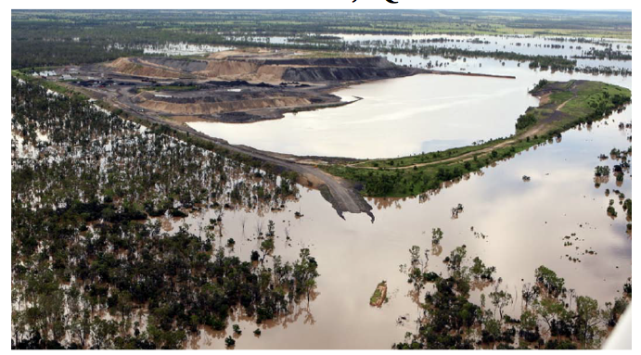
Coal mine in Bowen Basin flooded in December 2010...

Slide 3
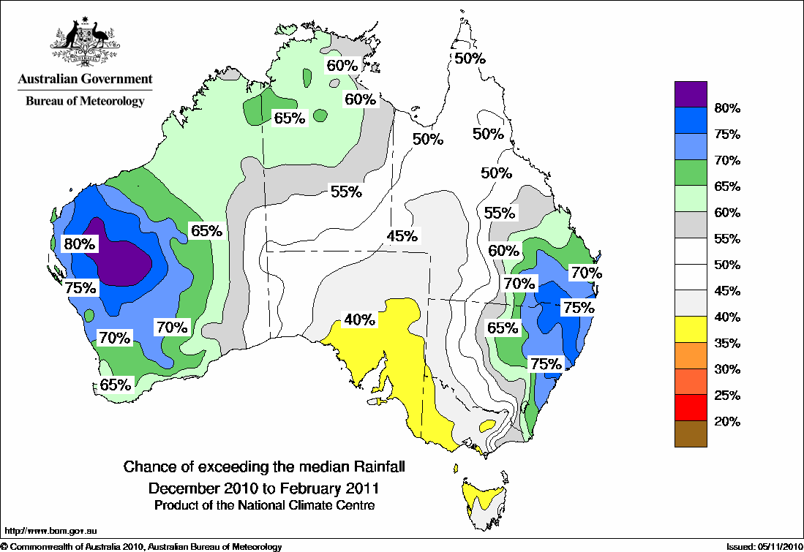
Official forecast for December 2010 to February 2011 for Bowen Basin was 50-55% probability of above median rainfall
Notes:
forecasts are presented as coloured maps showing regions delineated according to probability of exceedance of a the median rainfall.

Slide 4
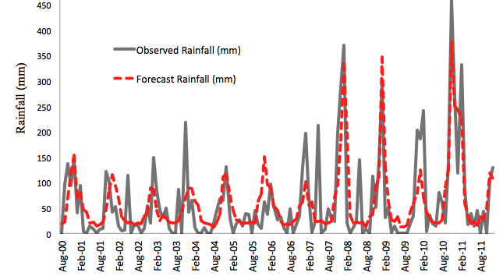
Artificial Neural Network Monthly Rainfall Forecast for Nebo, Bowen Basin, August 2000 to December 2011

Slide 5
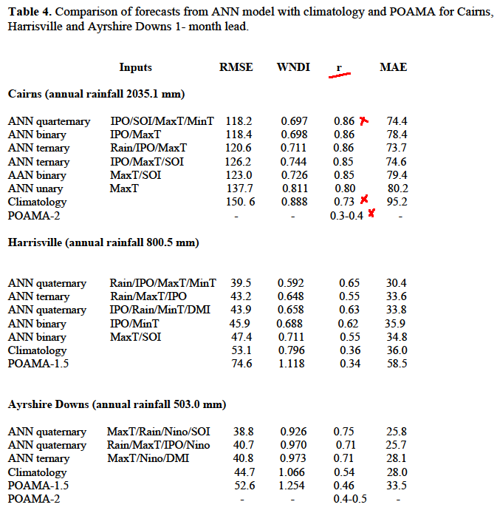
From Abbot J. & Marohasy J. 2014. Input selection and optimisation for monthly rainfall forecasting in Queensland, Australia using artificial neural networks.
Atmospheric Research, Volume 138, Pages 166-178.
Notes:
Lot of information here. But what I would like to draw your attention to is the RMSE. R is a linear correlation coefficient. The correlation is much higher using AI than POAMA.
The artificial neural network models (ANN) based on AI consistently outperform GCM
& provide a better forecast than climatology (long term mean)

Slide 6
Thank you.
Jennifer Marohasy Ph.D
www.jennifermarohasy.com
jennifermarohasy@gmail.com
Mobile 61 41 887 3222

