Slide 1
CO₂ in the Glacial Periods of our Long Ice Age
Milankovitch vs. Gore: no contest
ICCC-9, 7-9 July 2014

Slide 2
Our Million-Year Ice Age
No Correlation HERE
10X CO₂
Last million years
ICE Age !

Slide 3
Al Gore Discovers a Pattern

Slide 4
First principle of causality
The cause must come before the effect.

Slide 5
Milankovitch Cycles
From IPCC’s AR4

Slide 6
Very Good Correlation
Milankovitch cycles (particularly insolation at >65º latitude)
Temperature
CO₂ Concentration
M
T
C

Slide 7
Sequence
C ➔ M ➔ T ?
C ➔ T ➔ M ?
T ➔ M ➔ C ?
T ➔ C ➔ M ?
M ➔ C ➔ T ?
M ➔ T ➔ C ?
… or is there some accidental correlation?

Slide 8
Rule Out M as an Effect
M ➔ C ➔ T ?
M ➔ T ➔ C ?
… or is there some accidental correlation?

Slide 9
Assuming that CO₂ Is the Cause
Where did the CO₂ come from, to cause warming?
And how was this caused by Milankovitch cycles?
Where did the CO₂ go, to cause cooling?
Said differently, why didn’t all that CO₂ keep the earth warm?
And how was this caused by Milankovitch cycles?

Slide 10
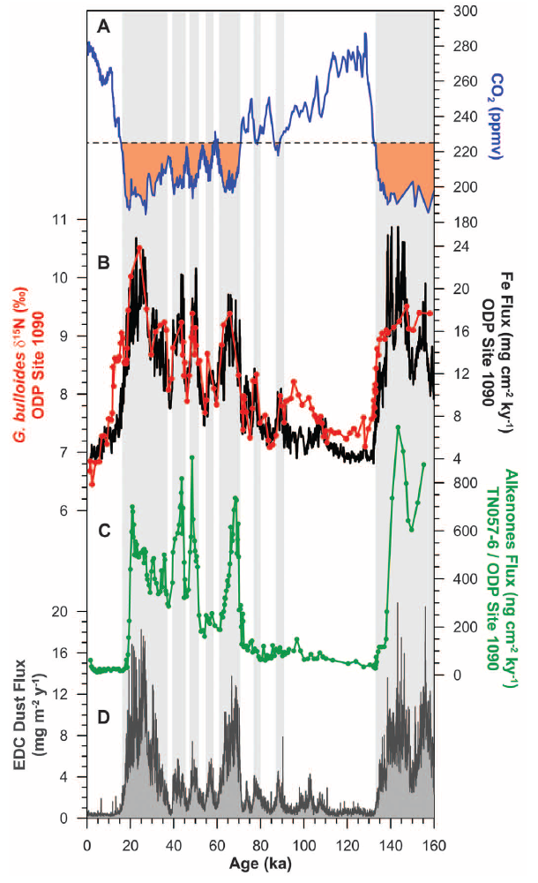
Mechanism During Cooling
CO₂
Iron Flux (black); δN¹⁵ in Globigerina bulloides (red)
Alkenones
EPICA Dome C Dust Flux
CO₂
Fe
Alfredo Martínez-García et al., “Iron Fertilization of the
Subantarctic Ocean During the Last Ice Age,”
Science 343, 1347 (2014).

Slide 11
Sequence
Before
Cooling
Desertification
“Peak glacial times and millennial cold events are characterized by increases in dust flux”
Fe-bearing dust fertilizes oceans
More phytoplankton consume more CO₂
Atmospheric CO₂ concentration decreases
After

Slide 12
Conclusion #1
Cooling preceded reduction of CO₂ concentration
Diminishing CO₂ concentration was NOT the cause of cooling during the descent into the last glacial period
The cause must come before the effect.

Slide 13
The Warming
What came first?
Warming?
CO₂?
Mechanism?

Slide 14
Mechanism During Warming
CO₂
Iron Flux (black); δN¹⁵ in Globigerina bulloides (red)
Alkenones
EPICA Dome C Dust Flux
CO₂
Fe
Alfredo Martínez-García et al., “Iron Fertilization of the
Subantarctic Ocean During the Last Ice Age,”
Science 343, 1347 (2014).

Slide 15
Garcia et al:
“A poleward migration of the Subantarctic Front upon deglacial warming would decrease the concentration and increase the δ¹⁵N of the nitrate being supplied to Site 1090 (16), both of which would work to raise FB-δ¹⁵N at a given rate of productivity and nitrate use. Thus, in the deglacial decrease in FB-δ¹⁵N associated with the waning of iron fertilization, frontal migration may yield pauses and/or reversals.”
In other words, when the earth warms, decreasing iron fertilization of the oceans leads to increasing CO₂.

Slide 16
Sequence
Before
Warming
Greening of deserts
Less Fe-bearing dust to fertilize oceans
Less CO₂ consumption by phytoplankton
CO₂ concentration increases
After

Slide 17
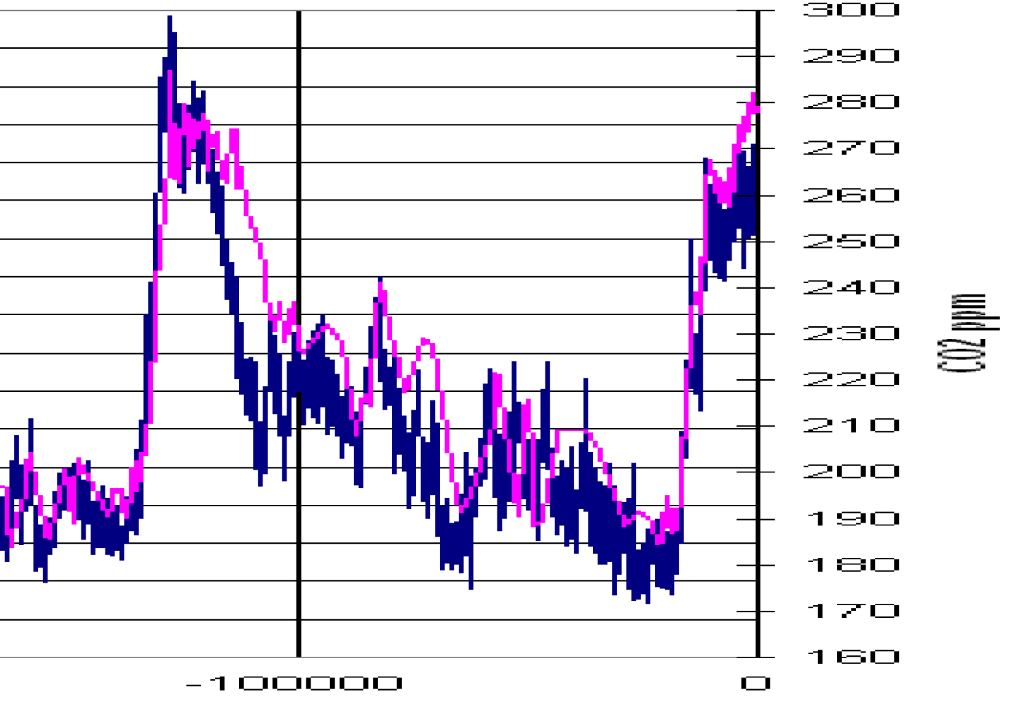
EPICA Ice Core
Temp: BLUE
CO₂: PINK
?

Slide 18
From two papers …
From Science :
“High-resolution records from Antarctic ice cores show that carbon dioxide concentrations increased by 80 to 100 parts per million by volume 600 ± 400 years after the warming of the last three deglaciations.” [emphasis added.]
Hubertus Fischer, Martin Wahlen, Jesse Smith, Derek Mastroianni, Bruce Deck, “Ice Core Records of Atmospheric CO₂ Around the Last Three Glacial Terminations,” Science, vol. 283. no. 5408, pp. 1712 – 1714 (12 March 1999)
See also Nicolas Caillon, Jeffrey P. Severinghaus, Jean Jouzel, Jean-Marc Barnola, Jiancheng Kang, Volodya Y. Lipenkov, “Timing of Atmospheric CO₂ and Antarctic Temperature Changes Across Termination III ,” Science, vol. 299, no. 5613, pp. 1728 - 1731 (14 March 2003)

Slide 19
From Another
“We find no significant asynchrony between them, indicating that Antarctic temperature did not begin to rise hundreds of years before the concentration of atmospheric CO₂, as has been suggested by earlier studies.”
F. Parrenin,* V. Masson-Delmotte, P. Köhler, D. Raynaud, D. Paillard, J. Schwander, C. Barbante, A. Landais, A. Wegner, J. Jouzel, « Synchronous Change of Atmospheric CO₂ and Antarctic Temperature During he Last Deglacial Warming, Science 339, 1 March 2013
Conflict! Conflict!

Slide 20
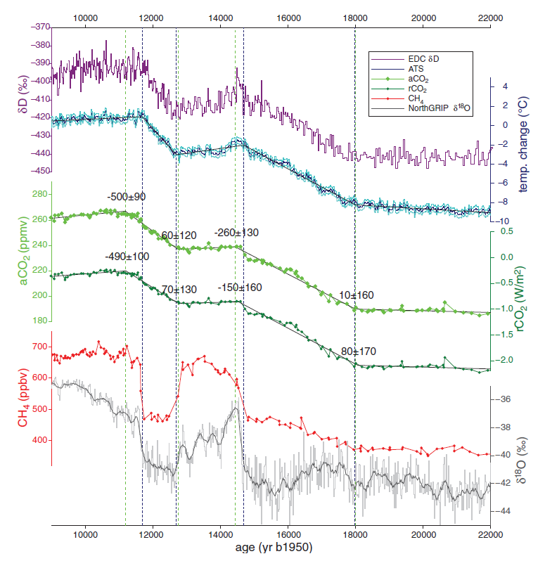
Temperature
CO₂
Parrenin Data
Concentration
“Forcing”

Slide 21
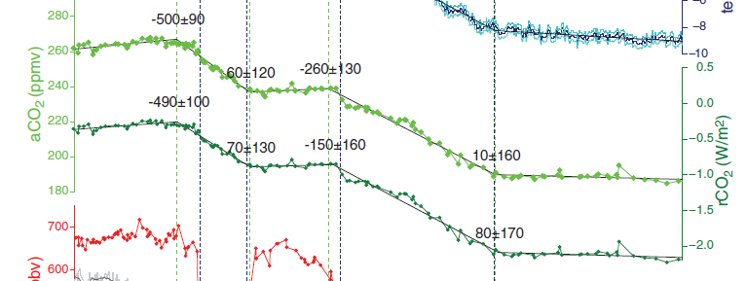
Parrenin et al, Continued
Temperature markers
Time lags
CO₂ Concentration
CO₂ “Forcing”
Negative means CO₂ increases come after temperature changes

Slide 22
Look at the Numbers
CO₂ Lags (years)
Temperature Lags (years)
260 ± 130
150 ± 160
500 ± 90
490 ± 100
10 ± 160
80 ± 170
60 ± 120
70 ± 130
Meaningless. Uncertainty ≥ value
Average of best data: CO₂ lags 417 ± 108 years (r.m.s.)

Slide 23
SUMMARY
All evidence for the last half-million to million years says that variations in CO₂ concentration have been come after temperature changes.
This is not to say that CO₂ is not a greenhouse gas. It is. But the warming effect was never enough to stave off glacial periods.

Slide 25
Temperature Record from Vostok
400,000 years
Interglacials
Ice ages

