Slide 1
IPCC’s Phony Evidence for AGW
S. Fred Singer, SEPP
ICCC-9. Las Vegas, NV
July 8, 2014
<singer@SEPP.org>

Slide 2
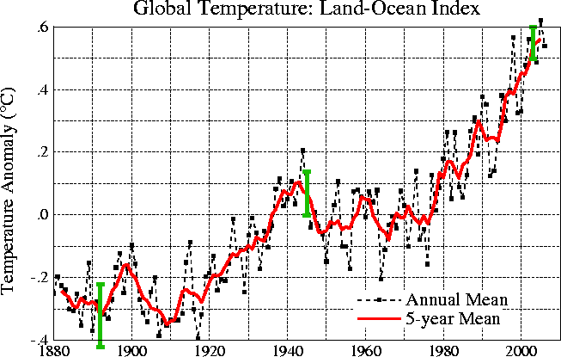
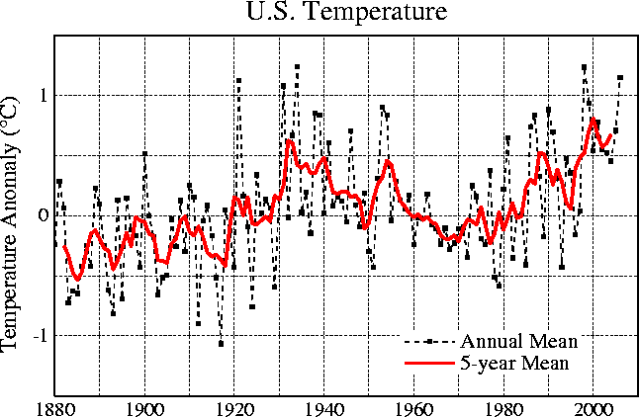
a.
b.
Notes:
Fig. 4
For all graphs:
http://data.giss.nasa.gov/gistemp/graphs/
World
http://data.giss.nasa.gov/gistemp/graphs/Fig.A2.lrg.gif
US
http://data.giss.nasa.gov/gistemp/graphs/Fig.D.lrg.gif
Other
http://data.giss.nasa.gov/gistemp/graphs/USHCN.2005vs1999.lrg.gif

Slide 3
IPCC Evidence changed for every AR
AssRpt Yr AGW Estim “Evidence”
AR1 1990 Lagged auto- correl of temp record
AR2 1996 50% Mfgd HotSpot
AR3 2001 >66% HockeyStick
AR4 2007 >90% Circ argument : gap betw
AR5 2013 >95% obs –GAST & unforced model (1970-2000)

Slide 4
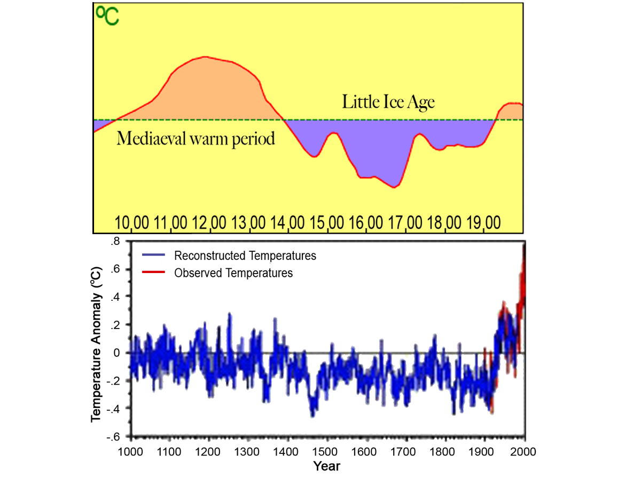
Comparison of Temperature History as Presented in First & Third IPCC Reports
Source : Hockey Stick? What Hockey Stick? How alarmist “scientists” falsely abolished the Mediaeval Warm Period, SPPO Commentary and Essay series. Page 3
Source : Nature, Not Human Activity, Rules the Climate: Summary for Policymakers of the Report of the Nongovernmental International Panel on Climate Change, Chicago, IL: The Heartland Institute, 2008. Figure 1
Notes:
Top figure from IPCC-AR1 (1990) Bottom figure from IPCC-AR3 (2001) – does away with MWP and LIA

Slide 5
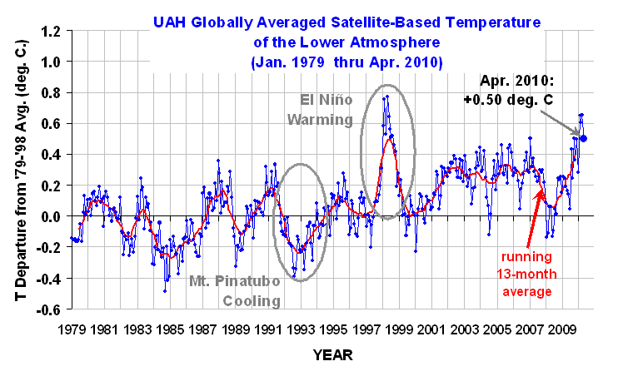
Temperature Changes from more than 30 Years of Satellite Observations
Source: drroyspencer.com/latest-global-temperatures
Notes:
In June 2009, the global temperatures dropped to the 30 plus year average then rose with the 2009-10 El Nino.
You will note the cooling by the Mt. Pinatubo volcano and the pronounced warming of the 1998 El Nino year and the current El NIno. In its calculations of natural influences the IPCC included volcanoes but excluded El Ninos which overestimates the influence of man.

Slide 6
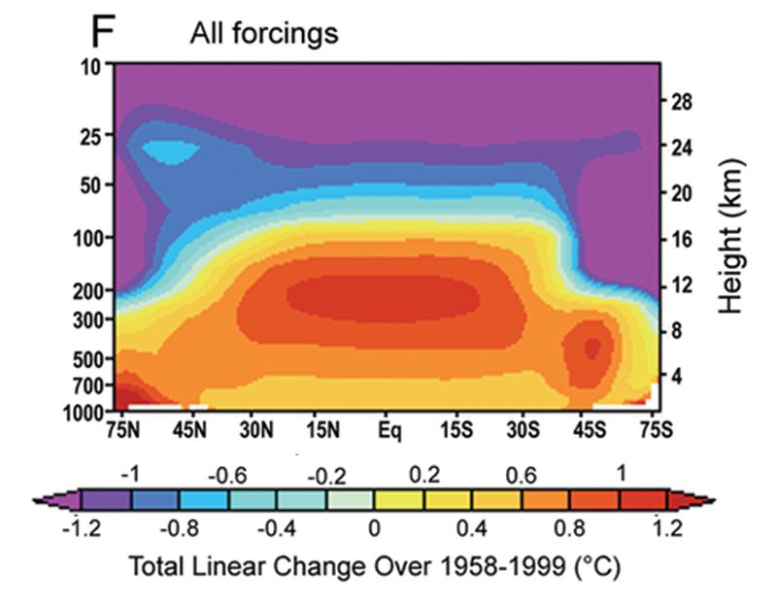
CCSP 1.1 – Chapter 1, Figure 1.3F PCM Simulations of Zonal-Mean Atmospheric Temperature Change
Notes:
Fig. 7: GH-model-predicted temperature trends versus latitude and altitude [this is figure 1.3F from CCSP 2006, p.25]. Note increasing trends in tropical mid-troposphere.
All GH models show an amplification of temp trends with altitude. Up to about a factor 3.0 over equator at 10 km
Note that 1958 was a cool year; the increase since 1979 is much smaller
Also note; Little variation with latitude in surface trends. NH is about the same as SH. But warming in both polar regions

Slide 7
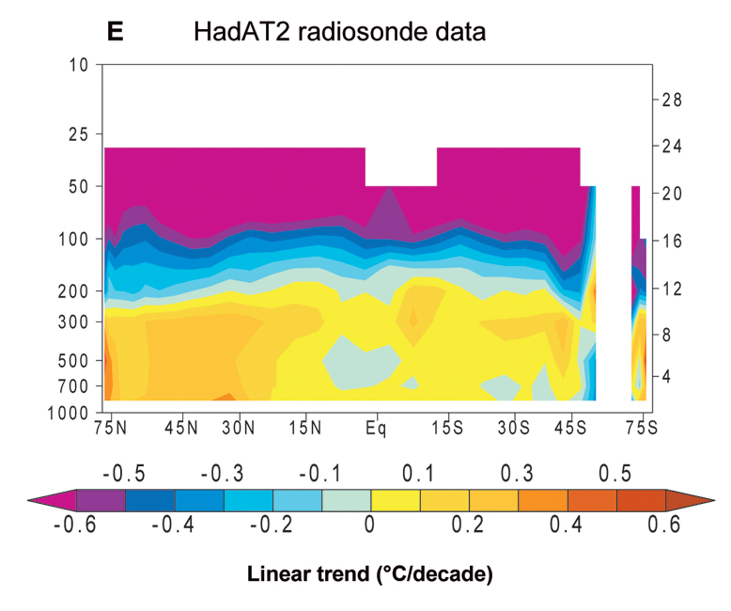
CCSP 1.1 – Chapter 5, Figure 7E
Notes:
Fig. 8: Observed temperature trends versus latitude and altitude [this is figure 5.7E from CCSP 2006, p.116]. Note absence of increasing trends in tropical mid-troposphere.

Slide 9
