Slide 1

Earth’s Future Biosphere: Key Findings of Climate Change Reconsidered II, Biological Impacts
Dr. Craig D. Idso, Lead Author/Editor
Nongovernmental International Panel on Climate Change (NIPCC)
www.nipccreport.org

Slide 2
IPCC Position
Human activities, especially the burning of fossil fuels, are increasing the carbon dioxide content of the atmosphere
Rising CO₂ concentrations will lead to …
  Catastrophic global warming
  Numerous undesirable consequences
  Little to no positive effects.
The NIPCC disagrees with many aspects of the IPCC position (www.nipccreport.org)

Slide 3
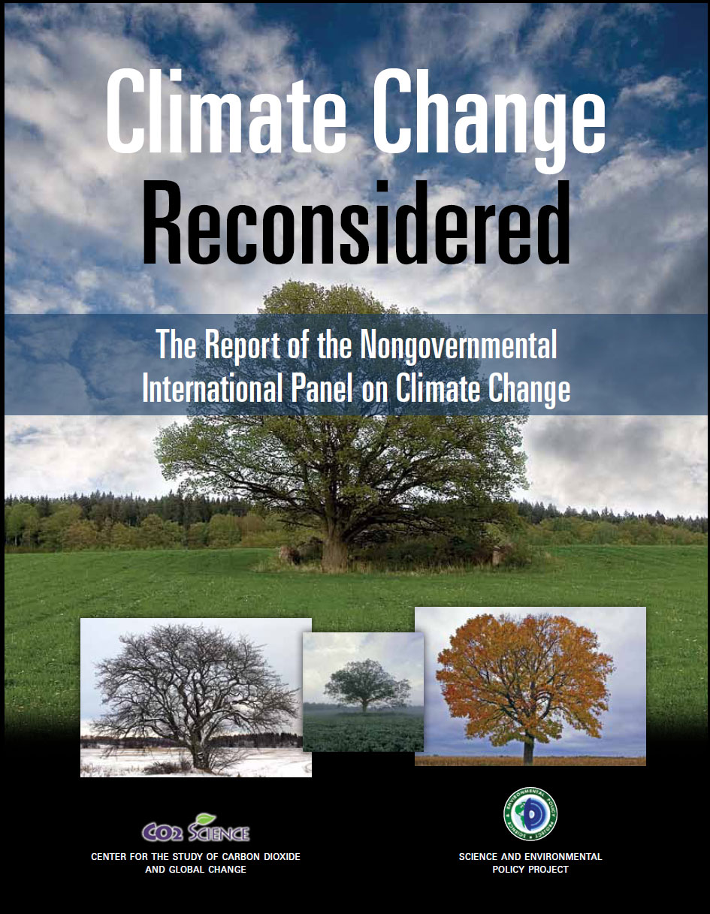
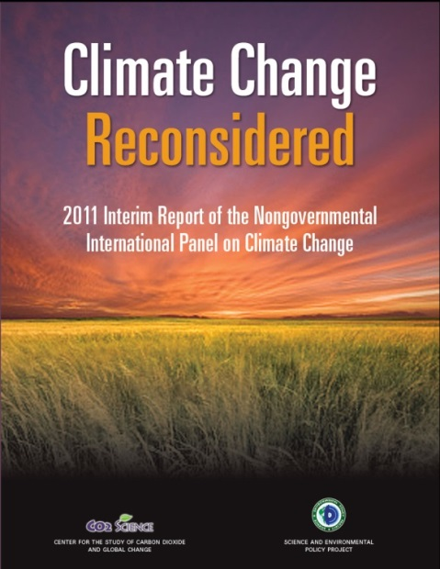
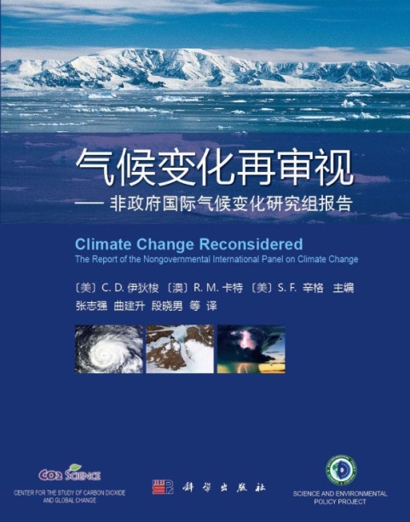
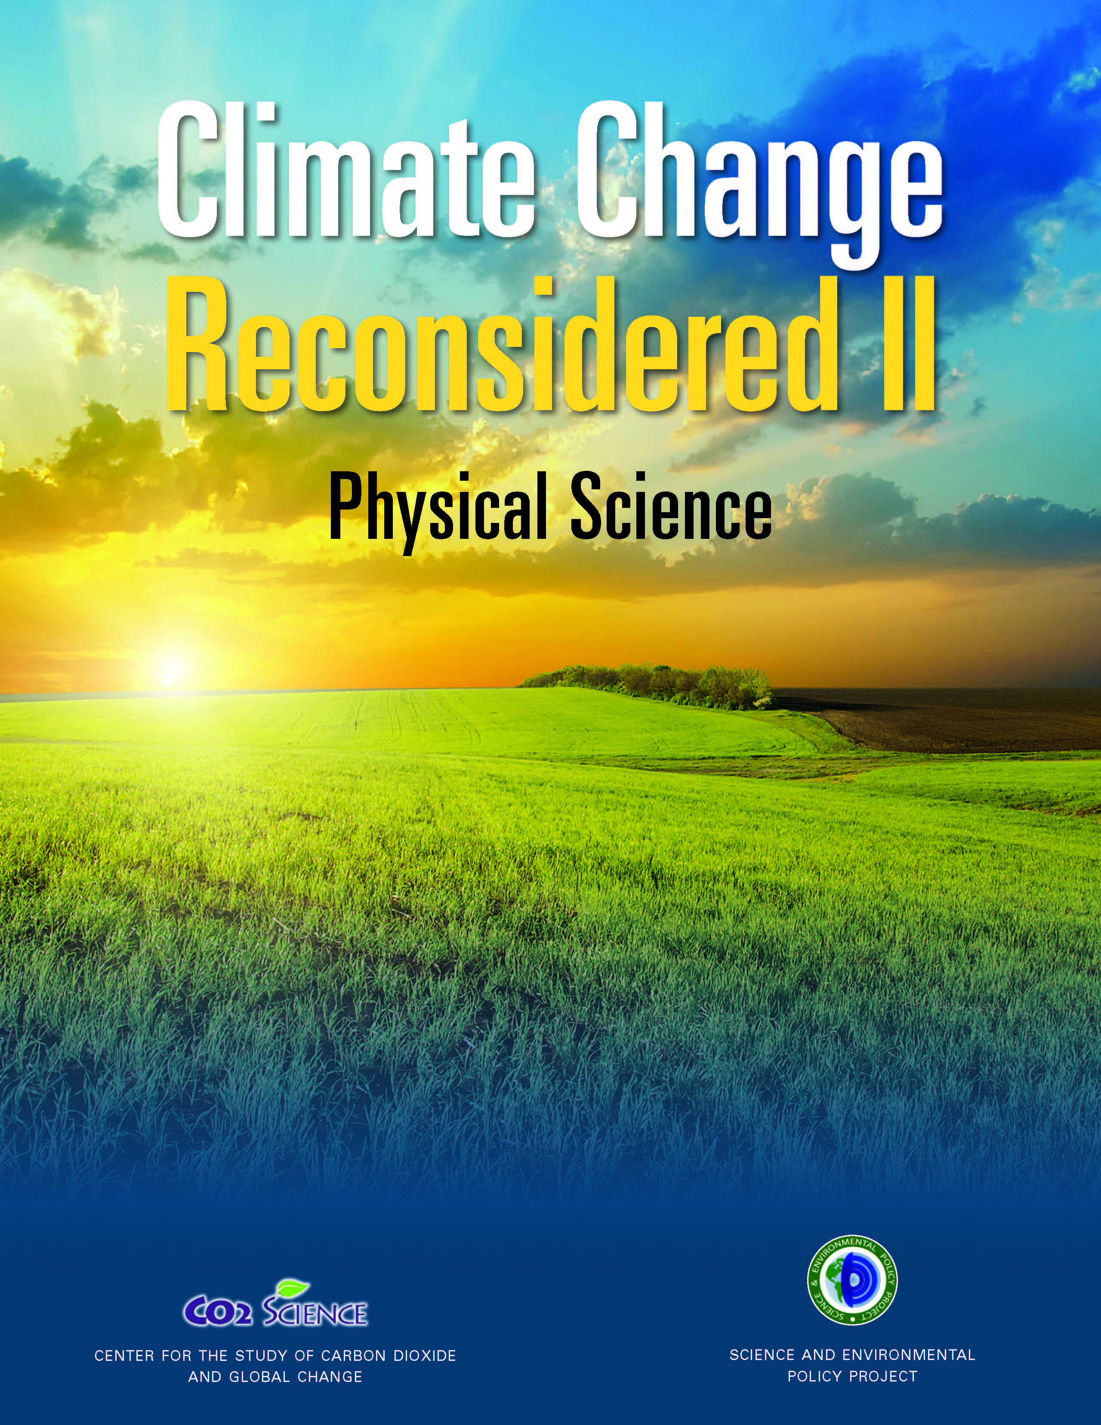
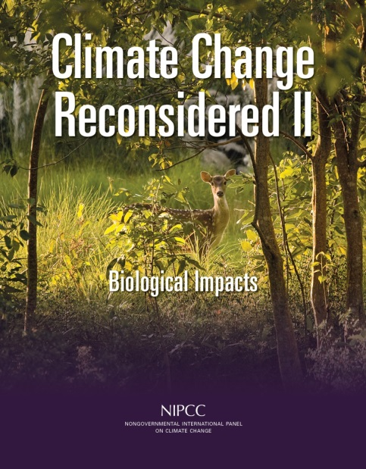
The Climate Change Reconsidered Reports

Slide 4
CCR2 Volume 2: Physical Science
No dangerous human influence in Earth’s climate.
This finding is sufficient to dismiss nearly all of the negative climate-related impacts predicted by IPCC WGII.
Nevertheless, there is a huge body of literature on the biological impacts of rising temperatures and atmospheric CO₂ levels that the IPCC ignores

Slide 5
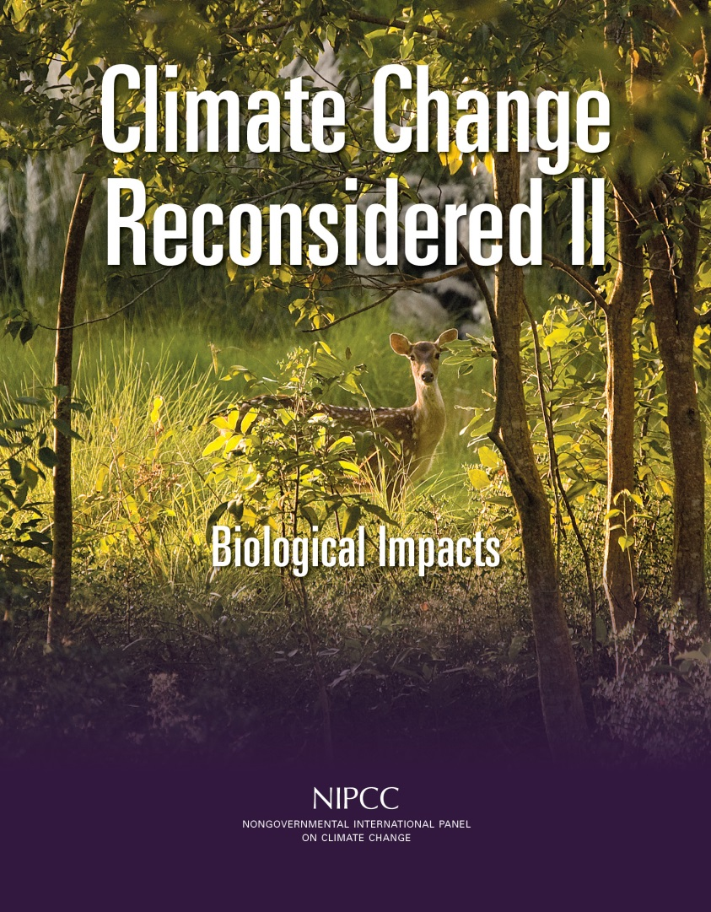
CCR2 Volume 2: Biological Impacts
37 authors, contributors and reviewers from 12 countries
7 Chapters
1062 pages
Thousands of peer-reviewed journal references
Reporting the science the IPCC ignores

Slide 6
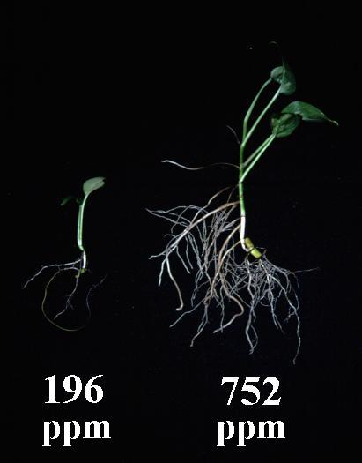
Chapter 1: CO₂, Plants, and Soils
Atmospheric CO₂ is NOT a pollutant

Slide 7
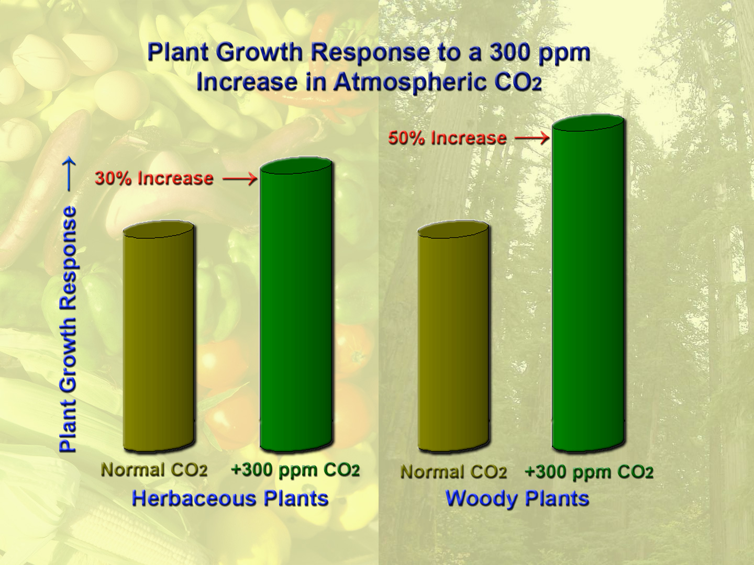
Chapter 1: CO₂, Plants, and Soils
Elevated levels of CO₂ increase the biomass and productivity of nearly all plants and ecosystems

Slide 8
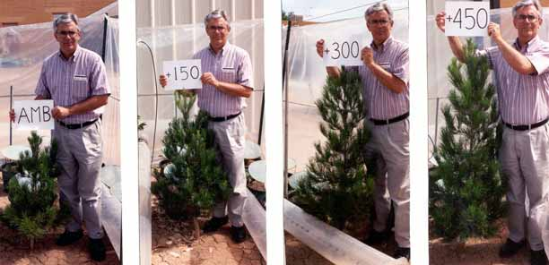

Slide 9
Chapter 2: Plant Characteristics
In addition to plant productivity and biomass, atmospheric CO₂ enrichment enhances numerous other plant characteristics
  34 discussed in Chapter 2

Slide 10
Water Lily CO₂ Experiment Example
Normal Air (350 ppm)
  Emerged on time
  Smaller leaves
  Less leaf dry matter
Elevated CO₂ Air (650 ppm)
  Emerged on time
  Larger leaves
  More leaf dry matter (68% more)

Slide 11
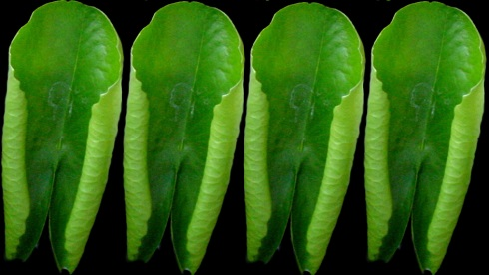
Ambient vs Elevated CO₂ Results
Normal Air (350 ppm)
  Fewer leaves
  Shorter growing season
Elevated CO₂ Air(650 ppm)
  More leaves (75% more)
  Longer growing season

Slide 12

Ambient vs Elevated CO₂ Results
Normal Air (350 ppm)
  Less flowers, less substantial
  Less flower and leaf stem dry matter
Elevated CO₂ Air (650 ppm)
  More flowers (twice as many, more petals, longer petals, weighed more)
  More flower and leaf stem dry matter (60% more)

Slide 13

Ambient vs Elevated CO₂ Results
Normal Air (350 ppm)
  Produced fewer major roots
  Produced less total below-ground dry matter
Enriched CO₂ Air (650 ppm)
  Produced more major roots (3.2 times more)
  Produced more total below-ground dry matter (4.3 times greater)

Slide 14

Elevated CO₂ also enhances health-promoting (nutritional) properties of foods and medicinal properties of plants.

Slide 15
Chapter 3: Plants Under Stress
Atmospheric CO₂ enrichment reduces the negative effects of a number of environmental plant stresses
  high salinity
  low light
  high and low temperatures
  insufficient water
  air pollution
  herbivory
  etc.

Slide 16
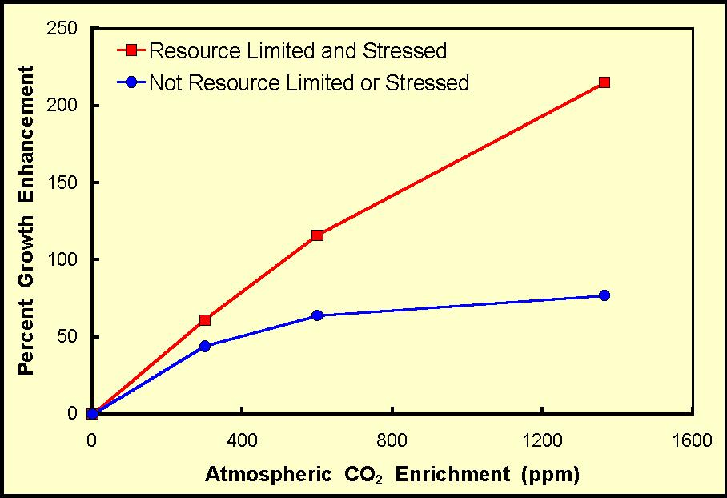

Slide 17
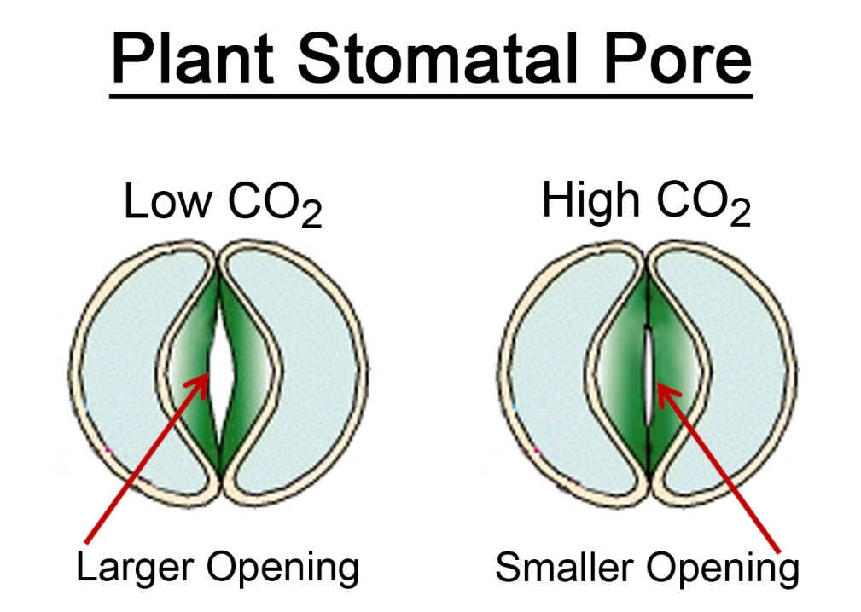
Adding CO₂ to the Atmosphere Reduces Plant Water Stress
Plant water use efficiency (WUE) -- the amount of biomass produced per unit of water lost -- is
enhanced at high CO₂
The result is a
reduction in water
loss via transpiration,
thus increasing plant
WUE by as much as 70-100%

Slide 18
Adding CO₂ to the Atmosphere Reduces Plant Water Stress
Water Use Efficiency Benefits
  Can produce the same amount of crop yields using less water
  Plants will be able to grow and reproduce where it has previously been too dry to exist
  Win back lands lost previously to desertification
  Greater vegetative cover can reduce adverse effects of soil erosion

Slide 19
Adding CO₂ to the Atmosphere Ameliorates High Temperature Stress
The beneficial effects of atmospheric CO₂ enrichment typically rise with an increase in air temperature.
  Higher atmospheric CO₂ concentrations typically boosts the optimum temperature for plant photosynthesis by several degrees Centigrade
  Higher CO₂ raises the temperature at which plants experience heat-induced death

Slide 20
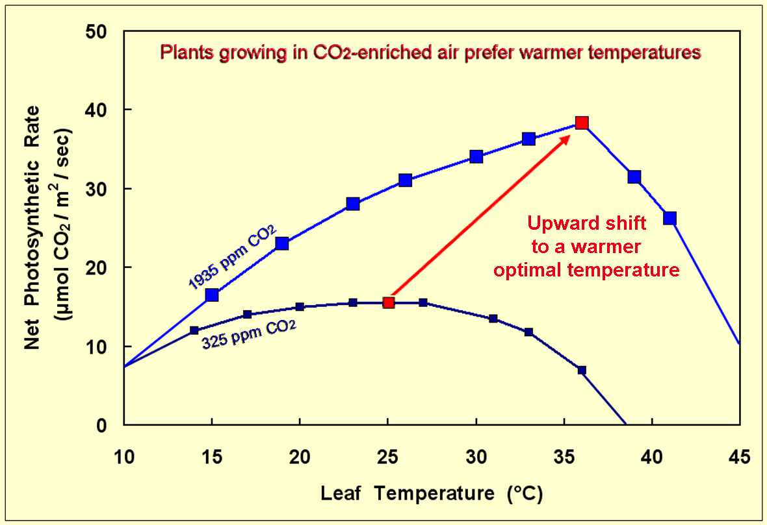

Slide 21
Adding CO₂ to the Atmosphere Ameliorates Environmental Stresses
Earth’s plants will likely not be eliminated from large portions of their current natural habitats in a CO₂-enriched world of the future
The NIPCC foresees a likely great CO₂-induced proliferation of regional biodiversity, as opposed to extinctions of species globally
  There is much evidence from the peer-reviewed scientific literature to support such an outcome…

Slide 22
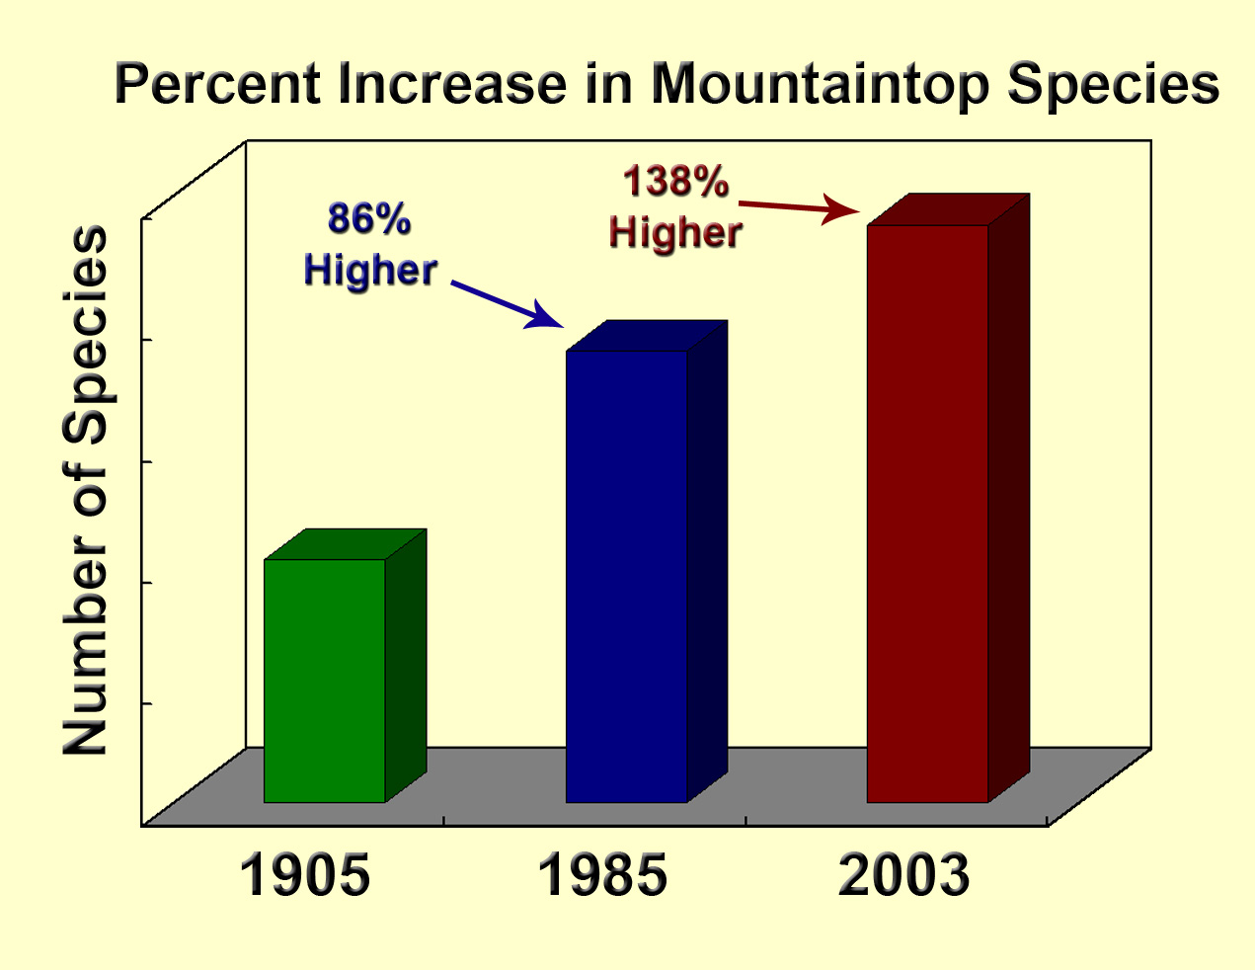
Change in Mountaintop Species of the Swiss Alps

Slide 23

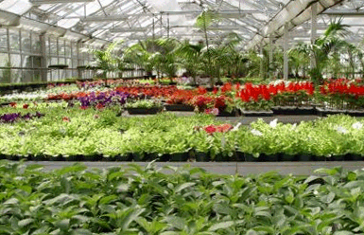

Chapter 4: Earth’s Vegetative Future
Rising temperatures and atmospheric CO₂ levels have benefited historic food production ($3 trillion in past 50 yrs) and will continue to do so in the future.
Without the yield-enhancing benefits of CO₂ enrichment on agriculture, world food supply could fall short of world food demand by the year 2050

Slide 24
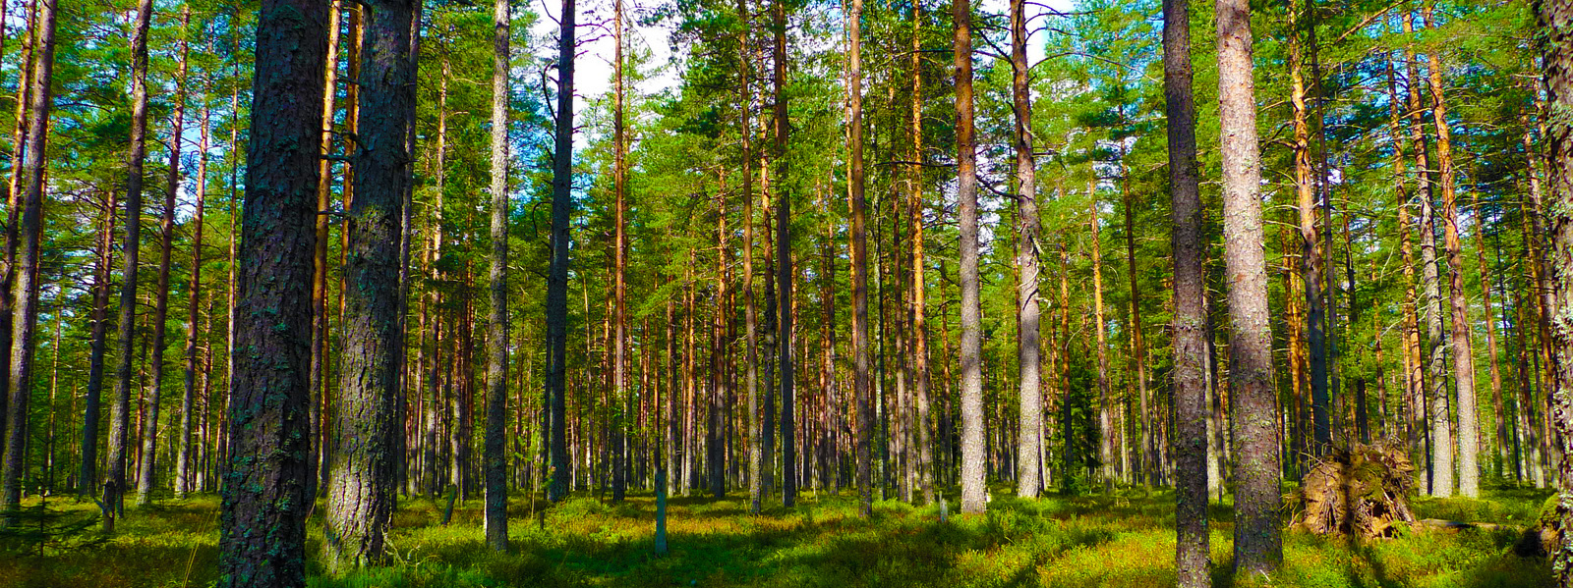
Chapter 4: Earth’s Vegetative Future
The ongoing rise in the air’s CO₂ content is causing a great greening of the Earth.

Slide 25
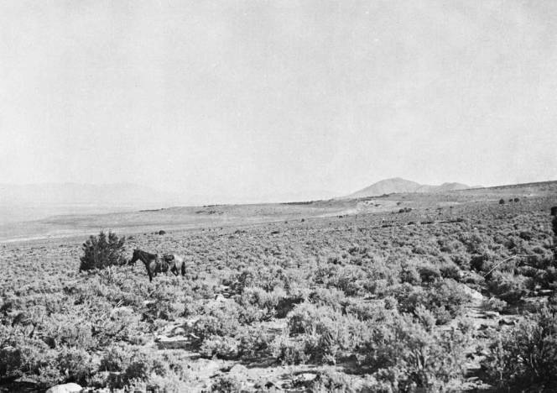
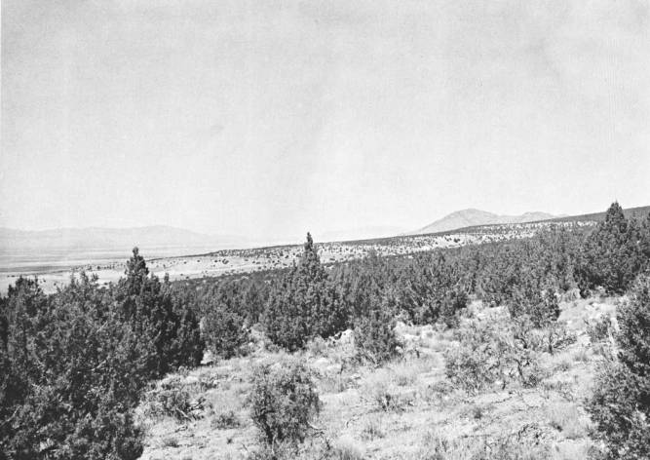
Repeat Photos of Section 13, T4S,R8W, Utah
1901
1976
Juniper trees have greatly expanded their range

Slide 26
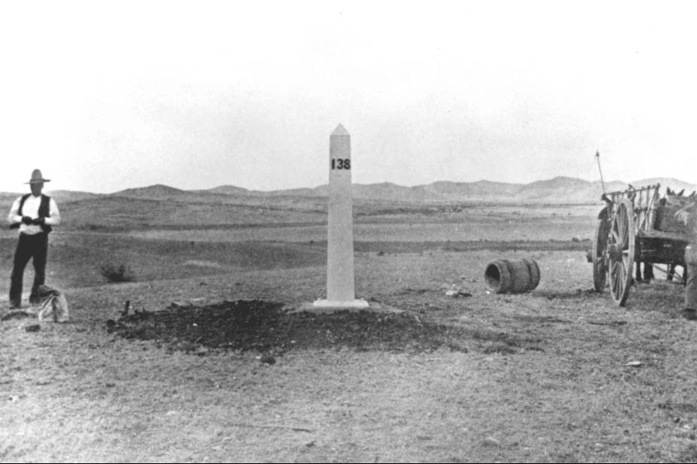
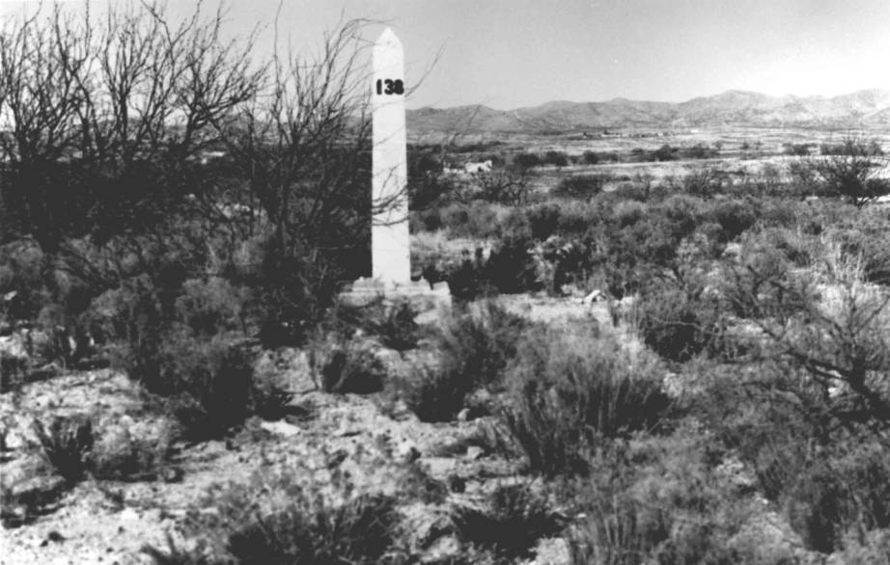
Repeat Photographs Taken Near Sasabe, AZ
1893
1984
Devoid of shrubs in 1893, this area now boasts significant
populations of mesquite, ocotillo, mimosa, snakeweed
and burroweed

Slide 27
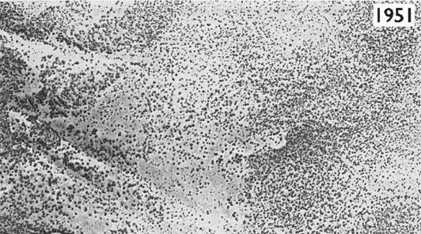
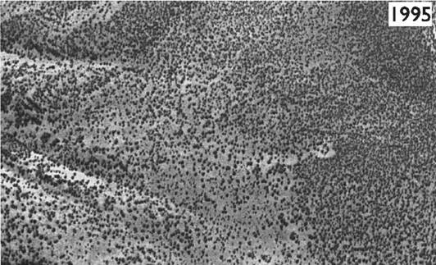
Horse Ridge Natural Research Area,
Central Oregon
1951
1995
1:15,840 aerial photographs reveal extensive increase
in tree cover

Slide 28
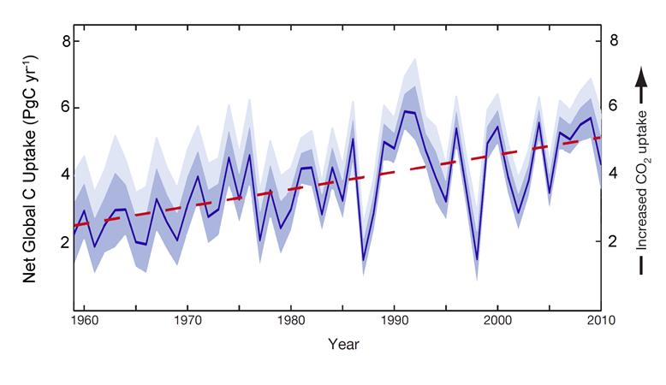
Annual global net carbon (C) uptake by Earth’s lands and oceans (1959-2010)
Source: Ballantyne et al. (2012).

Slide 29
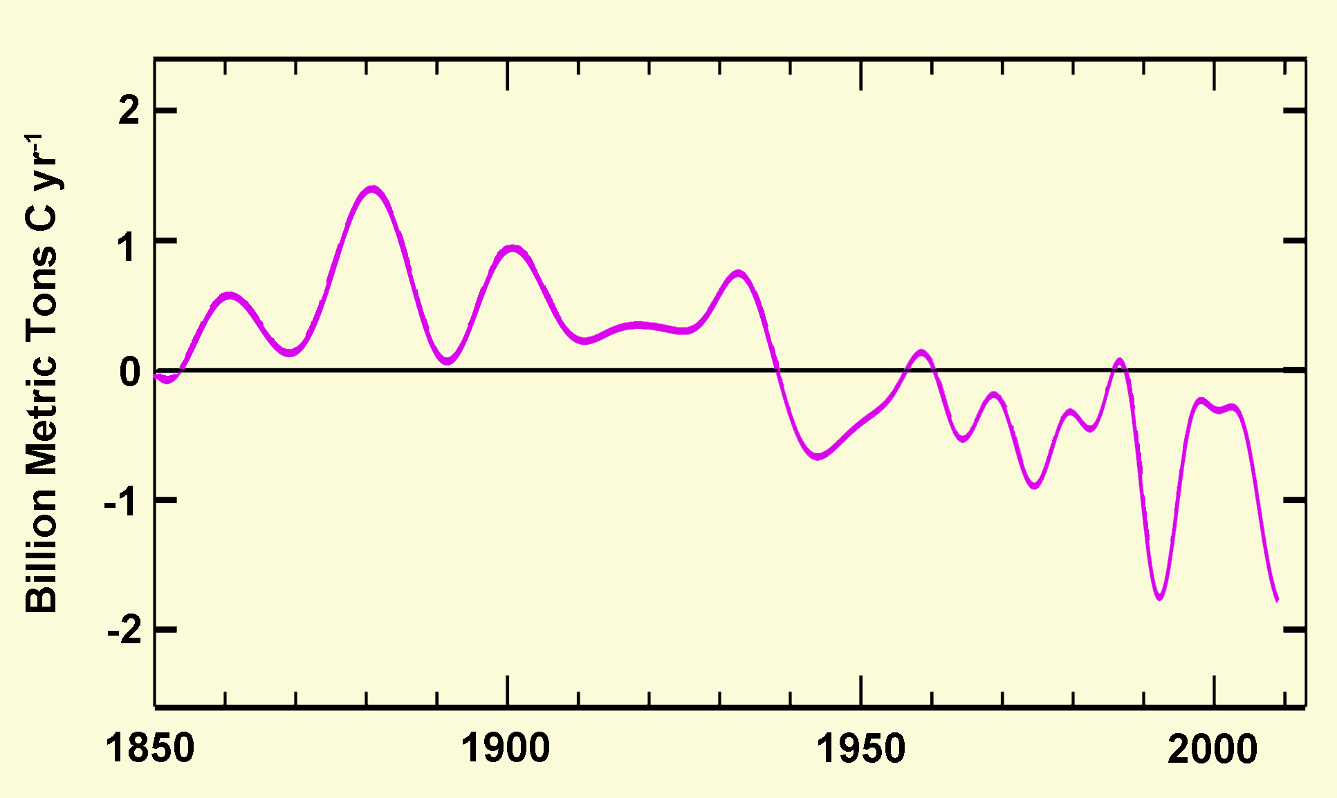
Earth’s land surfaces were a net source of CO₂-carbon to the atmosphere until about 1940.
Source: Five-year smoothed rates of carbon transfer from land to air (+) or from air to land (-) vs. time. Adapted from Tans (2009).

Slide 30
Chapter 4: Earth’s Vegetative Future
The observed CO₂-induced stimulation of growth has occurred all across the globe in spite of many real and imagined assaults on Earth’s vegetation, including fires, disease, pest outbreaks, deforestation, and climatic change!

Slide 31
Chapter 5: Terrestrial Animals
Rising temperatures and atmospheric CO₂ levels do not pose a significant threat to terrestrial animals.
  Empirical data show that warmer temperatures and rising levels of atmospheric CO₂ tend to foster the expansion and proliferation of animal habitats, ranges, and populations, or they otherwise have no observable impacts one way or the other.

Slide 32
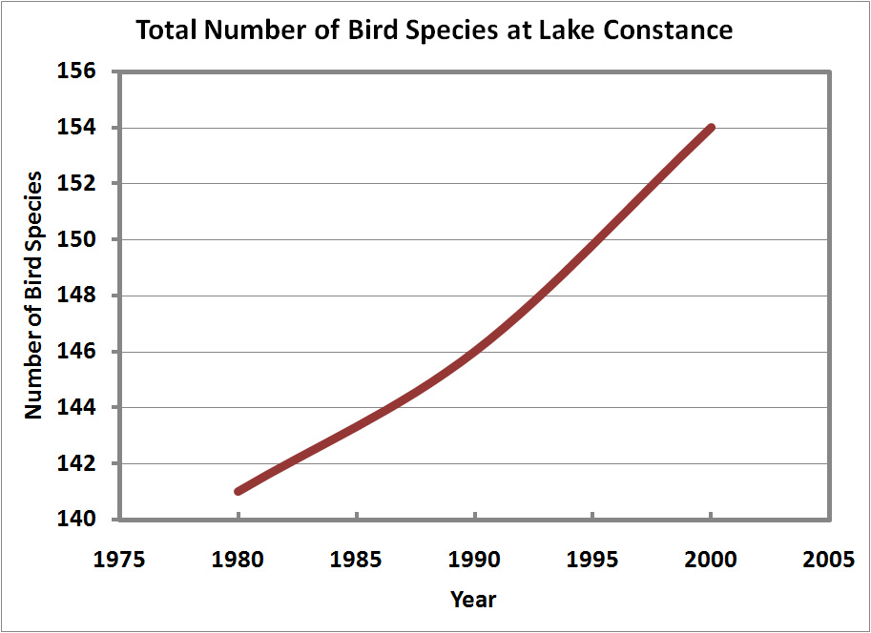
Chapter 5: Terrestrial Animals
  Multiple lines of evidence indicate animal species are adapting, and in some cases evolving, to cope with climate change of the modern era.

Slide 33
Evolution May Also Play a Significant Role in Helping Animals Adapt to Climate Change
Animals (and plants) can evolve over much shorter periods of time than was previously thought possible
  populations have undergone localized microevolution in thermal tolerance, temperature-specific development rate, and thermal preference in very few years
  insects have shown marked changes in thermal tolerance after a handful of generations

Slide 34

Chapter 6: Aquatic Life
Rising temperatures and atmospheric CO₂ levels do not pose a significant threat to aquatic life.

Slide 35
Chapter 6: Aquatic Life
  Many aquatic species have shown considerable tolerance to temperatures and CO₂ values predicted for the next few centuries, and many have demonstrated a likelihood of positive responses in empirical studies.
  Any projected adverse impacts of rising temperatures or declining seawater and freshwater pH levels (“acidification”) will be largely mitigated through adaptation or evolution during the many decades to centuries it is expected to take for pH levels to fall.

Slide 36
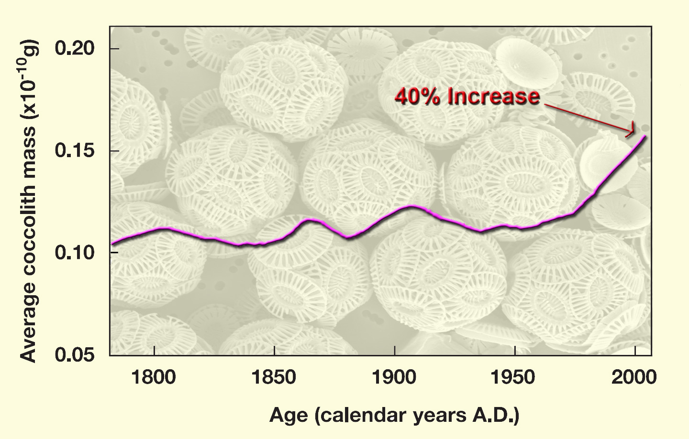
Claims of great harm to marine organisms via ocean acidification are largely overstated
Source: Iglesias-Rodriguez et al., 2008. Science 320: 336-340
In spite of rising CO₂ (declining pH) and temperature

Slide 37
Chapter 7: Human Health and Welfare
A modest warming of the planet will result in a net reduction of human mortality from temperature-related events.

Slide 38
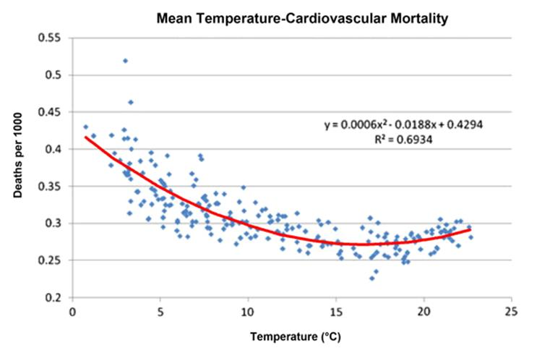
Monthly deaths in the Castile-Leon region of Spain attributable to cardiovascular disease
Source: Fernandez-Raga et al. (2010).

Slide 39
Earth’s Future Biosphere: Key Findings of Climate Change Reconsidered II, Biological Impacts
Dr. Craig D. Idso, Lead Author/Editor
Nongovernmental International Panel on Climate Change (NIPCC)
www.nipccreport.org

Slide 40
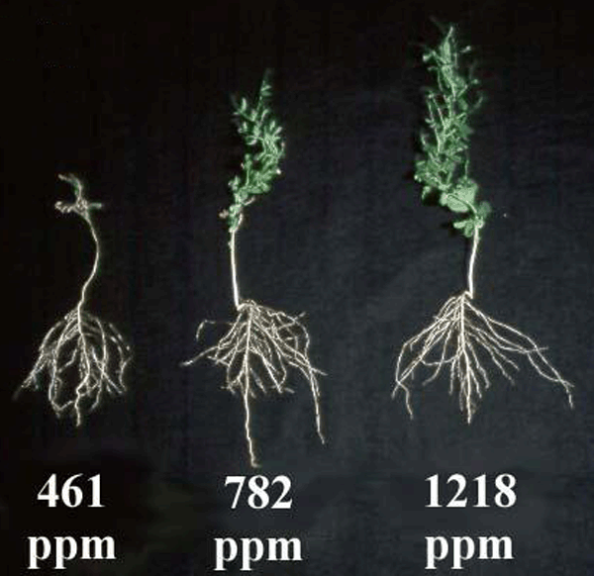

Slide 41
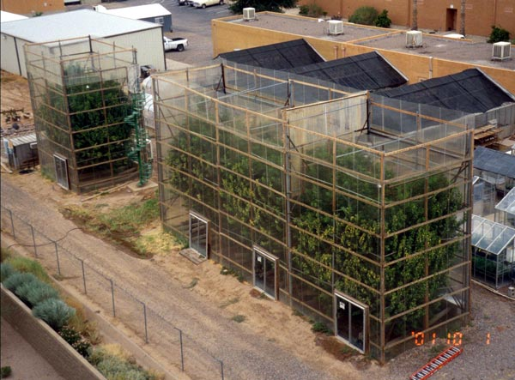

Slide 42
Other Reasons to Suggest Ocean Acidification Will be a Non-Problem
The responses of other entities and processes within a marine community have the potential to buffer the negative impacts of ocean acidification on neighboring organisms

Slide 43
Other Reasons to Suggest Ocean Acidification Will be a Non-Problem
Models are focused on changes in bulk water chemistry that do not represent conditions actually experienced by marine organisms, which are separated from the bulk water of the ocean by a diffusive boundary layer

Slide 44
Other Reasons to Suggest Ocean Acidification Will be a Non-Problem
Essentially all forms of marine life have the inherent genetic capacity to adapt and evolve
Nearly all studies to date have been conducted over short timeframes and therefore cannot adequately address the well-known influence of adaptation or evolution

