Slide 1
Is Global Warming Causing Extreme Events?
Anthony R. Lupo
Department of Soil, Environmental, and Atmospheric Science
302 E ABNR Building
University of Missouri
Columbia, MO 65211
Seventh International Climate Change Conference, Chicago, IL 21- 23 May, 2012

Slide 2
Outline
Introduction / Background
Tropical Cyclones
The 2010 Russian Drought
March 2012
Summary and Conclusions

Slide 3
Introduction
Extreme Events – What are they?
Temperature / precipitation: statistically these are occurrences in the tail(s) of a one(two) tail probability distribution or record setting events, and could be defined using return period.
Events causing human casualties and/or contributing to economical disasters. (e.g. tornadoes, floods, hurricanes, drought, etc..)

Slide 4
Introduction
During 2011: the USA suffered 14 One Billion dollar disasters.
(see http://www.noaa.gov/extreme2011/index.html)
Often, these events are cited as evidence that the climate system has moved into a new regime, likely because of human activities, or that such an event is has not been observed in the modern era.

Slide 5
Introduction
The state of Missouri was impacted by two of these 14 events during 2011. The Missouri/Mississippi River Floods, and the Joplin Tornado.
The USA was not the only place where extreme weather was found in 2011 and into 2012 (e.g., extreme cold in Europe and Alaska).

Slide 6
Background
There is no one cause that can be ascribed to the occurrence of extreme events. These can be said to be the result of:
extreme atmospheric / climatic forcing processes
the prolonged occurrence of events that are typically thought of as quiescent.

Slide 7
Background
Extreme storms / storminess: caused by global warming?
The General Circulation is driven by unequal heating (and as a consequence unequal mass distributions) across the globe due to mainly latitude and topography.

Slide 8
Background
Anthropogenic Global Warming (e.g., IPCC) will warm the artic regions faster, and the upper troposphere faster (“hot spot”).
Wouldn’t both actions slow down the General Circulation? Wouldn’t this make extreme storminess less likely?

Slide 9
Tropical Cyclones
Some studies maintain that human induced warming will cause / is causing an increase in tropical cyclone activity.
Lupo (2011) examined the global trends in tropical cyclones looking at individual basins as far back as there were reliable records.

Slide 10
Tropical Cyclones
a = total hurricane occurrences b = tropical storms only

Slide 11
Tropical Cyclones
Global tropical cyclone frequencies across the decades.
Category | 1970-89 | 1990-1999 | 2000-2009 | All
TS | 40.2 | 36.2 | 43.1 | 39.9
Cat 1-2 | 25.5 | 26.6 | 20.9 | 24.6
Cat 3-5 | 19.0 | 25.3 | 23.3 | 21.7
Cat 4-5 | 9.8 | 18.1 | 16.7 | 13.6
Total hur. | 44.5 | 51.9 | 44.2 | 46.3
Total TS+hur | 84.7 | 88.1 | 87.3 | 86.2

Slide 12
2010 Russian Drought
The hot summer of 2010 set many high temperature records during July and August 2010 over Eastern Europe and western Russia. (Lupo at al., 2012).
It was estimated over 50,000 Russian people perished due to the heat, pollution, and forest fires. (Russian Academy of Sciences).

Slide 13
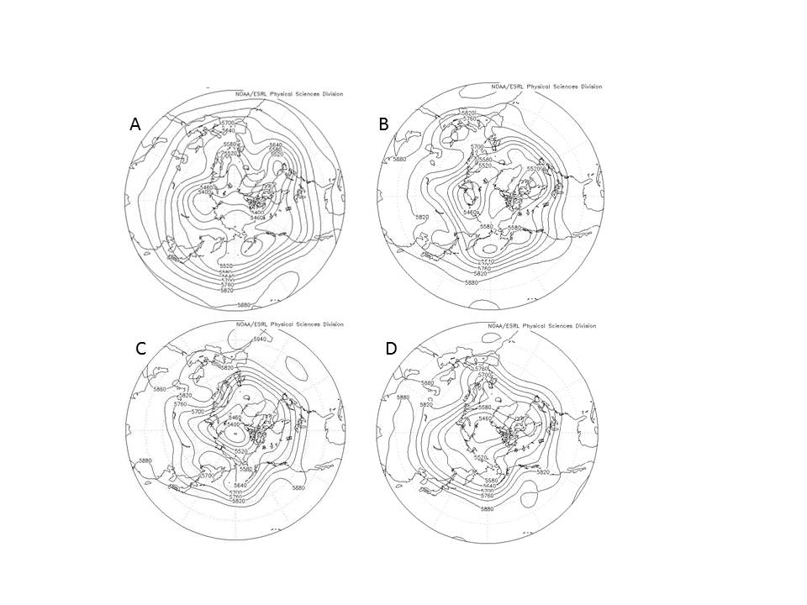
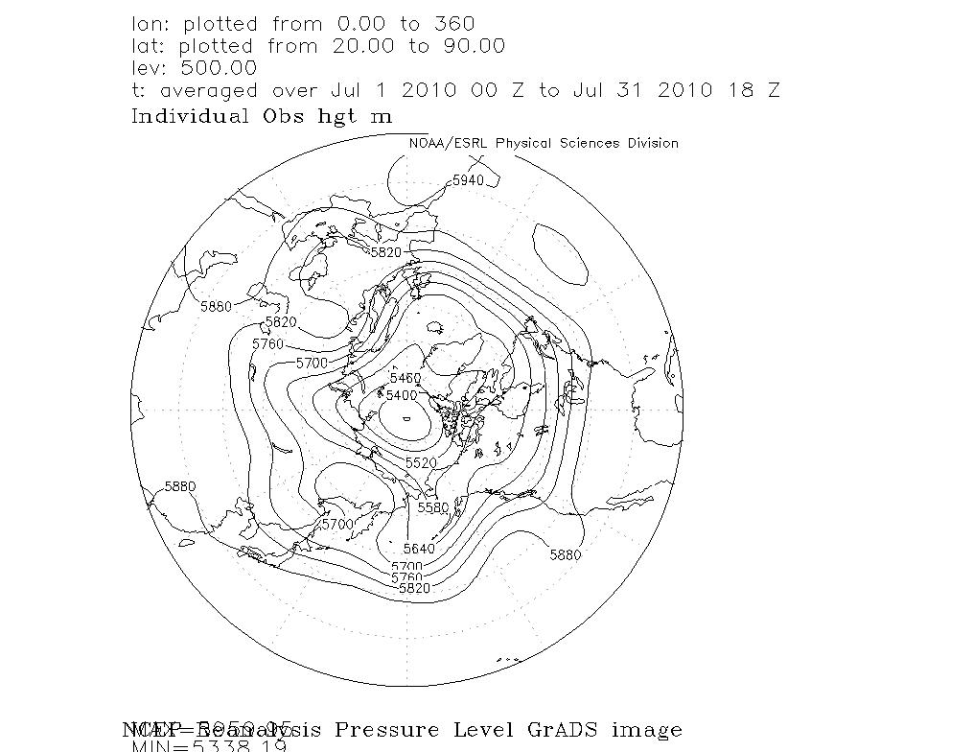
2010 Russian Drought
Caused by prolonged blocking occurring over the region during May – August.

Slide 14
2010 Russian Drought
Strong, long lived, blocking events compared to typical and warm season blocking.
Our study has shown that more spring season blocking can be linked to drought in western Russia
Event | Onset / Termination | Duration | Intensity | Formation (longitude)
1 | 12Z 2 May / 00Z 24 May | 21.5 | 3.08 | 40 E
2 | 00Z 22 June / 00Z 28 June | 6.0 | 1.69 | 50 E
3 | 00Z 4 July / 00Z 30 July | 26.0 | 2.44 | 20 E
4 | 12Z 31July / 00Z 16 August | 15.5 | 2.50 | 45 E
S | N/A | 7.6 | 2.13 | N/A
T | N/A | 8.2 | 3.04 | N/A

Slide 15
2010 Russian Drought
Research in blocking has demonstrated summer season blocking is dominated by large-scale processes, whereas cold season blocking strongly depends on synoptic-scale transients.
What about the blocking events contributing to the Russian drought?

Slide 16
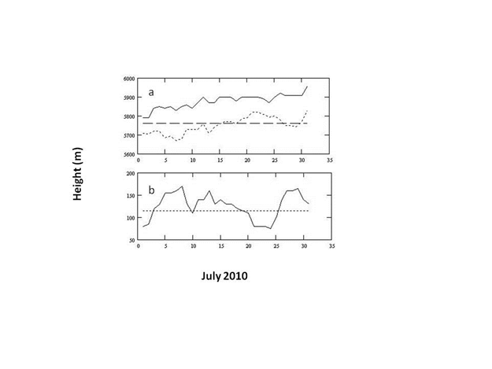
2010 Russian Drought
Block center point height diagnostic (a = total and planetary-scale, b = synoptic-scale) from Hussain and Lupo (2010).

Slide 17
March 2012
March 2012 was unusually warm across much of the USA, and in Missouri was about 8.5 ºC above normal. How unusual was it?
The warmest March in over 120 years of records. It was the largest warm anomaly for any month except December 1889 (about +9.5 ºC)

Slide 18
March 2012
An initial examination of the causes center on;
The preceding winter months warm and dry
La Nina, and a strongly positive Arctic Oscillation
strong ridging over central North America

Slide 19
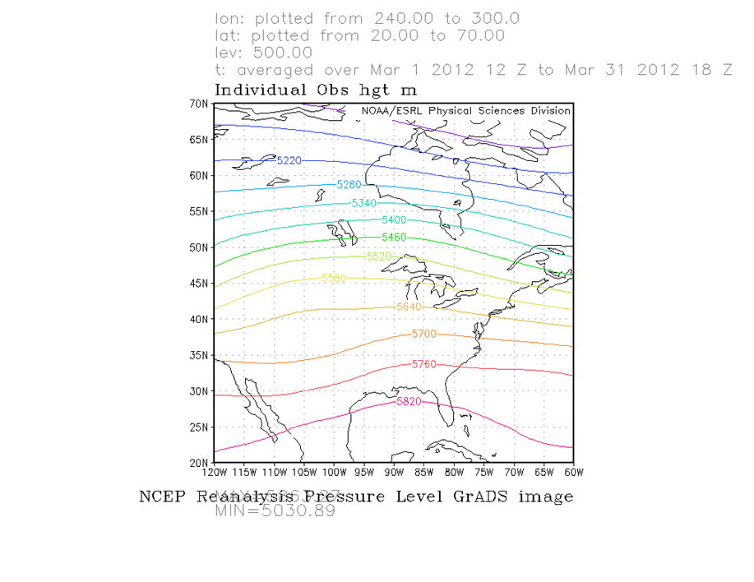
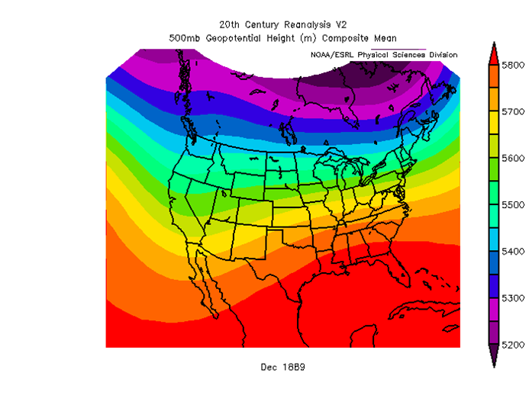
March 2012
December 1889 March 2012

Slide 20
Summary and Conclusions
Using tropical cyclones as an example here, there is little evidence that the occurrence of event-driven extreme events are on the increase due only to climate and climate change in the latter part of the 20th century.
Events such as drought have occurred and will continue to occur in Eastern Europe and western Russia, historically we can link drought to blocking.

Slide 21
Summary and Conclusions
There is little evidence that extreme events occurring recently are events that are previously unknown.
Climate change in either direction will cause changes in the frequency of extreme events regionally, and globally.

Slide 22
Summary and Conclusion
Questions
Comments
Criticisms
Lupoa@missouri.edu

