Slide 1

ICCC-7 Heartland Institute
7th International Conference on Climate Change, May 21, 2012

Slide 2
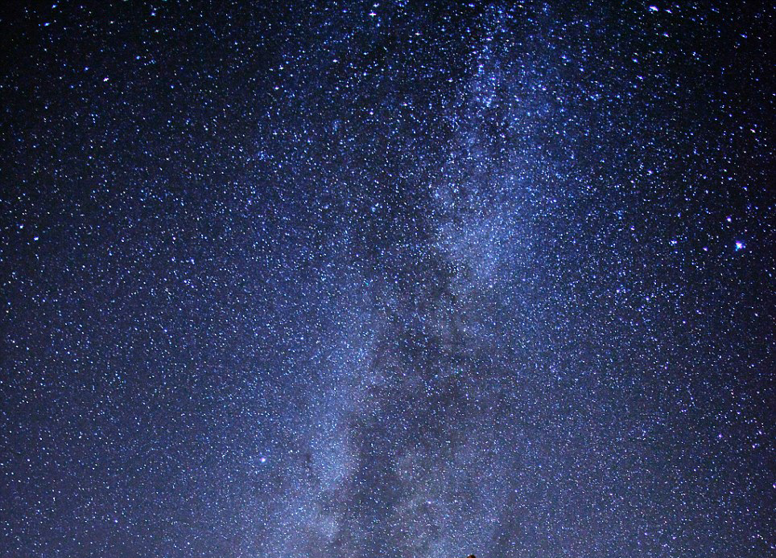

Slide 3
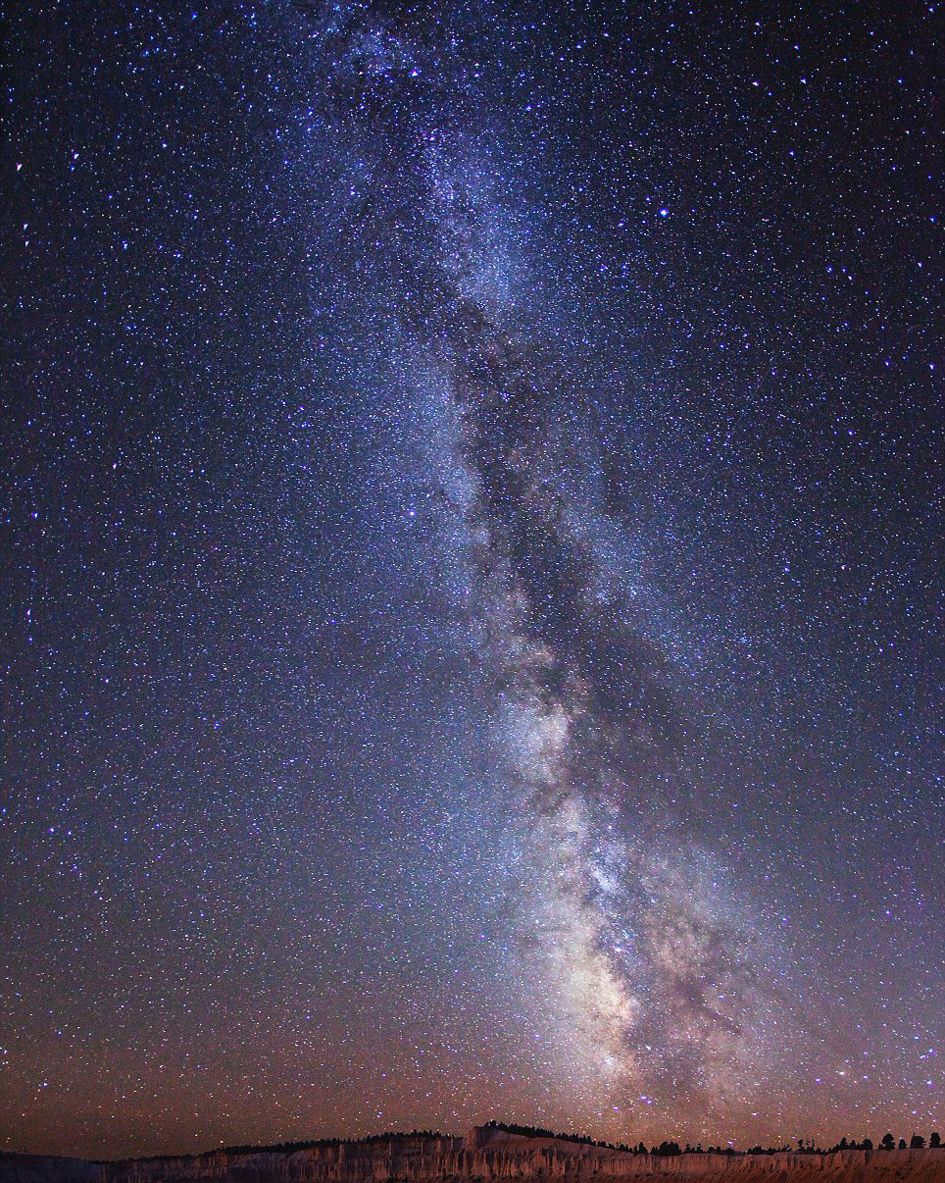

Slide 4
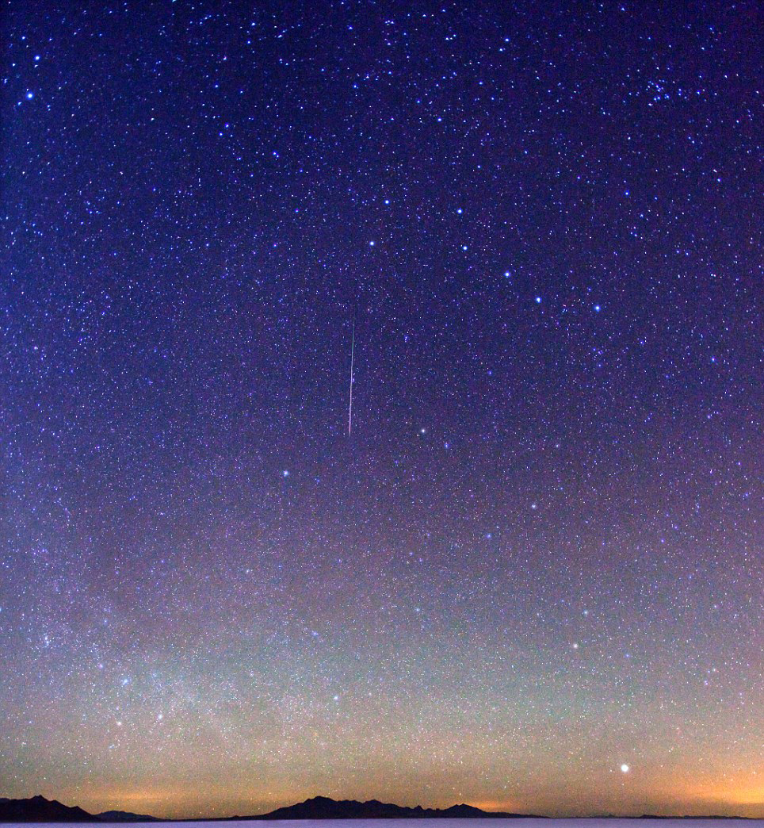

Slide 5
