Slide 1
Oceans of Evidence
Some Interesting IPCC inspired linkage to weather, and Acing and Icing the Case

Slide 2
I Come from the Private Sector
We Don’t Get Paid for Ideas, but for the result of our ideas. And we don’t get paid much, or for long, if wrong. Not only is this different from current AGW crowd, but if they have their way, even if we are right, we wont get paid, and if they are wrong, they will.
Private sector Sales pitch. Heh try my product, and if you see value, lets talk.
AGW : Here’s my idea, lets not talk, where’s my grant?

Slide 3
The Times have changed Look at this charts

Slide 4
Temp forecast vs reality/c02

Slide 5
Logic question 1972
Based on the previous charts, one can say temperatures
A) have a stronger correlation to ocean and sun than co2 and they are likely to be driving climate, and warming forecasts are busting
B) co2 is in complete control and warming forecasts are not busting
C) not enough data
D) All of the above
E) None of the above

Slide 6
Possible question, based on same chart this year
Based on the previous charts, one can say
A) co2 is in control
B) all data showing its not is fabricated
C) its worse than we thought
D) The Fossil fuel industry is destroying the planet
E) Its all George Bush’s fault
F) All of the above

Slide 7
The “Fight”
Not for the Faint of heart but fights for truth never are.
Mass case of Dunning-Krueger effect.. Confidence from ignorance of fact

Slide 8
Now just why would the arctic warm like that ( and then cool like it did)

Slide 9
Given that Bill Gray is right ( again) we could all go home now, but

Slide 10
1st Off Thanks to the IPCC
By debunking their trapping hot spot theory, look what I found
1) A powerful link to Ace Index
2) Relationship to Us Tornadoes

Slide 11
Bottom 10 Ace Years 400 mb March ( WARM OVER COLD SIGNAL!

Slide 12
Top 10 Ace years, notice double warmth, weak cool where TUTT will be COLD OVER WARM SIGNAL!

Slide 13
This is wild. The two hyper Nino years vs low ace years ( 8 of them nino)

Slide 14
This year ( have below normal ace)

Slide 15
Tornado idea
400 MB global Change in temp year to year determines tornado season total against previous year
Theory is the colder it is globally, the more chance for troughs to be stronger over US

Slide 16
Tornado totals

Slide 17
5 Yellow vs 6 increase

Slide 18
6 purple pink vs 7 ( slight) decrease

Slide 19
7 vs 8 Increase

Slide 20
8 vs 9 ( decrease)

Slide 21
9 vs 10 decrease

Slide 22
10 vs 11 increase

Slide 23
This year vs last ( only 2 outbreaks were when temp colder)

Slide 24
Biggest Questions for me
1) Will I have to thank the IPCC when I get my Nobel Prize
2) Can I play myself in the movie

Slide 25
To start all this off

Slide 26
So let me get this straight
co2 .004 of atmosphere
man contribution 3-5% . DOE figures, not EIB, not CATO, not YMCA or RunDMC
Using 5%, that means man has put in .0002
Termites 2.5 times mans input
So we are to believe, that a “GHG” that is 1/400th of the “GHG” , that we have put in .0002 of something that has 1/1000th of the heat capacity of the oceans, is ruining the planet

Slide 27
Wait there is more
US on its worst day puts in 20%. Meaning we have contributed .00004 to this whole mess
Yearly basis 1.5 ppm
5% man
.075 ppm. US 20% or .015 ppm
That’s .15 pp10m
1.5 pp100million
15 parts per billion
AGW agenda Conclusion. Destroy our way of life

Slide 28
On to the show, this is it

Slide 29
PDO/AMO on US ( court Brian Bledsoe)

Slide 30
The Case for the Ace ( Dr Spencer)

Slide 31
More recent PDO

Slide 32
amo

Slide 33
Dr Maue global ace.

Slide 34
Ocean Heat Content

Slide 35
Its warmer than 76, or is it ?
Crucial assumptions
Tropical cyclones essential in redistribution of energy
2) If energy is already redistributed, what is the need for cyclones
3) Overall energy budget of earth HAS NOT CHANGED but is merely distorted Key is not to measure temp, but energy ( all temperatures ARE NOT created equal in the world of energy)

Slide 36
Warm/cold PDO

Slide 37
Idea
Warm Phases add heat to atmosphere
Initial warming in the tropics
Ace turns up because of spike in energy in tropics
Warming works north leading to distortion in global energy pattern
Once warming is complete ( end of the 20 yr cycle)Ace levels off and falls, no reason to redistribute ( someone needs tell the president)

Slide 38
400 mb 1972-1991

Slide 39
Mission accomplished 400 mb 1992-2011

Slide 40
Most of the 400 mb warming over polar areas
Implications.. Since winter trop is very often lower than 400mb level , this means enhanced blocking.
Switch of pdo/amo means cooling starting over mid latitudes first
Enhanced blocking, cooling, threatens more severe winters as turn around progresses until opposite reached ( which would mean ace will come back up)

Slide 41
Surface 1972-2011

Slide 42
Surface 1992-2011

Slide 43
Ace response is to the distortions of the temp because of oceans, not co2

Slide 44
Some conclusions
As globe starts cooling again, because it will cool where it warmed the most, the energy will again bundle more in the tropics and ace will come up
East coast long overdue for multi hit season as cycle is much like the 1950s.
Comments showed absolute ignorance on Irene, which was not near 38,44,Sisters of 54 and Donna
Other comment on Japan Earthquake and Irene showed ( Earth p’d off) shows amazing ignorance of fact
As globe cools, the Bovine Bologna Brigade offensive will increase even more

Slide 45
So it’s a simple Test ( which Bill Nye did not wish to acknowledge on OReilly
The earths temps should fall as the oceanic cycles reverse ( to 1978 levels by 2030, using satellite era temps)
This is like a thermostat in a house, the first cooling, most dramatically shown last year, is the drop in the mid level temps
Surface response lags a bit, but is starting in jagged fashion
Simple test, we should go back from where we came.. Ace is a hint BTW global “warming” as shown here, can lead to less, not more.
Simple fact, once the balance is reached it warms no more if no more heat is added from source
Obviously ocean, not co2

Slide 46
Triple Crown of Cooling
1 Oceans
2 Solar
3 ( wild card) volcanic
4 Question: How can any clear thinking human being, in light of the facts, not at least admit there is enough doubt to allow the test to go forward, instead of crashing the economy

Slide 47
That’s nice, what about the ice

Slide 48
Total global sea ice above normal

Slide 49
First of All The Good Old Days?

Slide 50
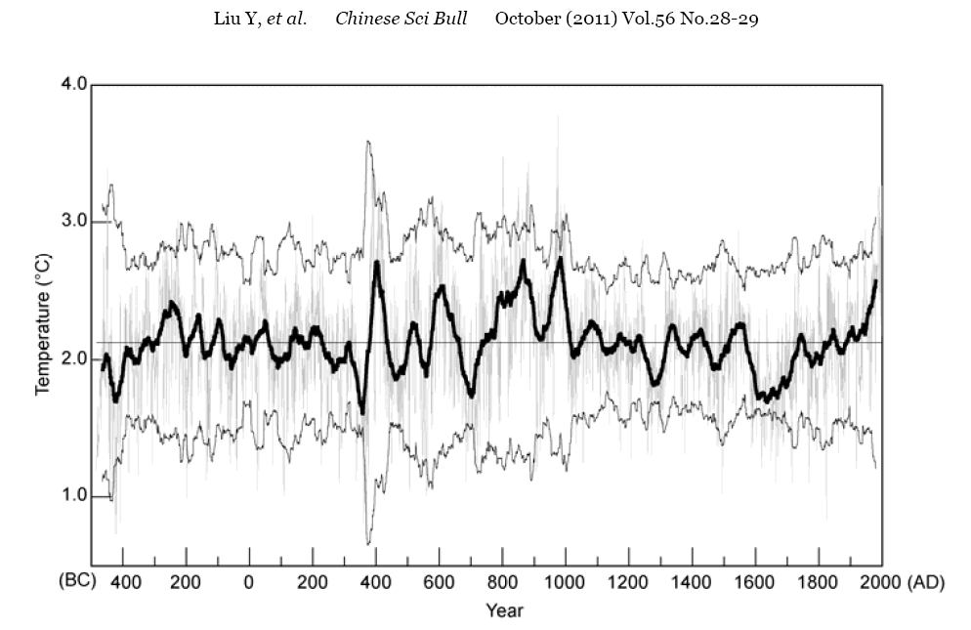
Speaking of Ice, How come no hockey stick in China
Nothing to do with this, but wanted to slip it in anyway

Slide 51
Inconvenient Truths
It takes more energy to raise or lower saturated air/water, than it does dry air.
Warm PDO leads to rise in tropical air and water temps, much greater input of energy into the atmosphere, BUT THERE IS COMPENSATING COOLING IN SOUTHERN WATERS.
Warm AMO does so also but not as much as PDO ( atlantic smaller ocean) Both together are a field day for the heat ( note 1 bonus point if you can tell me where “field day from the heat came from” Some of you have to be ex hippies)

Slide 52
Just what do you think is going to happen when you warm the oceans
Inconvenient truth: 75% of land masses in northern hemisphere
Inconvenient truth Arctic Ice cap surrounded by land
Inconvenient truth. Warm PDO/AMO “attack” northern ice cap with warm water from below
Inconvenient truth Land masses warm in response to the warm cycle in a seemingly much greater manner Why?

Slide 53
More Inconvenient Truths
Because the energy added to the atmosphere by warming tropical water, and the water ringing the continents, has a much greater impact on cold dry air than warm moist air. ( watch your car thermometer on calm very cold morning, how it can bounce up and down)
The energy needed to raise a saturated parcel of air at 80 degrees one degree can raise the temp at -20 over 25 degrees!
So just what do you think happens when the oceans warm in tandem? Because of the creators creation ( note this is not AL Gore) the global temp warms but energy does not change

Slide 54
How do we know this?
Because the southern hemisphere ice cap INCREASED! It simply means the warm amo/pdo distorted the temps, but the overall energy has not changed, meaning we are about to go back from where we came. In fact, one can argue total global sea ice being above normal is a sign we are in a heap of trouble given triple crown of cooling ( ocean, solar, wild card, volcanic activity)

Slide 55
Bill Gray is Right ( again ( and again))

Slide 56
One possible cause.. Loss of Pirates

Slide 57
By the way, God help us if the JAMSTEC is right this fall/winter

Slide 58
Wow, CFS Siding in!

Slide 59
Some conclusions
Energy can neither be created nor destroyed. Co2 being part of the makeup of the planet is already accounted for, and its minute makeup is more than readily handled by the makeup of the atmosphere ( water vapor 400 times the amount) and the heat capacity of the ocean. Arguments among us on this amounts to theologians arguing over how many angels you can stick on the head of a needle
Any system in distress, fights to return to normalcy ( Le Chateliers principle)
Biggest danger: Fight back from system has begun, but combination of oceanic, solar and wild card, volcanic activity( triple crown of cooling) make the option of colder more likely a problem than warmer. US and globe ill equipped to face cooling even back to the 1970s, yet alone the threat of the mini ice age
CO2 IS NOT THE UNMOVED MOVER OF THE PLANETARY CLIMATE, It’s a trace gas needed for life on the planet, and a darn good plant food
And now to really get people who treat man and earth as God something to ponder, a little Judeo Christian wisdom

Slide 60
Eccl 1:9
What has been will be again, what has been done will be done again; there is nothing new under the sun.

Slide 61
Questions

